Slide 1
Should students be writing their own lexical curriculum?
Mike Groves

Slide 2
Pre-Amble
The “working together” theme..
This is not a data driven presentation
EAP is not a monolith
There are a lot of people teaching through “subject specific word lists”

Slide 3
From “How not to write a PHD Thesis“ THE (28 Jan 2010)
Use phrases such as “some academics” or “all the literature” without mitigating statements or references
I make my postgraduates pay for such statements. If they offer a generalization such as “scholars of the online environment argue that democracy follows participation”, I demand that they find at least 30 separate references to verify their claim. They soon stop making generalizations.

Slide 4
Chen, Q., & Ge, G.-C. (2007). A corpus-based lexical study on frequency and distributions of Coxhead’s AWL word families in medical research articles (RAs). English for Specific Purposes, 26, 502-514. doi:10.1016/j .esp.2007.04.003
Chung, T. M. (2009). The newspaper word list: A specialised vocabulary for reading newspapers. JALT Journal, 31, 159-182
Liu, J., Han, L. (2015) A corpus-based environmental academic word list building and its validity test English for Specific Purposes, Volume 39, pp. 1-11. DOI: 10.1016/j.esp.2015.03.001
English for Specific Purposes, Volume 27 (4) pp. 442–458 http://dx.doi.org/10.1016/j.esp.2008.05.003
Hirsh, D., & Coxhead, A. (2009). Ten ways of focusing on science-specific vocabulary in EAP. English Australia Journal, 25(1), 5-16
Hsu, W (2011) A business word list for prospective EFL business postgraduates Asian-ESP Journal, Volume 7 (4) (2011), pp. 63–99
Hsu, W. (2013) Measuring the vocabulary load of engineering textbooks for EFL undergraduates English for Specific Purposes, Volume 33 (1), pp. 54-65. doi=10.1016%2fj.esp.2013.07.001
Konstantakis N. (2007) Creating a business word list for teaching business English ELIA, Voulme7 (1) pp. 79–102
Lei , L., Liu, D (2016), A new medical academic word list: A corpus-based study with enhanced methodology, Journal of English for Academic Purposes, Volume 22, June 2016, Pages 42-53. http://dx.doi.org/10.1016/j.jeap.2016.01.008.
Lessard-Clouston, M. (2006). Breadth and depth specialized vocabulary learning in theology among native and non-native English speakers. Canadian Modern Language Review, 63, 175-198. doi:10.3138/cmlr.63.2.175
Lessard-Clouston, M. (2012). Technical vocabulary use in English-medium disciplinary writing: A native/non-native case study. The Linguistics Journal, 6, 127-150.
Li, Y., Qian, D.D. (2010) Profiling the Academic Word List (AWL) in a financial corpus System, Volume 38 (3), pp. 402-411.doi=10.1016
Martinez, I.A., Beck, S.C., Panza C.B. (2009) Academic vocabulary in agriculture research articles: A corpus-based study English for Specific Purposes, Volume 28 (3) (2009), pp. 183–198 http://dx.doi.org/10.1016/j.esp.2008.05.003
Mudraya, O (2006) Engineering English: A lexical frequency instructional model English for Specific Purposes, Voulme25 (2) (2006), pp. 235–256 doi:10.1016/j.esp.2005.05.002
Muñoz, V.L.(2015) The vocabulary of agriculture semi-popularization articles in English: A corpus-based study English for Specific Purposes, Volume 39, pp. 26-44. doi=10.1016%2fj.esp.2015.04.001
Ryan, G. (2012). Technical vocabulary acquisition through texts: A corpus and a case study in theology classrooms. Köln, Germany: Lambert Academic
Valipouri, L., Nassaji, H. (2013)A corpus-based study of academic vocabulary in chemistry research articles Journal of English for Academic Purposes, Volume 12 (4), pp. 248-263. doi=10.1016%2fj.jeap.2013.07.001
Wang, J., S. Liang, S. , G. Ge, S. (2008) Establishment of a medical academic word list
Ward, J (2009) A basic engineering English word list for less proficient foundation engineering undergraduates, English for Specific Purposes, Volume 28,(3) PP 170-182,http://dx.doi.org/10.1016/j.esp.2009.04.001 Wenhua Hsu, W. (2014), Measuring the vocabulary load of engineering textbooks for EFL undergraduates, English for Specific Purposes, Volume 33, Pages 54-65, http://dx.doi.org/10.1016/j.esp.2013.07.001.
Yang, MN (2015), A nursing academic word list, English for Specific Purposes, Volume 37, pp 27-38, http://dx.doi.org/10.1016/j.esp.2014.05.003.

Slide 5
Common statement
“Based on the occurrences and lexical behavior of the AWL in the agriculture academic domain, Martinez, Beck, and Panza (2009) criticized the AWL for being too general in nature, which resulted in its containing some vocabulary EAP learners may not immediately need or in its lacking some vocabulary they may need imminently. They found that only 92 out of 570 words in the AWL appeared very frequently in agriculture research articles and suggested that a more restricted, field-specific, academic word list needed to be produced.(Wen Shu, 2014)

Slide 6
Main question
Is designing increasing numbers of subject specific word lists the best way to solve the problem?
EAP Perspective
More global perspective

Slide 7
Architects and Engineers
Architecture
Can be inclusive or can marginalise
Can promote or destroy community
Can promote or destroy agency

Slide 8
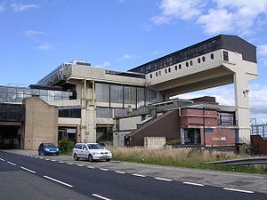
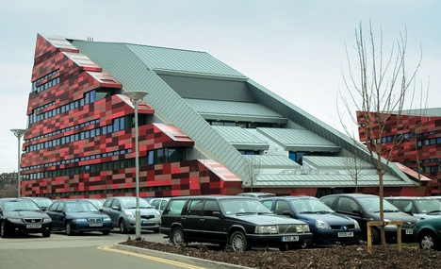

Slide 9
Engineering
Solving localised problems under constraints (Madhaven, 2015)
Making things that work (McCarthy, 2006)

Slide 10
A look at Hyland
Writing as a Social Activity. (Hyland, 2002)
Academic English is not a “unitary mass”, instead a set of “subject specialisms” (Hyland, 2002:p.388)
That “weak students need to control core forms before moving onto specific ….features of language is not supported by research into SLA” (Hyland, 2002 p.388)

Slide 11
“The communicative demands of the modern university, much like the modern workplace involve far more than simply controlling linguistic error or polishing style” Hyland (2007; p.2)
Literacy is not a "thing", it is a "thing we do" (Hyland and Tse, 2007)

Slide 12
But
As Hyland (2007) admits (p.14) there is a key set of linguistic features, which allows us to even use the term ‘Academic discourse”
He then cites the growing body of research into subject specific discourse.
“Placing specificity at the heart of EAP’s role means that teachers are less likely to focus on decontextualized forms”- p.14

Slide 13
Interactive metadiscourse (Hyland and Tse, 2004)
Transitions | Express semantic relation between main clauses | In addition/but/thus/and
Frame markers | Refer to discourse acts, sequences, or text stages | Finally/to conclude/my purpose is to
Endophoric markers | Refer to information in other parts of the text | Noted above/see Fig./in Section 2
Evidentials | Refer to source of information from other texts | According to X/(Y, 1990)/Z states
Code glosses | Help readers grasp meanings of ideational material | Namely/e.g./such as/in other words

Slide 14
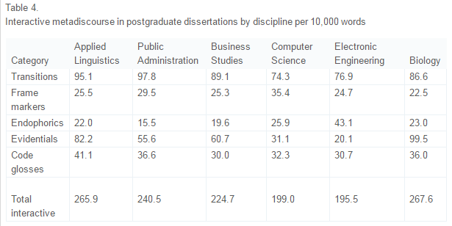
From Hyland and Tse (2004)

Slide 15
From Hyland and Tse (2007)
“Similarly, analyze appears to be used differently across fields. In the social sciences, it tends to occur more regularly as a noun, while in engineering, students are six times more likely to come across the form analytical. There are also semantic differences. The word analysis, for instance, is often associated with particular types of approach, so that it appears in discipline-specific compound nouns such as genre analysis or neutron activation analysis. The verb form also has field-specific meanings. In engineering, it tends to refer to methods of determining the constituent parts or composition of a substance …., and in the social sciences it tends to mean simply considering something carefully”
(Hyland and Tse, 2007)

Slide 16
Compared to...
In this modern era of technology….
Everybody knows…
Research proves that...
(Anecdotal)

Slide 17
Supplying word lists- The risks
Limiting students agency
Creating intellectual silos
Not equipping students with the skills needed for breadth, depth or progress in the field.
Opportunity cost

Slide 18
Students creating their own lists- the opportunities
Students have a problem- they need to align their linguistic output to the wider and narrower norms and expectations of their chosen field
We should not be solving a localised problem, we should be creating a space where problems are solved.
A word list is a thing. An ever developing vocabulary is thing that we do

Slide 19
Let’s compare lexis to another EAP classic
“And this is how you do Harvard APA referencing”
Or “Look at the example. Which is the journal title? What do does 78(2) mean?”
In other words, equipping students with the skills to interrogate the text and use the answers they find to build their own academic voice.

Slide 20
On a global level
What is the point of education? What are we doing?
We are working with international students in an internationalised education system
Are we here to further the career goals of the children of the extant elite?

Slide 21
Two answers
“the strategic role of international academic cooperation in globalizing solidarity among nations and establishing a true global citizenry” (Gacel-Ávila, 2005, p,133)
From the HEA “preparing 21st century graduates to live in and contribute responsibly to a globally interconnected society” (HEA, 2014)

Slide 22
According to Hadley (2014, p.26)
HE is a balance between two ideals
“The scholarly ideals of Wilhelm von Humbolt, in which scholars link their research interests to instruction…….[students] are steeped in both the academic knowledge and cultural ideals necessary for contributing to the nation state”
“ Providing the knowledge and vocational skills need for economic development”
“The goal has shifted towards producing graduates who have the mental ability to learn quickly and serve the needs of the global market”

Slide 23
Coming back to what we do
Students (should) have access to rich, subject specific discourse
It is our job to teach to teach the students strategies to build their own lexicons
Creating a space for students to explore discourse, and empowering them to solve their own problems
This goes beyond lexis, including ideas of metadiscourse and other markers of academic identity

Slide 24
Strategies could include.
Using lextutor and the like to analyse their own output
Encouraging students to explore the myriad of tools available to them (word clouds, quizlet) and use them in informed and disciplined ways.
Rigorous (possibly assessed) strategies for recording important vocabulary
Training students to identify the key subject specific lexis in what they are reading
Building an understanding of “smaller cultures” within the university (Connor, 2011)

Slide 25
Conclusion
In the collaboration between student and teacher, should be giving our student the answers, or teaching them what questions they need to ask and how to ask them?

Slide 26
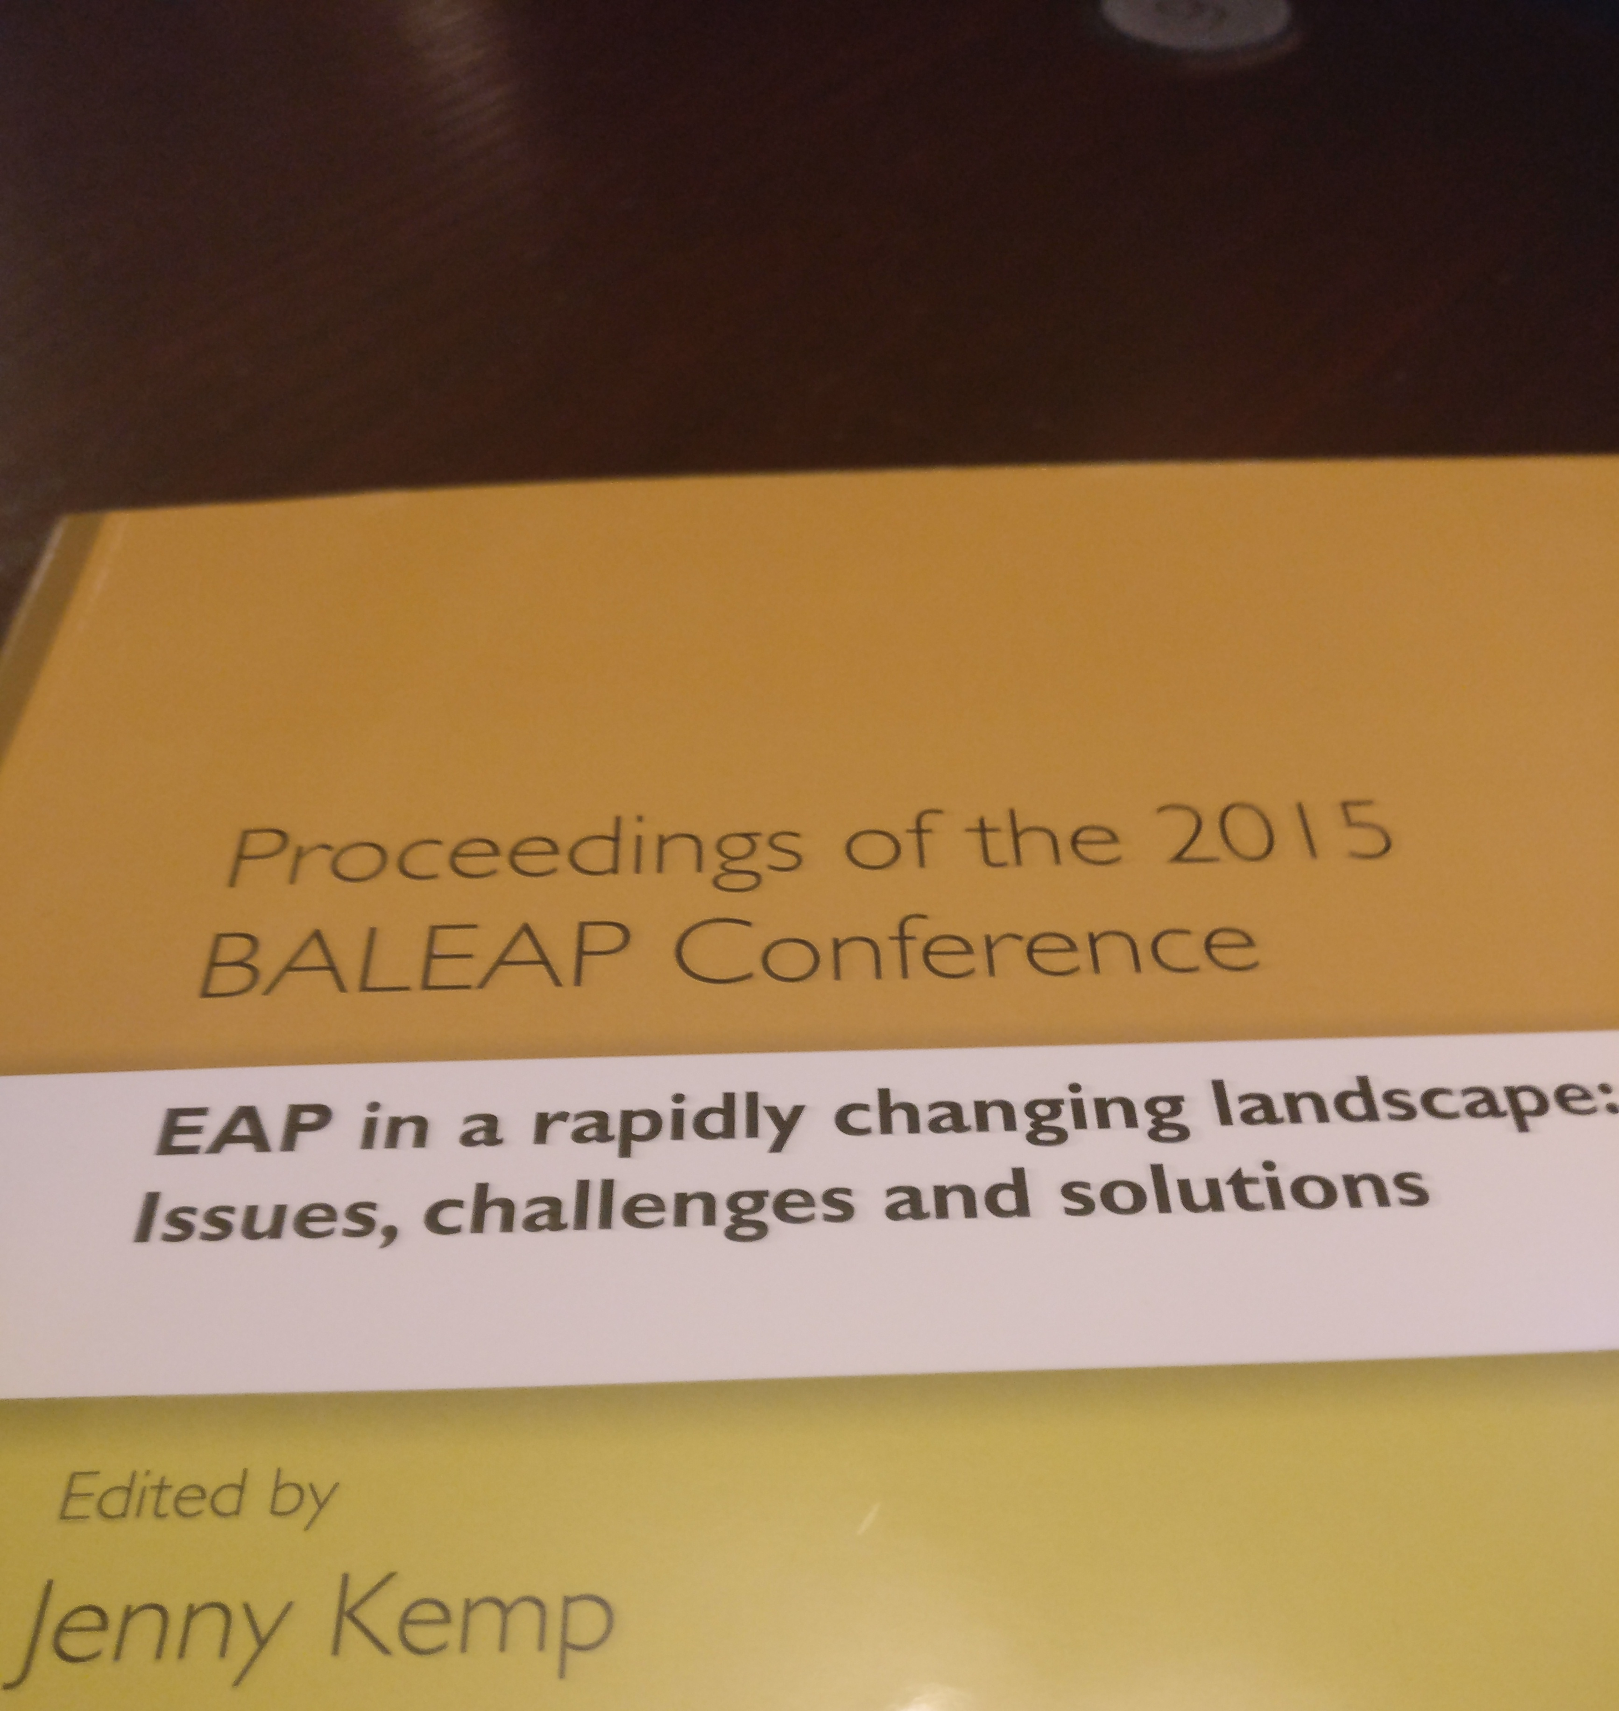
Coda
From Hyland (2017)
Bridging course - "Here we want students to see that writing at university is very different to writing at school" (p.172)
Discipline specific course "We teach specific word knowledge and strategies for learning and applying new terms" (p. 180)

Slide 27
References
Brabazon, T (2010). How not to write a PhD thesis. Times Higher Educational Supplement, January 28th. [online]https://www.timeshighereducation.com/news/how-not-to-write-a-phd-thesis/410208.article [27/03/17]
Connor, U (2011) Intercultural Rhetoric in the writing classroom Ann Arbor: The University of Michigan Press​
Gacel-Ávila, J. (2005) ‘The Internationalisation of Higher Education: A Paradigm for Global Citizenry Journal of Studies in International Education 9(2) pp 121-136 Hadley, G. (2014) English for Academic Purposes in Neoliberal Universities: A Critical Grounded Theory. London: Springer​ Higher Education Academy (2014) Internationalising higher education framework [Online] https://www.heacademy.ac.uk/internationalising-higher-education-framework [06 June 2014)​
Hsu, W (2011) A business word list for prospective EFL business postgraduates Asian-ESP Journal, Volume 7 (4) (2011), pp. 63–99
Hyland, K and Tse, P. (2007) Is there an ‘Academic Vocabulary’? TESOL Quarterly, 41 (2). pp. 235-253
Hyland, K. (2002). Specificity revisited: how far should we go now? English for Specific Purposes. 21 (4): 385-395.
Madhavan, G (2015). Think like and engineer. London. Oneworld Publishing
MCarthy, N (2006). Philosophy in the making, Ingenia [Online] http://www.ingenia.org.uk/Content/ingenia/issues/issue26/mccarthy.pdf [27 March 2017]

