Slide 1
International students as Curriculum Advisers for academic writing courses: developing and implementing staff-student partnerships
Terri Edwards and Tamara Barakat
Durham University
terri.edwards@durham.ac.uk
tamara.m.barakat@durham.ac.uk

Slide 2
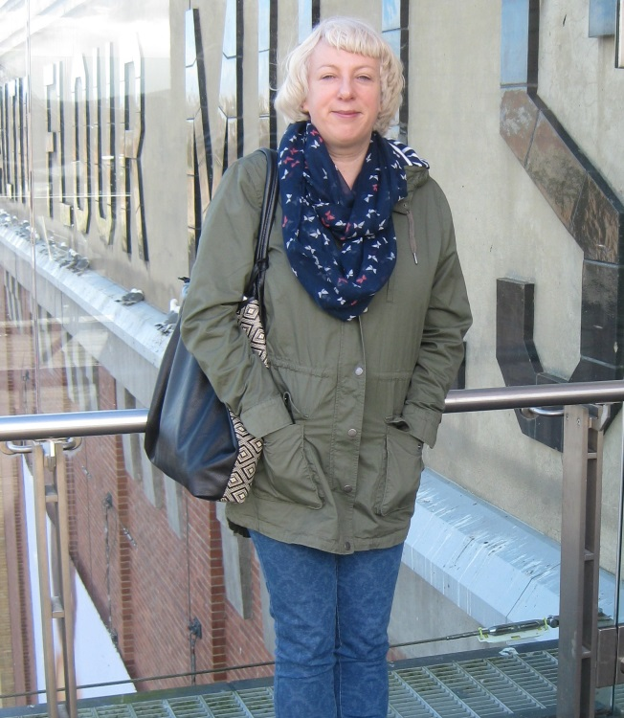
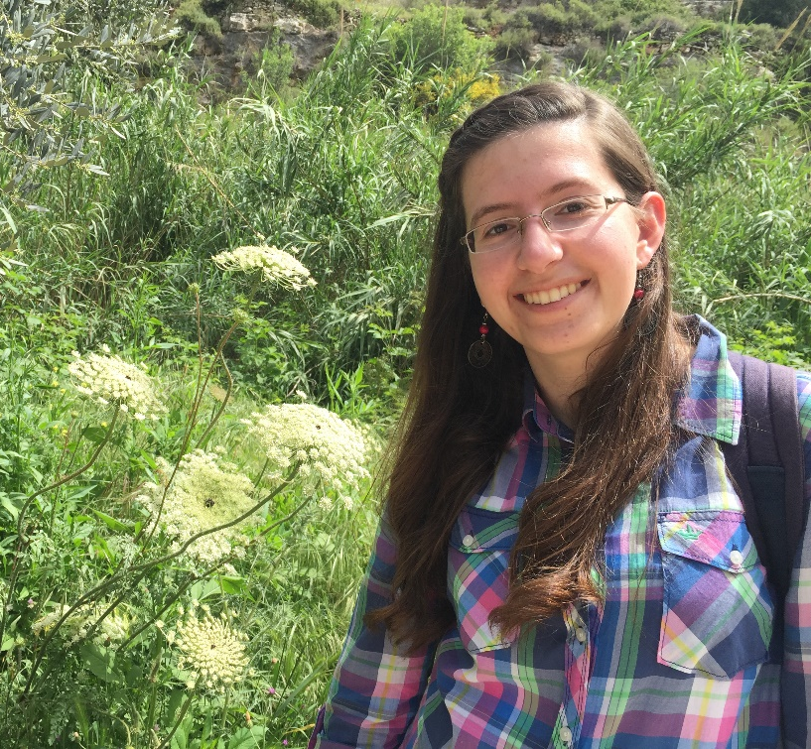
INTRODUCTION
Tamara Barakat
MA Arabic/English Translation
and Interpreting, Durham University
Terri Edwards
Teacher of The Academic Writing Workshop, In-sessional, DUELC

Slide 3
Context: Durham University English Language Centre: supporting international students all year round
Summer Pre-sessional – 500 students/year
In-sessional courses – free, open to all – classes from 2 to 200
Some discipline-specific courses (Law, Psychology, Business)
One-to-one consultations (more than 1,000 last academic year)
We collect feedback (online and written)
We have staff-student consultancy committees (SSCCs)
We run a focus group each term for the In-sessional programme
BUT
at no point do we ever ask students what they need/want to study

Slide 4
This is very odd…(at least to Terri)
ELT: the importance of “learner-centredness”
ESP: the customers get what they need/want
EAP: Literature insists on primacy of needs analysis (see e.g. Hyland & Shaw, 2016)
BUT
Top-down ethos of HE – students as “novices”
The “deficit model” of international students

Slide 5
A discourse of ‘Othering’? (Said, 1978)
HE and EAP pedagogy take little/no account of the ‘cultural capital’ that international students bring to the academy (Bourdieu, 1990; 1998), such as:
Prior disciplinary knowledge/cross-disciplinary knowledge
Professional knowledge (jobs/internships/volunteer work)
Technological expertise (“digital natives” – Prensky, 2001)
Linguistic expertise (love of ‘language for its own sake’)
Cultural expertise/travel/exchanges
ALSO: Disciplinary and genre writing expertise (developed at the UK uni)
This can be particularly be seen at UG third year, Master’s
second term onwards, PhD after second year review

Slide 6
Problems with EGAP curriculum design
ELC staff can’t be expert in every discipline, but have to cater for all
Faculty are often too busy to see us or work with us in a sustained way
Students change (more sophisticated!)
Courses get stale (Brooman, Darwent & Pimor, 2015)
Students have always been Terri’s best
expert informants, materials providers and
active assistants

Slide 7
So… a staff-student partnership project was born
Exploratory study: three UG 3rd-year students critiqued the same set of materials (main handout and lecture slides) from a no-stakes course: “The Academic Writing Workshop”
Terri read up on the staff-student partnership literature
Terri, with help from ELC teachers Michelle Joubert, Clare Carr, and Finance Officer Tracy Reith, applied for and got a small amount of funding from UKCISA for a Pilot Project
£

Slide 8
Evolving methods: what we have done so far
Reflection on the Academic Writing Workshop
Evaluation and review of same set of materials
Interviews – “talk around text”
Review of academic writing book
Evaluation and review of another set of materials, chosen by ourselves
Created a Facebook group and a Dropbox folder

Slide 9
What’s next?
Attending and evaluating a session
Running a focus group discussing the project together
Running another round of semi-structured interviews (Curriculum Advisers’ individual reactions)
Developing and trialing the materials in the next academic year

Slide 10
Significance
actively explore an issue
empowerment
altruistic values
active agents of change
personal, academic and professional skills
creative
It is exciting!
power to co-create
opportunity to be heard
a meaningful project
trust, faith, and appreciation in student abilities

Slide 11
Research & Teaching Implications
This process works, and it’s fun!
International students bring insights to the curriculum that we don’t have
The process doesn’t have to be time-consuming unless you’re doing this as research
Staff-student partnerships are beneficial to teachers, students and institutions

Slide 12
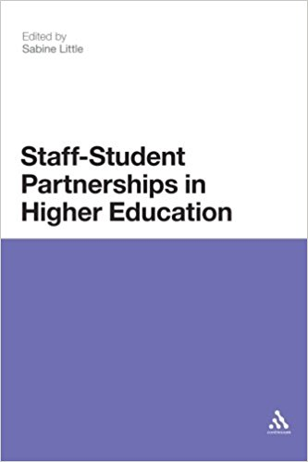
If you want to try it yourself
Picture source: amazon.co.uk

Slide 13
References
Bourdieu, P. (1990). The Logic of Practice. Stanford: Stanford University Press.
Bourdieu, P. (1998). Practical Reason: On the Theory of Action. Stanford: Stanford University Press.
Brooman, S.; Darwent, S. and Pimor, A. (2015). The student voice in Higher Education curriculum development: is there value in listening? Teaching International, 52(6), 663-674.
Cook-Sather, A., Bovill, C., and Felten, P. (2014). Engaging students as partners in learning and teaching: a guide for faculty. San Francisco: Jossey Bass.
Hyland, K. (2016). General and Specific EAP. In: K. Hyland and Shaw, P. (Eds.) The Routledge Handbook of English for Academic Purposes. London & New York: Routledge, 17-29.
Little, S. (Ed.) (2011). Staff-student partnerships in Higher Education. London & New York: Continuum.
Prensky, M. (2001). Digital natives, digital immigrants. In On the horizon. Bingley: MCB University Press, 9(5).
Said, E. (1978). Orientalism. London: Penguin.

Slide 14
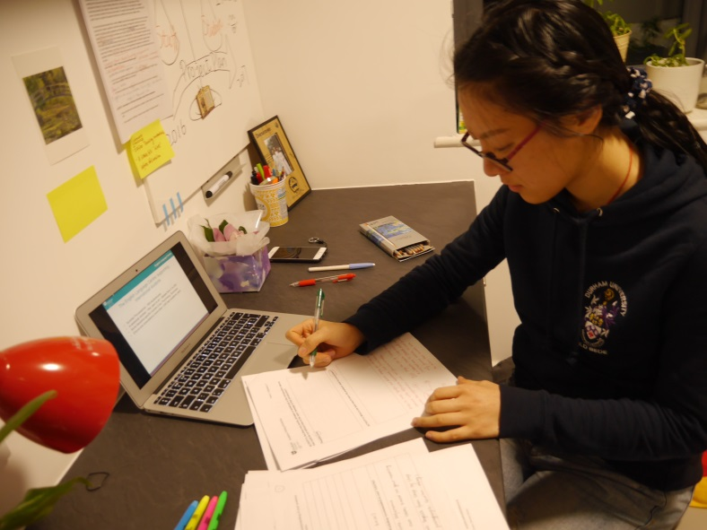
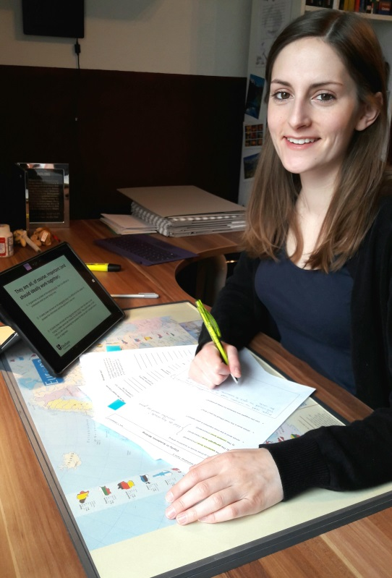
Thank you for listening!

