Slide 1


Talking Movies
Film Seminars as
an Intermediary Community of Practice
Notes:
Today I’m going to talk about how talking movies, ie discussing films in seminars, has both supported students on a particular course I teach while also facilitating their participation in the wider HE context
I’ll do this with reference to student evaluations
My experience on this course, together with feedback from the stds, has encouraged me to think of using the seminar format in many other areas of provision, outside traditional EAP speaking classes.

Slide 2
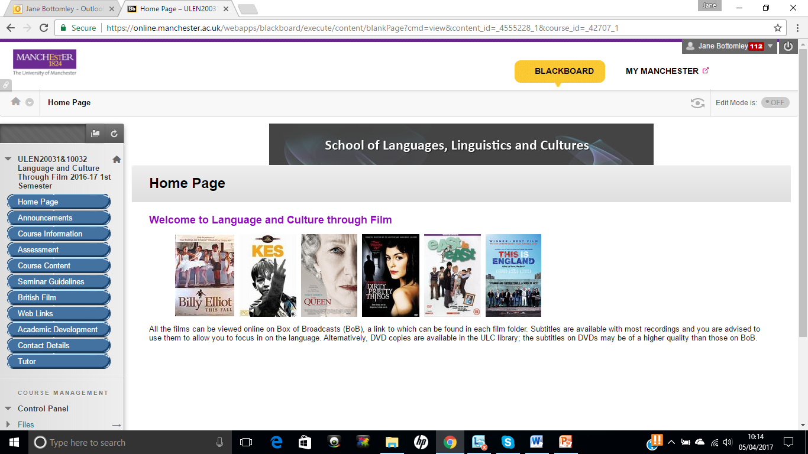
Language Experience across Programmes (LEAP)
Notes:
The course is a 10-credit undergraduate course on our LEAP programme
Like the LEAP EL courses in general, it aims to use specific content, in this case film, as a vehicle to explore language and culture, while helping students develop academic skills they can employ on any course

Slide 3
A community of practice
a learning community engaged in ‘a process of collective learning in a shared domain of human endeavor’ (Wenger-Trayner, 2015)
centred on a shared interest in film and a belief in its capacity to enhance English studies by providing a window onto language and culture
Notes:
If a ‘community of practice’ can be defined as …, then I think we more or less qualify – though I’m still a bit hazy about the exact meaning of community of practice’

Slide 4
Positioned between EAP and disciplinary communities of practice
Credit-bearing
Not part of degree programme
I am not a film academic
The workings of academic discourse are exposed
Notes:
Credit-bearing and positioned within school practices re teaching and learning and assessment
However, it differs from other modules in the school in that it is not part of a degree programme and I am not a film academic

Slide 5

Notes:
We open up the watch and examine what’s going on underneath in terms of organisation and language for instance
This tends not to happen on academic courses

Slide 6
Building a bridge
‘intermediary community of practice’ (Chivers, 2016)
‘legitimate peripheral participation’ (Lave and Wenger, 1991)
Fosters transition towards full participation in wider academic life and beyond
Notes:
What we do on the course has its own value – where we are is nice, but it’s also good to think about other places we can go, and what we need to pack for the journey

Slide 7
Course structure
Mini ‘lecture’ + workshop
Seminar
Notes:
The course originally consisted of …
But in recent years, we have introduced a seminar …

Slide 8
Value of seminars on this course?
Low stakes, non-threatening
Space to develop and test ideas and language for written and oral assignments
Chance to learn from others with higher understanding (Tan, 2003)
Feedback for me

Slide 9
Value of seminars for general academic development?
Initiation into common mode of course delivery in HE, believed to facilitate learning
Supports English language students in the move from ‘sociolinguistic’ groups, where the focus is on ‘communicative needs of the group, such as socialisation or group solidarity’ to ‘sociorhetorical groups ‘who link up in order to pursue objectives that are prior to those of socialisation and solidarity, even if these latter should consequently occur’ (Swales, 1990: 24)
Develop ‘pragmatic competence’ (Thomas, 1983) and transferable skills
  Seminar skills
  Intellectual skills (criticality, creativity)
  Communication skills
  Collaborative skills
  Language skills
  Social skills
  Intercultural skills
Notes:
In terms of serving the wider purpose of supporting students more generally with academic literacy skills, …
‘the ability to use language effectively in order to achieve a specific purpose and to understand language in context’

Slide 10
Graduate attributes
(Barrie, 2004; Hounsell, 2011):
graduate attributes
research, scholarship and enquiry
personal and intellectual autonomy
collaboration, teamwork and leadership
employability and career development
global citizenship
communication and information literacy
ethical, social and professional understanding
lifelong learning
Notes:
The skills developed through seminars also tie in with several graduate attributes

Slide 11
Developing seminar skills: developing awareness of conventions
Power distance between teacher and students reduced, reflected in/facilitated by teacher style – conversational, encouraging participation
Turns quite long and complex
Turn-taking managed non-verbally through eye contact, back channels (Hmm, uh, huh) or overlap of utterences
Discussion proceeds via moves eliciting information or confirmation
Moves supported by justification and evidence
Students responsible for preparing and presenting material for discussion
All students to contribute – silence denotes lack of involvement
(Alexander et al., 2011)
Notes:
Development of seminar skills involves raising awareness of the unwritten rules governing participation, rules which are often a mystery to many students
These involve …

Slide 12
Developing seminar skills
+ intellectual and collaborative skills
Negotiation of ideas
Co-construction of knowledge, understanding and meaning
Ideas are ‘emergent rather than presented already formed for inspection’ (Alexander et al, 2011:)
Notes:
Students also need to understand how knowledge and ideas typically evolve in a seminar setting

Slide 13
Description + analysis
(twist on Borton’s reflective model, 1970)
Description – the What?
Analysis/Evaluation – the So what?
“Loach often uses real people instead of actors.”
“Clothes are interesting, and that Sean’s clothes change throughout the film.”
“There are a lot of close-ups in this scene.”
“Blair’s language seems to become more direct in this phone call.”
“This adds to the sense of authenticity in Kes.”
“His clothes reflect his evolution through the film as he experiences different groups and attitudes.”
“This puts a focus on the emotional reactions of the characters.”
“It maybe shows power is shifting.”
Notes:
In terms of revealing the workings below the surface, we sometimes use a what/so what model to highlight the need for analysis, not just description

Slide 14
Criticality, stance, and language
Opinion (East is East):
  George is defeated
  the ‘half a cup of tea’ symbolises that George is only half integrated into British society
Are there other interpretations?
Yes. Better to say:
  He seems to feel
  It could symbolise
Notes:
The relationship between stance and hedging is also made explicit
In speaking and writing on this course, a frequent problem is that stds fail to adopt a nuanced stance, so we get overgeneral statements like this
Seminars offer a good opportunity to highlight the role of language in stance - in a more natural context than a lot of EAP materials, which don’t often relate hedging to a std’s own voice

Slide 15
Developing creativity
“Where does this music occur in the film? What effect does it have?”
“Put the screen shots of the scenes in order according to which ones disturbed you most (death, sex, drugs, violence, scatological humour).”
“Walk over to the picture of the character you most sympathise with and say why.”
“Stop me writing when you know which quote this is. Where in the film does it occur? Who says it? Why is it important?”

Slide 16
Is it working?
Do students value seminars?
Do they understand the conventions of seminars?
Do students feel that seminars are conducive to the development of valuable skills? Why?
Do they recognise that these skills are transferable?
Notes:
I attempt to make these things explicit in course documentation and classroom discussion, but that’s no guarantee that students will get it

Slide 17
Evaluations
Word association
Closed questions
Open questions
  What skills did you learn/develop?
  Are these useful in your academic life? Why?
  What advice would you give to students attending next year re how to take part in seminars?
Notes:
The word association was used to eliciit the student experience, and I’ll talk about that first.
There were some closed questions such as ‘Have you attended this type of seminar before?’, but I won’t say more on that today
With the open questions were a way of determining if the stds felt they were developing valuable and, importantly, transferable skills, and if they understood the conventions of seminars

Slide 18
Word association
seminars
?
?
?

Slide 19
Top 4?
I----------
I----------
C----------
C-------

Slide 20
Top 4
Interesting (14)
Interactive (5)
Comfortable (5)
Creative (5)

Slide 21
Student experience
Interesting (14) fun (5) enjoyable (4) entertaining engaging unforgettable surprising different exciting cool
Notes:
The student experience was largely very positive, though I’ll mention some more negative responses later

Slide 22
Student experience
An Opportunity
A Challenge
Challenging (3)
Responsibility
Opportunity
Ability to speak in public
Self-confident about language
Challenging (3)
Responsibility
Sometimes shy
Nervous
A bit stressful
Worries
Courage

Slide 23
Themes
Academic
  Objective, analysing, perspective, observation
Cerebral
  Stimulating (2), insightful, revealing, thought-provoking, deep, intelligent
Formative
  Formative, developer
Collaborative
  collaborative, exchange, sharing
Interactive
  Interactive (5), dynamic, energetic, activeness,
Socio-cultural
  Enriching, broaden minds, culture, diversity, international
Notes:
Certain themes emerged in their choice of words

Slide 24
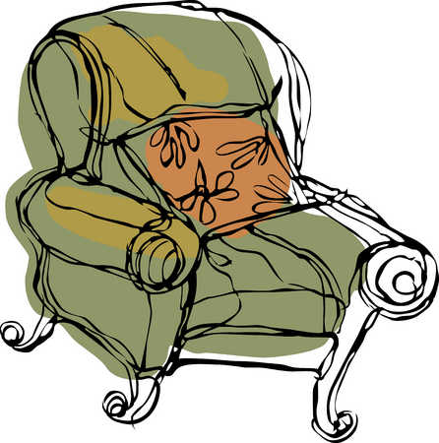

Comfortable (5)
Friendly (4)
Safe
Relax
Warm
Reassuring
Creative (5)
Free
No borders
Notes:
One interesting thing was that there were a lot of words connected to feeling safe and to feeling free, and I feel that the two are closely connected: stds feel safe and comfortable and are thus able to take risks

Slide 25
Awareness of transferability
Academically helpful
The skills I have developed in film analysis have been very useful in other classes.
This seminar became good practice for other tutorials.
It made me think about how to develop certain assessments.
Seminars helped me to use more proper language and helped me to develop my writing.
[Leading the seminar] required me to make a good structure and organisation which is a skill equally useful for presentations and writings.
It made me think about how I can focus my classes on my future career.
Notes:
The comments suggested that many of the stds were aware of the transferable nature of the skills they were developing

Slide 26
Awareness of conventions
Table manners in a group seminar
It was quite nice seeing a teacher participate in the discussion.
I should have a bit more participated in the seminar (my problem!)
I’ve learned participate in discussion is important since it would motivate not only myself but also the other course mates.
Don’t prepared something already written.
Notes:
There were also some comments on conventions, which one of them termed ‘table manners’, which I thought was quite nice
They were particularly aware of the need fore everyone to participate

Slide 27
Sense of progression
At first it was very difficult […] became much easier
At the beginning it was quite complicated but then we got to know each other and it becomes easier.
It was quite hard to come up with activities. But I felt positively because everyone was eager to attend the activities.
Notes:
They also reported a sense of progression

Slide 28
Increasing confidence
Gaining self confidence
I am much more confident.
I have confidence in speaking up in public.
It helps me to be more confident in oral.
More confident and less afraid of using English
I lose the fraid to speak in loud voice.
Notes:
And growing confidence

Slide 29
Developing communication skills
Oratory skills; oral practice; how to debate; speaking in public;
I have developed oral […] skills.
A good way to practice my speaking skills
It helps a lot to develop my speech skills.
I can reinforce my communicative skills.
It can make me speak more and […] in front of some people [than if] I haven’t attended seminars.
I achieved to speak English more fluently as you take active part.
The seminars give us the chance to speak more and give our different views or opinions.
I have developed my speaking and use of English.
It taught me much of how to speak more logically and clearly.
Notes:
Many students felt they had developed their oral and public speaking skills

Slide 30
Being aware of audience
Expressing yourself in discussion is sometimes difficult because you have to get others to understand your point – the seminar was good practice.
I needed to use clear and understandable language that others can understand.
Notes:
There were also some comments which suggested a growing awareness of the importance of audience

Slide 31
Finding a voice
It gave me an opportunity to describe my opinion and convey it to other people.
It helped me […] voice my opinion more than I used to in the past.
In the seminars, we had to make our ideas and arguments clear, which is one really important point.
With every opinion our perspectives get bigger.
We started to look at things in different ways.
We were given all the necessary instruments to develop skills and produce successful analysis, without having our own ideas influenced by the tutor to the point of them being not our own anymore.
Learning to argue for something and support it with concrete evidence.
It helped me realise the importance of supporting arguments with evidence.
It forces me to speak and give arguments in English in front of other persons and also to be able to justify all my opinions and choices.
Don’t be afraid of showing your opinion, because as long as you can explain it, you will always be right.
Notes:
Many stds mentioned the importance of having their own independent voice and argument, while understanding that it must be justified and supported with evidence

Slide 32
Developing criticality
[I developed] critical thinking.
Think about topics from another perspective.
It helped me to develop […] critical skills and to consider different points of view and different ways of perceiving […].
It has allowed me to develop analytical […] skills.
I learned the method to analyse something.
This seminars has helped me to analyze the subject better and developed my ideas.
[I developed] logical thinking.
Think of films in a diverse way not just […] subjective point of view.
The seminars taught me […] to question myself.
Notes:
They also commented on the need to acknowledging multiple perspectives and the importance of analysis, objectivity, and a questioning approach

Slide 33
Finding the right words:
‘voice needs language’ (Argent, 2017)
Having to find the right words to express myself.
It taught me academic words and expressions and set phrases.
Push yourself to try to express the complex concepts.
It helped me see how a film comment could be done in an academic way.
The skill of expressing opinions using academic language.
By being objective while analysing a scene we got use to criticise in an appropriate way. In other words right now we know what kind of language we should use.
It helped me to moderate my way of speaking and use expressions expressing my way of thinking without forcing people to think the way I do.
Notes:
Importantly, I think, they commented on the importance of finding the right words: ‘voice needs language’

Slide 34
Improving organisation
[I learned to] organise an idea.
A new way of organising ideas
Organise in a better way the ideas I want to develop
Structuring my thoughts in a simple, logical and clear way
Notes:
They also mentioned the importance of organising their ideas clearly

Slide 35
Learning how to lead a seminar
Very useful to develop organisation and leadership skills
Leading a seminar […] makes you build an outline, manage your time and build a structured analysis.
My experience as a seminar leader […] pushed me out of my comfort zone.
I’m not a person who is good at leading something like a discussion […] I could manage to do that and I got confidence.
I realised I was able to lead a seminar in English.
I was really proud of me.
Notes:
And on their experience of leading a seminar

Slide 36
Developing autonomy
[Leading the seminar] makes me more autonomous about my academic skills.
I […] learned to work independently [preparing the seminar].
Notes:
Leading seminar also helped some stds in terms of autonomy

Slide 37
But …
Seminars are hard!
  A bit stressful (cos I know I must say something)
  Worries (because I am not good at expressing my thoughts in English)
  Though I have many things that I want to explain, I can’t.
  I still feel like my brain won’t work sometimes when using English.
  Difficult to participate [without knowing the questions beforehand].
  Let [us] have preparation time.
They don’t always work
  When the students lead the seminar because they’re not as experienced so it can be quite chaotic.
  A guideline of what is important when leading a seminar could be discussed.
Don’t see them as developing academic skills
  I couldn’t remember we learned academic skills in particular. More like talking to friends than academic discussion.
  It didn’t develop academic skills – the essay has.
  It was difficult to think academic things. I just focus on speaking properly.
Notes:
But the majority of the feedback was positive and I would now like to explore the possibility of introducing more seminar classes in other areas, not just on speaking courses, but as part of writing provision and assessment preparation

Slide 38
References
Alexander, O., S. Argent and J. Spencer (2008). EAP Essentials: A Teacher’s Guide to Principles and Practice. Reading: Garnet
Argent, S. (2017). The language of critical thinking. Available at: https://www.baleap.org/event/eap-northcritical-thinking [last accessed 6th April, 2017].
Barrie, S. (2004). A Research-based approach to generic graduate attributes policy. Higher Education Research & Development, 23, 3.
Borton, T. (1970). Reach, Touch and Teach: Student Concerns and Process Education. London: Hutchinson.
Chivers, L. (2016). Communities of practice for international students: an exploration of the role of Peer Assisted Study Sessions in supporting transition and learning in higher education. Journal of Learning Development in Higher Education, Special edition: academic peer learning, part two. Available at: http://www.aldinhe.ac.uk/ojs/index.php?journal=jldhe&page=article&op=view&path%5B%5D=366 [last accessed 20th March, 2017].
Hounsell, D. (2011). Graduates for the 21st century: integrating the enhancement themes. The Quality Assurance Agency for Higher Education, 2-3.
Lave, J. and Wenger, E. (1991). Situated Learning: Legitimate Peripheral Participation. Cambridge University Press.
Jones, J. F. (1999) From silence to talk: cross-cultural ideas on students’ participation in academic group discussion. English for Specific Purposes, 18/3, 243-259.
Kurczek, J. and Johnson, J. (2014). The student as teacher: reflections on collaborative learning in a senior seminar. Journal of Undergraduate Neuroscience Education, 12(2), 93-99.
Swales, J. (1990). Genre Analysis. Cambridge: CUP.
Tan, B. (2003). Does talking with peers help learning The role of expertise and talk in convergent group discussion tasks. Journal of English for Academic Purposes, 2/1, 53-66
Wenger-Trayner, E. and Wenger-Trayner, B. (2015). Introduction to communities of practice. Available at: http://wenger-trayner.com/introduction-to-communities-of-practice/, [last accessed 2nd September, 2016].

