Slide 1
Discuss
Talk to someone near you.
How do you or the place you work give corrections / feedback to your learners on their writing?
What are the advantages and disadvantages of this?

Slide 2
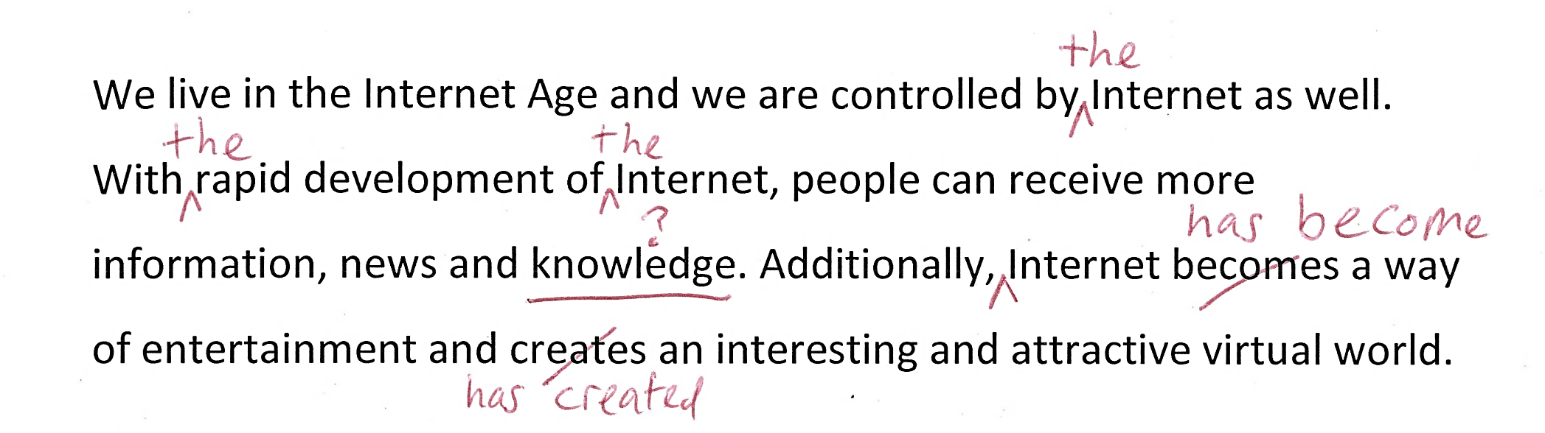
Red pen corrections

Slide 3
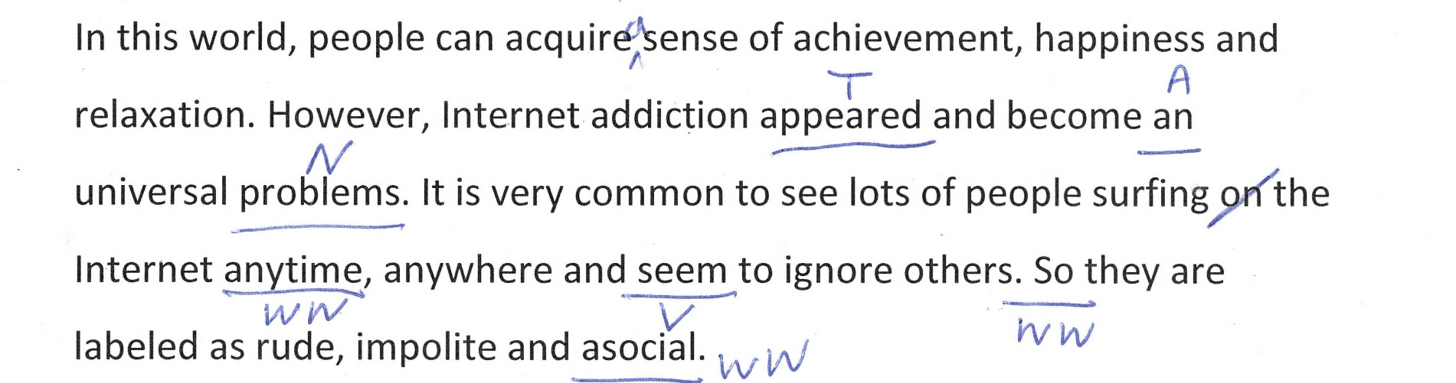
Correction codes

Slide 4
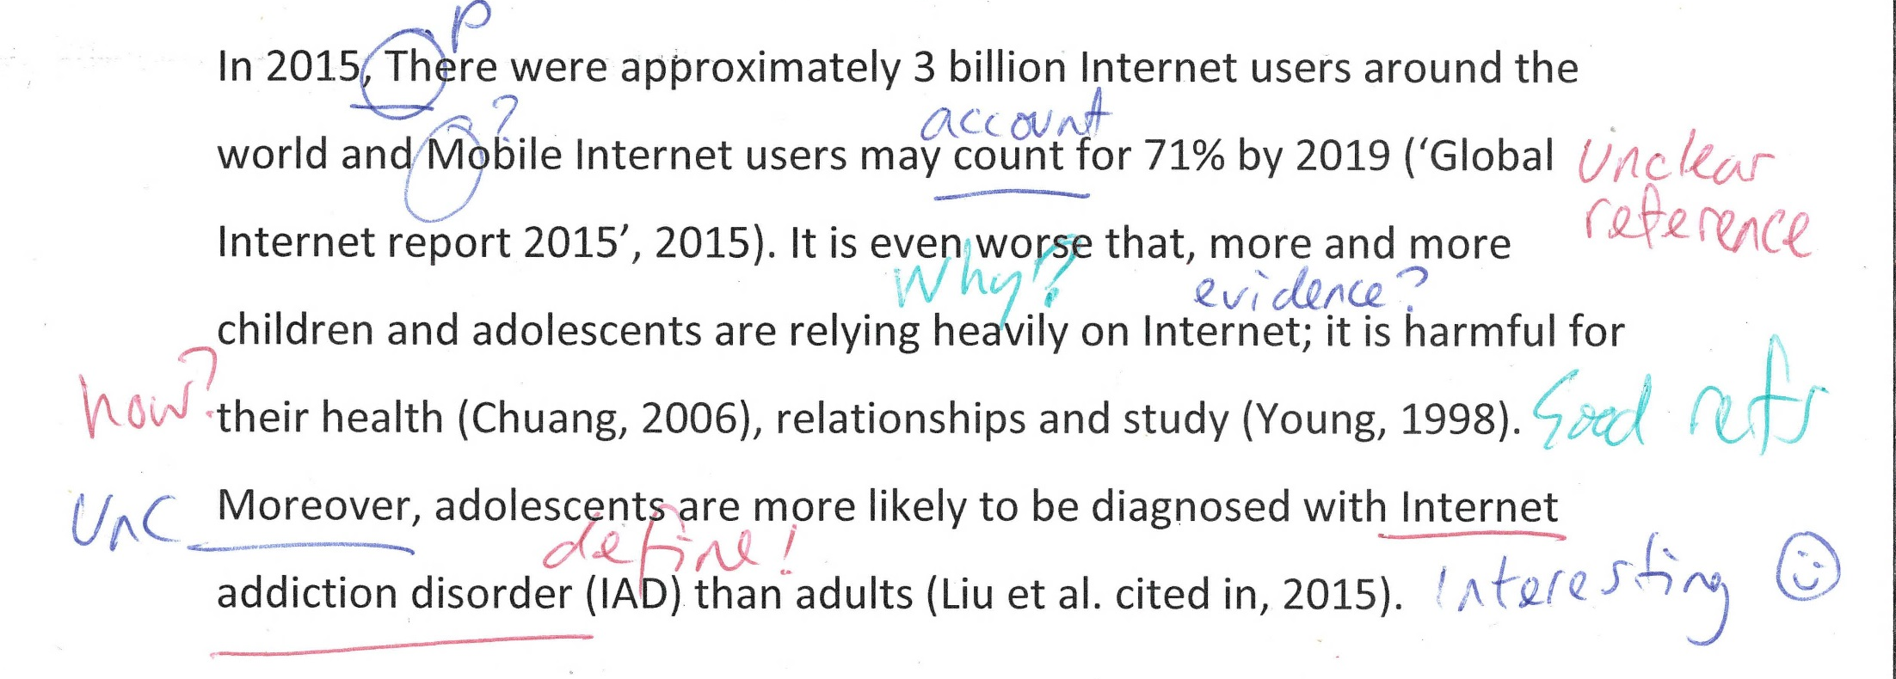
Correct everything?

Slide 5
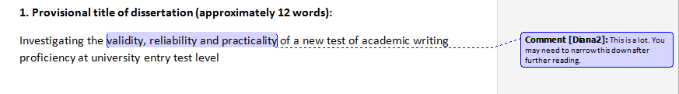
Track changes and comments

Slide 6
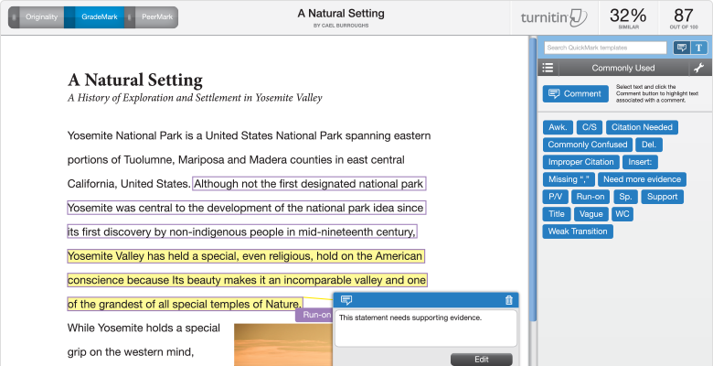
http://www.zaojiance.com/sites/files/features-gm-dv-lg.png
DOA: 08/04/17

Slide 7
Responses
What does this mean?
OK it’s a grammar mistake, but what’s the correct form?
How about if I change it to… [this]?
Why is this unclear?
What do you mean this is not related to the main topic???
Dialogue

Slide 8
Definitions
Dialogue →
Dialogic feedback
  2-way
  Face-to-face
  Online
Monologic feedback
  1-way

Slide 9
Bringing learners and tutors together in the writing process through dialogic feedback
Chris Smith
Chris.R.Smith@Sheffield.ac.uk
@Chris_Myth

Slide 10
Overview
Background
Context
Implementation
Feedback
Future

Slide 11
Learning Oriented Assessment
Background
“assessment in the dynamic sense involves transformation of... abilities through dialogic collaboration between learners and assessor-teachers, or mediators”
(Poehner, 2007, p324)

Slide 12
Context
Summer pre-sessional (10 & 6 week)
Assessment
  Extended Writing (2000 words, 60%)
  Seminar (20%)
  Presentation (20%)
No exit exam

Slide 13
Context
Summer pre-sessional (10 & 6 week)
Assessment
  Extended Writing
  Dialogic feedback
  Online and F2F

Slide 14
Extended Writing
2000 words
10-15 sources
Discipline specific questions
Discipline specific reading
Generic writing

Slide 15
Implementation:
Online
Google Docs
Shared live documents
Comment function
Ts encouraged to ask Qs

Slide 16
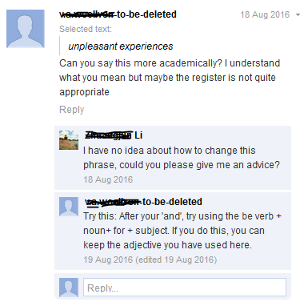
Comments
Responses
Questions
Answers

Slide 17
Tech specs
Google Apps for Education
Doctopus plug in
Large scale automated distribution
Embargo
Nick Murgatoryd & David Read

Slide 18
Feedback
(End of course)
“so much better than trying to mark on turnitin or marking paper copies”
“Good for marking short essays and sections but less effective for a 2000 word essays as constantly scrolling up and down and hard to see the whole picture”
“Please go back to paper.”

Slide 19
Feedback
(Focus group)
“Being on Google Drive I could access it anytime.”
[re comments] “you have more space – you’re not limited by the white space of the paper.”
“It’s 100% readable. [On paper] there’s room for misinterpretation.”
“What I didn’t like is how long it takes to do close reading feedback.”

Slide 20
Implementation:
Face-to-Face
Weekly tutorials
Friday writing workshop
All Ss 10 min tutorial
Focus Not giving but discussing feedback
4 key stages
  Plan
  2 paragraphs
  Draft (20 minutes)
  Final draft

Slide 21
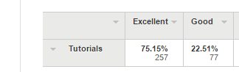
Student feedback
Tutorials
Very positive
97.66%

Slide 22
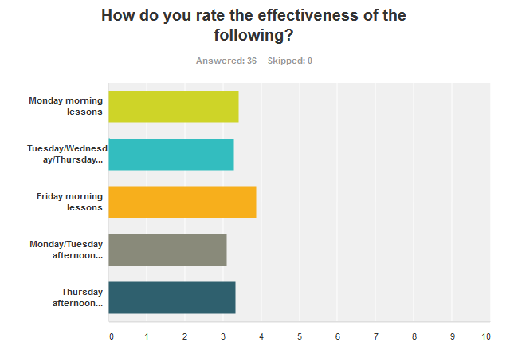
Teacher feedback

Slide 23
Teacher feedback
Tutorials
Positive
Negative
Each stage has feedback
Each tutorial has a focus
“Although it seemed a lot at first, I totally see the value of the tutorials now that the course has finished. It was much better to have tutorials than to have input sessions when students can't take in any more”
Intense
Impossible to cover everything
“With 16 students in the class I felt I was often pushed for time and unable to give effective feedback”

Slide 24
Parkinson’s Law
Dialogic feedback expands so as to fill the time available for its completion.

Slide 25
Parkinson’s Law
Dialogic feedback expands so as to fill the time available for its completion. And then more.

Slide 26
Parkinson’s Law
Dialogic feedback expands so as to fill the time available for its completion. And then more. And then even more.

Slide 27
Issues for the Future

Slide 28
Learner training
The 3 shocks:
Culture, Language & Academic
Different L1 & A1
“The students who engaged in the dialogical feedback were usually the strongest or the most sociable. The weakest, the ones who had less confidence, the ones who expected to come and just listen to me talk and take notes, usually they were not in dialogue.” (Focus Group)

Slide 29
Source engagement
“I used the comments section for paraphrasing. When students had to paraphrase, I asked them to put the original in the comments so I could compare, and sometimes they would comment on that saying “I had trouble with this paraphrase”

Slide 30
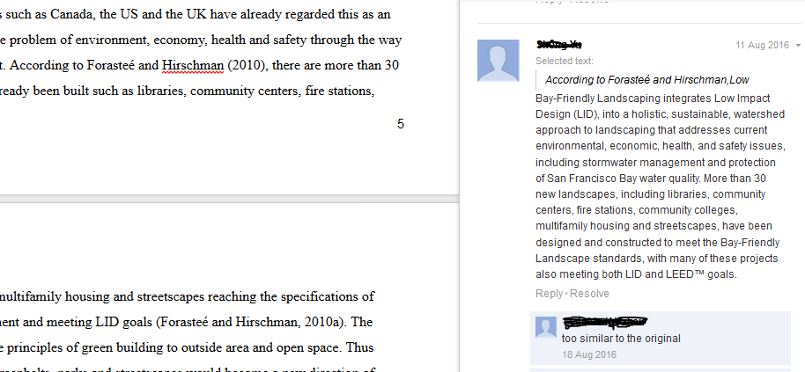
Source referencing
Add page numbers

Slide 31
Critical thinking
“A problem with [dialogic feedback] is that to engage in dialogue you need to see yourself as an expert or an equal. The problem they had with dialogic feedback with me was the same problem they had with commenting on sources. They accept me as the authority and the source as the authority, so whatever the source says or whatever the expert says, they can’t negotiate with it, they can’t talk about it, they just accept it.” (focus group)

Slide 32
Assessment security
Track development
Regular conversations
Revision history
Potential vivas

Slide 33
References
Well yes, there should be some references here, but my free hotel wi-fi ran out before I managed to get them and put them into the presentation. But really, were you actually going to look at my references for a full two and a half seconds and know where I got all my information from? No way. We could all be making up our reference lists and no one would be able to tell. But anyway, sorry.

