Slide 1


Essays With Benefits
Undergraduate Collaborative Writing
Peter Levrai & Averil Bolster
Friday 7th April, BALEAP 2017 Bristol

Slide 2
Why Hedgehogs?
There can be varying attitudes to collaborative writing.
“I’d rather vomit up a live hedgehog” (Strauss, 2001)
Concerns about
  Fairness
  Uneven workload / freeloading
  Scheduling

Slide 3
Why Group Essays?
Group writing is widespread in universities (Scotland, 2016)
Group writing has added benefits e.g. teamwork & critical thinking (Shin, 2015)
Group writing leads to better quality essays than individual writing (Wigglesworth & Storch, 2009; Shehadeh, 2011)
Results in better task fulfilment, grammatical accuracy and complexity (Storch, 2005; Mulligan & Garofalo, 2011)
Results in better grades (Mulligan & Garofalo, 2011; Berry, 2007)
Group-work helps with employability (Wigglesworth & Storch, 2009)

Slide 4
The Teaching Context
University of Macau (English Medium Instruction Institution)
1st Year undergraduate students
B1 & up (CEFR)
Novice writers
Preparation for first academic essay
The aim of the course is to help students develop “the language and associated practices that people need in order to undertake study or work in English medium higher education” (Gillett, 2015, para. 1).

Slide 5
Developing a Framework - 2015
Notes on a source (individual)
Outline (group)
First draft (group)
Second draft (group)
Final Draft (group)
Paragraph (individual)
Didn’t support group work effectively
Led to disjointed first drafts
Encouraged cooperation, not collaboration (Storch, 2013)
Levrai & Bolster, 2017

Slide 6
Developing a Framework – 2017
Moodle discussion of input texts (individual)
Group ground rules (group)
First draft (group)
Group work stop, check, reflect (individual)
Peer feedback (individual)
Outline (group)
Second draft (group)
Final Draft (group)
Group-work reflection (individual)
Annotated bibliography (individual)
‘Stormboard’ discussion of potential sources (group)
Tutorial (group)
Levrai & Bolster, 2017

Slide 7
Developing a Mark Scheme
Individual*
Forum Discussions – 5%
Annotated Bibliography – 20%
Peer feedback on 2nd Draft – 15%
Group Contribution – 10%
Group
Drafting – 10%
Final Draft – 40%
*Individual work also assessed through coursework and end-of-course reflection

Slide 8
Exploiting Web 2.0
Use of collaborative online spaces help the teacher ‘see’ inside the group-work process.
This can be an eye-opener.
Brainstorming & Planning
Drafting
Task Management
Stormboard
Google Docs
Trello

Slide 9
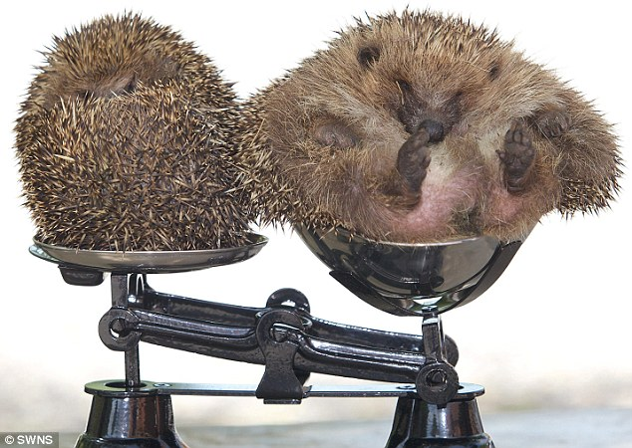
Student Perceptions

Slide 10
I understand what makes a good essay

Slide 11
I am better at essay writing

Slide 12
I would recommend group essays
Yes | No | N/A | Total
759 | 111 | 9 | 759

Slide 13
Why not group essays?
Comments
Most mentioned in Sem 1 201617

Slide 14
Why group essays?
Comments
Most mentioned in Sem 1 201617

Slide 15
Teacher Perceptions
Anecdotal – level meetings and informal discussions
Initially - interest, doubt, resistance
Learning curve first year
Generally positive attitude to group essays (surprising themselves)

Slide 16
Conclusions
Group essays can not be approached in the same way as individual essays.
Less marking but more monitoring.
With teacher support, collaborative essay assignments can be very successful.
Collaborative essays develop more than just essay writing skills.
Needs more research.

Slide 17

Group Essays In Context
Session 13H
Sunday April 9th
12:00-12:30
Sustainable Development Goals for a Sustainable EAP Course

Slide 18
References
Berry, E. (2007). Group work and assessment—benefit or burden?. The Law Teacher, 41(1), 19-36.
Gillett, A. (2015). What is EAP? Retrieved from http://www.uefap.com/bgnd/whatfram. htm
Levrai, P. & Bolster, A. (2017). ‘Undergraduate collaborative essays: constructive not a cop-out’, IATEFL 2016 Birmingham Conference Selections. IATEFL
Li, M., & Campbell, J. (2008). Asian students’ perceptions of group work and group assignments in a New Zealand tertiary institution. Intercultural Education, 19(3), 203-216.
Mulligan, C., & Garofalo, R. (2011). A collaborative writing approach: Methodology and student assessment. The Language Teacher, 35(3), 5-10.
Scotland, J. (2016). How the experience of assessed collaborative writing impacts on undergraduate students’ perceptions of assessed group work. Assessment & Evaluation in Higher Education, 41(1), 15-34.
Shehadeh, A. (2011). Effects and student perceptions of collaborative writing in L2. Journal of Second Language Writing, 20(4), 286-305.
Shin, M. (2015). Collaborative learning. English Teaching Professional, 97, 11-13.
Storch, N. (2013). Collaborative writing in L2 classrooms (Vol. 31). Multilingual matters.
Storch, N. (2005). Collaborative writing: Product, process, and students’ reflections. Journal of second language writing, 14(3), 153-173.
Strauss, P. (2001). I'd rather vomit up a live hedgehog‘ - L2 students and group assessment in mainstream university programs. Prospect-Adelaide-, 16(2), 55-66.
Wigglesworth, G., & Storch, N. (2009). Pair versus individual writing: Effects on fluency, complexity and accuracy. Language Testing 26.3: 445-466.

Slide 19

Thank You
peterlevrai@gmail.com
averilbolster@gmail.com
http://developeap.weebly.com
Slides available at
https://www.slideshare.net/PeterLevrai/

