Slide 1
BALEAP 2017: working together = learning together
Publishing research in EAP: the motivations and challenges from the perspectives of EAP practitioners, heads of EAP departments and journal editors
Dr Mary Davis, Oxford Brookes University
Notes:
I am talking about publishing research by EAP practitioners. I explored 3 areas but mostly focus on the perspectives of the practitioners in this presentation, and some data from heads of depts and journal eds. I made the decision not to refer to literature or ground in literature, to leave more time for my findings, and also find it rather convenient to be after Alex who has focused on lit.

Slide 2
JOHN SWALES
I still remain puzzled at how few BALEAP folks actually publish in the accredited journals. BALEAP itself, and its PIMS etc is extremely lively and interesting, but somehow its enthusiasts do not seem to pass the final hurdle into publishing recognition. So, I am hoping you can shed light on this issue.
Notes:
However, I would like to give the First word to JS who was first to respond to my request for participants on BALEAP forum, for which I am very grateful – he is our generous and wise tribal elder – wrote this – and this is my aim today – why don’t we pass the final hurdle?
Motivations
habit
pour encourager les autres“a way of helping doctoral students break through into publication
Challenges
These days the process seems to be very slow, so patience and open-mindedness is required

Slide 3
data collection
Interviews - 9 EAP practitioners
Survey – 30 Heads of EAP Departments
Email survey –7 journal editors

Slide 4
EAP PRACTITIONERS
No. | Years of EAP | PhD | EAP Publications
1 | 18 | Completed | JoAW
2 | 8 | About to start | ESPJ, InForm
3 | 18 | - | ISEJ
4 | 30 | - | InForm, BALEAP Conf Pro, EAL, books, others
5 | 30 | Began | System, CSEDU
6 | 7 | About to finish | JSIE
7 | 15 | Completed | BALEAP Conf Pro, EATAW Conf Pro
8 | 20 | Completed | ELTJ, BALEAP Conf Pro, books, others
9 | 25 | Completed | ELTJ, JSLW, BALEAP Conf Pro, books, others
Notes:
Journal of Ac Writing (EATAW), Int student experience journal, East Asian Learner, Computer supported education, Journal of studies in international education,
Asked about what published and where, motivation, challenges, how overcome, view of publishing research in EAP
PEOPLE WHO RESPONDED TO MY REQUEST WERE INTERESTED IN EAP RESEARCH, EXPERIENCED, MANY VERY EXPERIENCED IN EAP, had relationship with PhD, some multiple pub

Slide 5

Feeds into teaching
P5. As soon as I start engaging in a piece of research, my classroom practice comes alive because I am directly linking reflections on issues with my teaching practice. So every time I do some research, it really has a profound impact on my practice, and I like that, just to think, why are you doing this?
Oxford Brookes University Digital Asset Bank
Notes:
FIRSTLY MOTIVATIONS – I will refer to participants as p1-9

Slide 6
NEED TO WRITE TO TEACH WRITING
P1. I think that people need to write because that is one of the things that EAP is about, And if you don’t write yourself, I just wonder on what grounds you can offer advice to others
P4 I cannot imagine being able to help a Master’s student with his or her research and writing up of a dissertation, if you haven’t done any writing recently yourself.
Notes:
Here is a thought - CAN YOU TEACH WHAT YOU DON’T KNOW HOW TO DO? – and something you have done recently?

Slide 7
CREDIBILITY AND AUTHORITY
P5 Especially working on in-sessional with doctoral students, how can anyone have any credibility with their colleagues, unless they are seen to be doing something?
P9 I think fundamentally as an EAP professional, you are teaching students to write, to make presentations, do research, and if you don’t engage yourself in those things, you don’t have much authority to do that. I think staff can perform better if they are engaged themselves in the academic process
Notes:
Other respondents were concerned with their relationship with others – CREDIBILITY with colleagues, AUTHORITY to teach

Slide 8
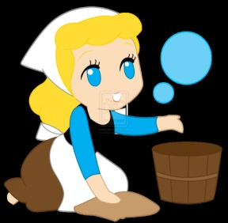
RAISE PROFILE, GET PROMOTION
P2 We need to try to raise our profile as serious members of the academic community, rather than support staff with no academic credentials at all
P3 If you ever want any kind of promotion or recognition, you need to publish in university, otherwise you really do feel like the Cinderella of the university world.
Clip art Cinderella
Notes:
Credibility issue – connected raising profile -Serious – get over cinderella image

Slide 9

DEFEND EAP, GET PROFESSIONAL STANDING
P7 in terms of defending EAP’s status as academic, it is absolutely vital.. to try to combat this ‘Noddy’ perception of us, this idea of us as not
academic.
P9 we are in the university environment, and if you don’t have any publications or conference papers, it does not say very much about your professional standing. You want to appear ‘worthy’ to your peers
Clip art Noddy
Notes:
Children’s character – noddy – not academic

Slide 10
time
P5 All of my research has been done in my spare time because it has never been an official part of my job, but that is bonkers
P8 I have no official research time, staff development time or scholarship time, but I make my own time, I do it in spite of my workload
P9 Major journals – ESPJ, JEAP, they tend to be interested in major pieces of empirical research, for us as EAP practitioners, it’s difficult to produce that volume
of work, we don’t have the time.
Clip art clock
Notes:
cHALLENGES – big factor that nearly all mentioned was time – allocation, spare time,

Slide 11
No working time
P6 All EAP professionals would like to say we are a profession, but you are not encouraged, once you get to a certain point, to take it any further. I find that contradictory really. They say it isn’t your job to research, it isn’t what your job’s involved in, this isn’t what you’re employed to do. In my workplace, every year, staff are encouraged to put in a bid for a project, I said look, I am doing this project, will you give me some hours for that, one or two hours a week, and the answer was very clearly absolutely not, this does not benefit the ELC so you’re not getting any time for that
Notes:
But were interested when published – getting some credit for dept

Slide 12

Year round teaching
P2 The vast majority of people in this profession focus on the teaching, the marking, and everything else connected with it, and the thing that has to slip is the research - the year round nature of EAP has a lot to do with it
P7 The main challenge is not having enough time because of teaching, we teach more weeks of the year. Now I am part-time, that is making it easier for me to find the time to read and write and get something that I hope will be of publishable standard
Bob Pomfret, Oxford Brookes University RADAR

Slide 13
LACK OF PUBLISHING CULTURE
P2 There is a lack of publishing culture within the profession. There are a few people who do publish, but when you look at the big names in EAP, they are generally lecturers in TESOL or SLA or something. The publishing culture seems to move away from the chalk face of what we actually do.
When I have been to BALEAP events, there does seem a particular way of presenting research which is very often this is the idea we had, this is what we did and here is some student feedback saying they liked it very much – which isn’t publishable
Notes:
Here’s another take on it – lack of pub culture and researching and presenting teaching ideas is not publishable

Slide 14

Lack of mentor
P9 we don’t have someone who could mentor. I think in most academic departments, there are mentors to help people, younger academics, so they nurture this kind of work, but we don’t seem to have that.
P8 there is a lack of mentoring
Oxford Brookes University Digital Asset Bank
Notes:
Lack of mentor – need more mentors – this is where BALEAP could step in – maybe could create baleap research mentors

Slide 15

Networking and collaborating
P3 It’s very hard to find a network of people to work with, and I think that would make a difference to carrying out research and getting published.
P9 The best kind of help can be at conferences, meeting people, editors of journals, other researchers who publish, talking to them, I think that’s very important
P4 Collaborating is very helpful
Oxford Brookes University Digital Asset Bank

Slide 16
Which journal?
P3 I sent it off to the ELTJ and they wrote back and said yes this is very interesting, very nice but it’s not about English, not about the nitty-gritty of teaching English, we don’t want it. So I then sent it off to Language Learning Technology which might have been aiming too high, because it has got a good reputation, and they said oh no, this isn’t rigorous enough, you haven’t controlled the variables, we don’t want it, so I’m going back to scratch and thinking where am I going to publish it, it doesn’t seem to fit into any particular pigeonhole.
Notes:
Participant described her journey around different journals – not knowing enough about it

Slide 17

Views of journals
P1 one is more likely to get accepted in a new journal, than one that has a long history
P4 I’ve never tried to submit to a journal I didn’t think would accept, I’ve never tried to submit to JEAP for example
Clip art journals
Notes:
Ways to avoid rejection

Slide 18
Good feedback
P5 We had the most fantastic feedback from the reviewers they were both incredibly helpful not only helped with the article, but contained a plan for the next 2 or 3 articles. I felt there was somebody out there who really understood what we were trying to achieve, they were so engaged, they helped shape what we were doing and I was very grateful to that person.
P8 Editors have been supportive – I have had lots of rejections but no terrible comments.
Notes:
Story of great feedback – and managing rejections – as long as no terrible comments – terrible comments. ‘this person cannot write’

Slide 19
Managers do not help
P2 My line manager is the interim head of the ELC and she doesn’t publish or do research, so she wouldn’t be able to help me.
P7 I don’t feel that our line manager has been very helpful. I think we’ve not been given sufficient professional development. Currently our line manager is an interim after our head of department’s retirement. They see us as teaching staff only.
P4 You need to be in a context that believes in research. Being with student services and things like that isn’t conducive to research and publication.

Slide 20

Managers are jealous
P8 Once a manager tried to pull the plug out of my computer! I have encountered jealousy from certain managers, and have the feeling that management is sometimes unhappy about efforts to publish because it might undermine their authority, some people can be paranoid. Let’s face it, if you’re a manager and people you manage are more intelligent and academically active than you are, there’s a threat and rivalry, augmented by research, so they may say ‘well done’ but wish they could do it.
Clip art jealousy

Slide 21
UNHELPFUL, HOSTILE WORKPLACE
P5 I get better support from the HEA, than any EAP unit I have worked in. My unit did not want me to publish anything. They threw as many bricks in the way as they could.
P6 Just trying to get any kind of recognition from my department is a real problem. I think having Language Centres that aren’t considered to be academic, there is certainly an implication that you should not be engaged in research

Slide 22
Survey of heads of eap depts
Have you published any research in EAP?
How many staff teach EAP in your department?
How many members of EAP teaching staff in your department do the following:
a)Carry out research b)present at conferences c)publish research
How important do you think it is for EAP teaching staff to publish research in EAP?
a)Very important b)important c)not important
Please explain the reason for your view in question 4.
Notes:
Looked at 120 unis, found 90 EAP depts, Contacted 60 individuals (identified as head of dept or director) by email over a month period, got 30 responses

Slide 23
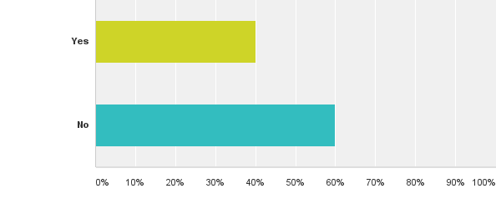
Q1: Have you published any research in EAP?
Answered: 30 Skipped: 0

Slide 24
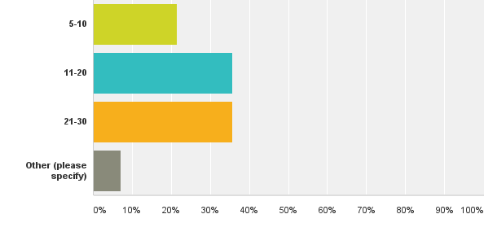
Q2: How many staff teach EAP in your department?
Answered: 28 Skipped: 2
Notes:
Raw figs 6, 11, 11, 2
Vast majority 11-30, the other – smaller than 5

Slide 25
eap staff research activities
Notes:
Raw numbers show 5 heads of dept said no one carried out research and 7 said no one published research. Mostly 1-2 people carried out and published research. A lot more presented at conference, but no head of dept said that more than 5 people published research.

Slide 26
Importance of eap practitioners PUBLISHING
Notes:
BUT – nearly all thought it was important

Slide 27
REASONS WHY IMPORTANT
HOD1 I feel very strongly that EAP is an academic subject. In order for us not to be perceived as a "service", we need to be active in both "scholarly" and "research" activity as academic colleagues in other disciplines are.
HOD2 I think it is very important for EAP teaching staff to carry out research and to publish it - one can take informed decisions, when setting up or updating courses, with regards to teaching and learning methods, designing materials, student needs, etc.
HOD3 Recently all staff have moved across to teaching only contracts and so research is not required, however, some staff still do research in their own time.
Notes:
V important for same reasons as the EAP pract – EAP needs to be scholarly and comparable to other disciplines, and to inform work, but even one who said not important – agreed staff do in own time

Slide 28
Journal editors
JEAP, ESPJ, JSLW, JoAW, System, InForm, ELTJ
Where do submissions to your journal tend to come from, in terms of the author’s base and professional role?
Do you see any specific challenges for EAP practitioners to publish research in your journal?
Do you have any advice to EAP practitioners who wish to publish research in your journal?
Notes:
Briefly – asked about profile of submissions, challenges, advice

Slide 29
Advice from journal editors
E1. Read a lot of research; get to know the journal and its expectations; research and publish with someone who has done both before and can show you the way.
E2. Have a solid rigorous research design
E3. Identify something that readers in other contexts could utilize
Notes:
I hope I have shed some light on EAP practitioners’ motivations and challenges, and I hope that despite the challenges of publishing research, you might be interested in following their advice.

