Slide 1
University literature essays in the UK, New Zealand and the USA:
Implications for EAP
Hilary Nesi, Neil Matheson, Helen Basturkmen

Slide 2
Why is it important to investigate differences?
There’s a tendency to lump together ‘Anglo-American’ or ‘Western’ writing styles. This causes problems for academic writing research.
Local differences in writing styles and tutor expectations could affect progress of students moving across settings.
Local differences may not be reflected in published EAP materials.

Slide 3
Kruse & Chitez (2012) – a comparison of university genres across three Swiss regions (French, German and Italian)
They conclude:
The Italian-speaking university stressed the expression of knowledge ‘in a personal voice’
The French-speaking university stressed the voice of the discipline – ‘the personal should not appear in the text’
The German-speaking university required students to switch between the academic and the personal, according to genre.

Slide 4
Evidence of difference in British and American essay writing styles
Ädel (2008) – compared essays from Louvain Corpus of Native English Essays (LOCNESS). The US writers used significantly more personal metadiscourse.
Chen (2013) – compared essays from LOCNESS-US, GS-UK, MICUSP and BAWE. The US writers used significantly more phrasal verbs.
Suggests that the US style is more informal and colloquial

Slide 5
How comparable are these datasets?
Genre, topic, discipline and level of study all have their effect on register – so we need to match all these up as far as possible…..
“It is only against a background of sameness that differences are significant”
(James 1980:169)

Slide 6
Genre families/categories
BAWE
Case study
Critique
Design specification
Empathy writing
Essay
Exercise
Explanation
Literature survey
Methodology recount
Narrative recount
Problem question
Proposal
Research report
UoA
Case study
Creative writing
Design specification
Essay
Evaluation
Explanation
Literature survey
Methodology recount
Narratives
Problem question
Proposal
Research report
Public writing
MICUSP
Argumentative essay
Creative writing
Critique/Evaluation
Proposal
Report
Research paper
Response paper

Slide 7
Genre families/categories
BAWE
Case study
Critique
Design specification
Empathy writing
Essay
Exercise
Explanation
Literature survey
Methodology recount
Narrative recount
Problem question
Proposal
Research report
UoA
Case study
Creative writing
Design specification
Essay
Evaluation
Explanation
Literature survey
Methodology recount
Narratives
Problem question
Proposal
Research report
Public writing
MICUSP
Argumentative essay
Creative writing
Critique/Evaluation
Proposal
Report
Research paper
Response paper

Slide 8
Comparable disciplinary areas
English literature
European Studies
Greek Drama
Classics
Film
We picked out essays covering the same sort of topics
We matched them across BAWE, MICUSP, and Auckland University Textbank
(UoA)

Slide 9
Our corpora
Mostly Level 2
UoA | BAWE | MICUSP
English x 7 (level 3) x 15 (level 2) | English x 20 (level 3) | English x 46 (level 3)
Greek drama x 1 (level 1) | Greek drama x 4 (level 2) | Greek drama x 1 (level 3)
European Studies x 1 (level 3) x1 (level 2) | Film (Classics) x 1 (level 3)
Total = 25 assignments 45267 tokens | Total = 25 assignments 75217 tokens | Total = 47 assignments 93411 tokens
Total writers = 13 | Total writers = 17 | Total writers = 40
NNS writers = 0 | NNS writers = 7 (2 German, 3 French, 1 Japanese ) | NNS writers = 6 essays, 3 writers (1 Urdu, 2 Chinese)
All Level 3

Slide 10
Our corpora
UoA | BAWE | MICUSP
English x 7 (level 3) x 15 (level 2) | English x 20 (level 3) | English x 46 (level 3)
Greek drama x 1 (level 1) | Greek drama x 4 (level 2) | Greek drama x 1 (level 3)
European Studies x 1 (level 3) x1 (level 2) | Film (Classics) x 1 (level 3)
Total = 25 assignments 45267 tokens | Total = 25 assignments 75217 tokens | Total = 47 assignments 93411 tokens
Total writers = 13 | Total writers = 17 | Total writers = 40
NNS writers = 0 | NNS writers = 7 (2 German, 3 French, 1 Japanese ) | NNS writers = 6 essays, 3 writers (1 Urdu, 2 Chinese)
MICUSP is bigger, but all results have been normalised

Slide 11
Sample titles:
Mary Shelley’s mad scientist and the birth of a monster
Clowns in two Shakespeare plays
Discuss the pursuit of justice with reference to at least two plays
The central message of Chaucer’s retraction
Charity in the character of Sir William Thornhill
The Vicar of Wakefield as a Failed Morality Story
Human-Animal Nature in H.G. Wells and Edgar Allen Poe
The Role of Nicholas Levin in Tolstoy's Anna Karenina
On Frames and Resistance in Pride and Prejudice
Autumnal Imagery in Persuasion
Less is More: Courtship in Twelfth Night
THE LADDER: Sexuality of Ancient Greece as an instrument of social mobility

Slide 12
Readability Scores
 | UoA | BAWE | MICUSP
Flesch-Kincaid | 41.7 | 43.5 | 50.9
Gunning FOG | 16.1 | 15.9 | 14.4
SMOG | 12 | 11.7 | 10.7
http://www.thewriter.com/what-we-think/readability-checker/

Slide 13
Findings
Using:
Multidimensional Analysis Tagger (MAT) 1.2 (Nini 2014)
Linguistic Inquiry and Word Count (Tausczik & Pennebaker 2010)

Slide 14
Complexity
(excluding references and footnotes)
 | Average words per sentence | Lexical words % | words longer than 6 letters | Nominalisation % | Attrib adj %
MICUSP | 29.72 | 46.8 | 24.15 | 2.9 | 6.3
BAWE | 31.97 | 47.7 | 26.54 | 3.2 | 7.4
UoA | 31.35 | 48.4 | 29.14 | 3.6 | 7.6
MICUSP shorter sentences.

Slide 15
Complexity
(excluding references and footnotes)
 | Average words per sentence | Lexical words % | words longer than 6 letters | Nominalisation % | Attrib adj %
MICUSP | 29.72 | 46.8 | 24.15 | 2.9 | 6.3
BAWE | 31.97 | 47.7 | 26.54 | 3.2 | 7.4
UoA | 31.35 | 48.4 | 29.14 | 3.6 | 7.6
MICUSP sparsest.
UoA densest.

Slide 16
Complexity
(excluding references and footnotes)
Using LIWC
MICUSP fewest and UoA most long words, nominalisations, left embeddedness
 | Average words per sentence | Lexical words % | words longer than 6 letters % | Nominalisation % | Attrib adj %
MICUSP | 29.72 | 46.8 | 24.15 | 2.9 | 6.3
BAWE | 31.97 | 47.7 | 26.54 | 3.2 | 7.4
UoA | 31.35 | 48.4 | 29.14 | 3.6 | 7.6

Slide 17
Some examples
Limited support exists for the hypothesis that in Aristophanes’ Lysistrata the focus on sexuality is just a diversion from the seriousness of war. In forming this view, an assessment will be made of the importance of scenes portraying the seriousness of war, immediately undercut by sexual humour, which may be seen to support the hypothesis. (UoA)
One common problem for the Christian tradition is the idea of evil in the world. Many struggle to believe in a faithful and loving god when there are so many apparent problems with society. People feel that if God is so loving and just, merciful and great, He would not let there be so much pain and struggle and toil in the world. Toil is a concept thoroughly explored in William Faulkner's As I Lay Dying. (MICUSP)

Slide 18
Interactivity
(excluding references and footnotes)
Micusp seems the most interactive
 | 1st person pronoun % | 2nd person pronoun % | Question marks % | Contractions %
MICUSP | 0.63 | 0.26 | 0.10 | 0.18
BAWE | 0.61 | 0.23 | 0.05 | 0.14
UoA | 0.24 | 0.11 | 0.02 | 0.09

Slide 19
Interactivity
(excluding references and footnotes)
 | 1st person pronoun % | 2nd person pronoun % | Question marks % | Contractions %
MICUSP | 0.63 | 0.26 | 0.10 | 0.18
BAWE | 0.61 | 0.23 | 0.05 | 0.14
UoA | 0.24 | 0.11 | 0.02 | 0.09
MICASE seems the most informal,
UoA the most formal

Slide 20
Some examples
Returns suitable is a trick of speech that could mean anything, and certainly doesn’t directly mean that Roxana would lay her life down for Amy. Roxana also deems it an excess of affection, which means Roxana herself doesn’t consider it normal……. (MICUSP ENG.G0.47.1)
The book ends with the narrator, seeing all [his] family assembled once more by a cheerful fireside (199). It is clear that he sees nothing more perfect in life than a happy, loyal family. Yet is the narrator's family loyal? Olivia runs away from home, which, at the time, was a grievous insult to her families honor. (MICUSP ENG.G0.02)

Slide 21
References and footnotes
 | UoA | BAWE | MICUSP
Total no. references | 168 | 262 | 103
Mean no. references | 6.7 | 10.5 | 2.2
Total words | 691 | 3009 | 393
Mean no. words | 28 | 120 | 8
Notes:
UoA 45267 tokens total corpus, 44576 cleaned
BAWE 75217 tokens total corpus, 74366 cleaned
MICUSP 93411 tokens total corpus, 93018 cleaned

Slide 22
References and footnotes
 | UoA | BAWE | MICUSP
Total no. references | 168 | 262 | 103
Mean no. references | 6.7 | 10.5 | 2.2
Total words | 691 | 3009 | 393
Mean no. words | 28 | 120 | 8
Big differences in the number and length of references and footnotes
Notes:
UoA 45267 tokens total corpus, 44576 cleaned
BAWE 75217 tokens total corpus, 74366 cleaned
MICUSP 93411 tokens total corpus, 93018 cleaned

Slide 23
References and footnotes
BAWE has lots of references, and long footnotes
 | UoA | BAWE | MICUSP
Total no. references | 168 | 262 | 103
Mean no. references | 6.7 | 10.5 | 2.2
Total words | 691 | 3009 | 393
Mean no. words | 28 | 120 | 8
MICUSP has far fewer references – often only to the source under discussion
Notes:
UoA 45267 tokens total corpus, 44576 cleaned
BAWE 75217 tokens total corpus, 74366 cleaned
MICUSP 93411 tokens total corpus, 93018 cleaned

Slide 24
Differences in use of footnotes and references is probably not due to differences in assignment purpose….
 | General argument | Close text analysis
MICUSP | 45 | 2
BAWE | 20 | 5
Auckland | 23 | 2
BAWE has more ‘close text analysis’

Slide 25
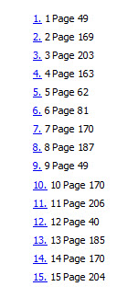

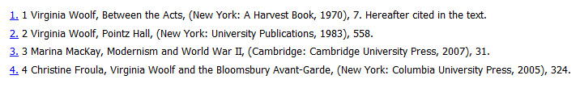
47% of MICUSP sample have only one or no references.
References in MICUSP
MICUSP references are a list of ‘Works Cited’ and/or numbered end notes
Often only references to the work under discussion

Slide 26
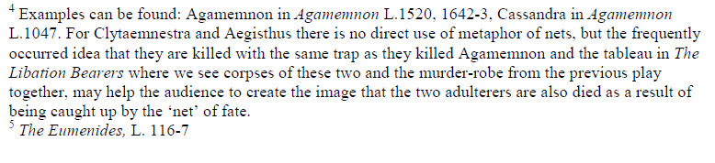
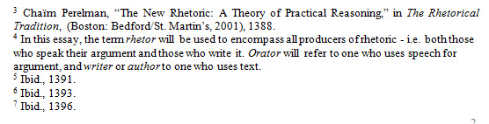
BAWE & UoA footnotes
MLA –style , containing the “comment, explanation, or information that the text can’t accommodate”

Slide 27
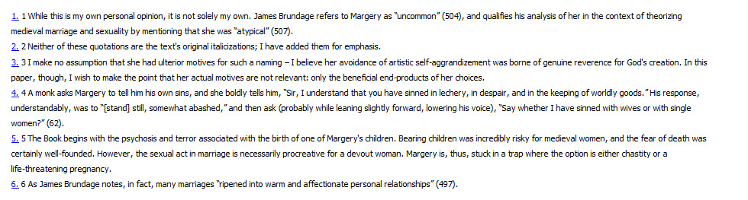
MICUSP ENG.G0.43.1
The only assignment in the MICUSP sample with footnotes .
Lots of references to self:
“I have added”
“I make no assumption”
“I wish to make the point”

Slide 28
Indications of advanced academic writing
With each year of study, BAWE texts become:
denser and more ‘compressed’
more nominalised
less personal
(Nesi & Gardner 2012; Gardner, Nesi & Biber forthcoming)

Slide 29
Common European Framework (CEF) proficiency levels
The higher the CEF level, the greater the
word length
average sentence length
Noun Phrase length and left embeddedness (words before the main verb)
(Present-Thomas 2014)
Notes:
for BAWE English and Linguistics essays and VU University Amsterdam English Linguistics / Literature essays

Slide 30
What can we conclude?
UoA essays seem the most ‘academic’ – despite the fact that not all were written by final year students.
MICUSP essays seem the most ‘personal’ – reflecting the writers’ own responses to the literature.
Could this be due to the education systems??

Slide 31
Typical US student writing experience
High school – non-academic personal essays or pseudo-academic 5-paragraph essays
1st year university – composition, ‘generalised academic writing’
2nd year - first introduction to disciplinary approaches
3rd year – starting to produce ‘expert insider prose’
(MacDonald 1994)
Compare the UK and NZ, where there is earlier specialisation, and less chance to study subjects outside one’s own discipline.

Slide 32
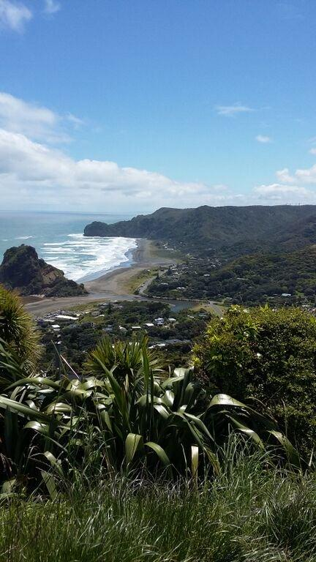
Thanks for listening!

Slide 33
References
Ädel, A. (2008) Metadiscourse across three varieties of English American, British and advanced-learner English. In U.Connor, E. Nagelhout & W. Rozycki (Eds.), Contrastive Rhetoric: Reaching to Intercultural Rhetoric (pp. 45-62). Amsterdam: John Benjamins.
Chen, M. (2013) Overuse or underuse: A corpus study of English phrasal verb use by Chinese, British and American university students. International Journal of Corpus Linguistics 18 (3) 418-442
James, C. (1980) Contrastive Analysis. London, Longman.
Kruse, O. & Chitez, M. (2012) Contrasting genre mapping in academic contexts: an intercultural approach. Journal of Academic Writing 2 (1) 59-73
MacDonald, S. P. (1994) Professional Academic Writing In the Humanities and Social Sciences. Southern Illinois University
Nesi, H, & Gardner, S. (2012) Genres across disciplines: Student writing in higher education. Cambridge University Press.
Nini, A. (2014). Multidimensional Analysis Tagger 1.2 - Manual. Retrieved from: http://sites.google.com/site/multidimensionaltagger
Present-Thomas, R. (2014) Academic Writing in English: a corpus-based inquiry into the linguistic characteristics of levels B1-C2. Unversity of Warwick: EALTA Conference 27-29 May 2014
Tausczik, Y.R. & Pennebaker, J.W. (2010) The psychological meaning of words: LIWC and the computerised text analysis method. Journal of Language of Language and Social Psychology, 29, 1: 24-54.

Slide 36
Patterns where BAWE is the outlier
 | MICUSP | BAWE | UoA
Types in 1st 400 tokens | 219 | 229 | 213
Possibility modals | 0.5 | 0.7 | 0.6

Slide 37
Similar patterns with other features…
 | MICUSP | BAWE | UoA
He/She | 4.5 | 2.9 | 2.6
They | 0.91 | 0.76 | 0.74
Conjunctions | 0.5 | 0.6 | 0.8
Notes:
No differences for downtoners, hedges, amplifiers, emphatics, necessity modals. Predictive modals, contractions
Nominalization contributes to both the information density of a clause and the referential
linking that builds in the construction of a text. In text-organizational
terms, nominalization enables something that has been presented in a series of
clauses to be distilled into one nominal element. Such distillation enables a chain
of reasoning to be developed by the writer (note, e.g., how the nominalization such
distillation at the beginning of this sentence refers back to the point of the previous
sentence). At the same time, however, it also tends to introduce abstraction, ambiguity,
and uncertainty, which can greatly decrease a text’s comprehensibility and,
thus, the reader’s interest and engagement. (FANG, SCHLEPPEGRELL, COX p254)

Slide 38
Introducing students to the academic discourse community in the USA
Fulkerson (2005) lists objections to the concept:
Unfair advantage to (white) upper/middle classes?
‘Hegemonic imperialism’ to insist that students use the language of their professors – don’t students ‘have a right to their own language’?
Would students need to learn the discourses of all the fields they take courses in?

Slide 39
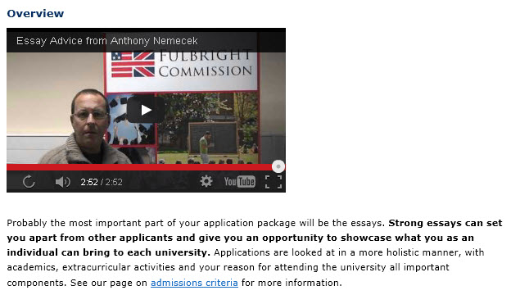
The American university admissions process encourages a very personal voice
Advice from the Fulbright Commission on US essay applications
The 500-600 word “essay” treated as
‘a creative writing piece’
‘a marketing tool’
possibly starting with ‘a personal anecdote or quote’

