Slide 1
Essex
Academic Skills Diagnostic
Liz Austin
University of Essex
TDC, Director of Taught Programmes
BALEAP Conference, Bristol April 2017
Notes:
1
TDC –Talent Development Centre – previously called University Skills Centre. The name change is in line with enhanced focus on teaching and learning as set out in the University’s Education Strategy
-
“..to develop and implement approaches to the academic and pastoral support of students that are focused on helping students to maximise their talents and abilities while studying at the University”

Slide 2
New online assessments
EDUCATION PLAN
AIM - “to ensure that all students receive appropriate induction to their study and the University, and on-going support that is aligned to their needs across writing, communication and numeracy skills”
SKILLS ASSESSMENT AIMS
1. Deliver tailored support to meet needs and aspirations of each student

Develop diagnostic tools to help identify levels of preparedness for academic life and study
2. Encourage resilience and self-help mind-set

Frame diagnostics as Discovery Tools, signposting to skills resources
Digital Literacies
Numeracy, Maths and Stats
English Language
Academic Skills
Notes:
2
Education Plan Contd
Targeted Support for Student Retention and Success, and Employability
Develop action plan to address attainment gaps and ensure that all students achieve their potential.
The diagnostics for IT and for Acad Skills are labelled discover tools – they aims to be both an assessment and a learning tool.
IT – by new TEL team, colleague is describing help they have given in TELP
English Language TEST – talk by colleague Adam Wattam [TITLE / TIME]
Numeracy, Maths and Stats by our TDC Numeracy tutor – also come along to support talk on Employability ‘Job Talk’ we have devised [ TITLE / TIME
Academic Skills now piloted across a number of depts including HHS – see talk by Caroline Hawthorne [TITLE / TIME]

Slide 3
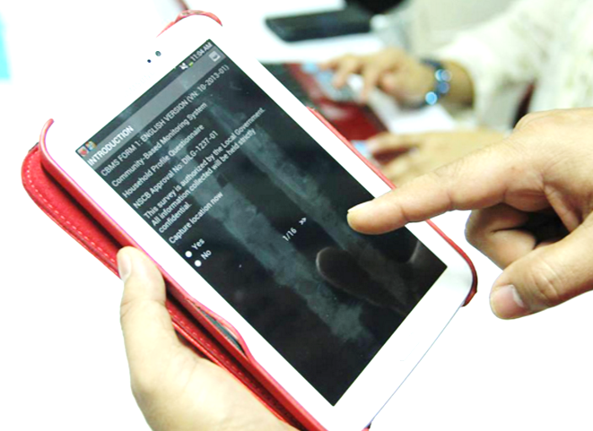
Content and Format
Academic Literacies framework
Easy-access mode
Magazine-style tally ‘quiz’
Length – 30 minutes
Department-bespoke versions

Slide 4
Trialling and feedback
Early trialling with peer mentors and our own class students
Several iterations of focus group sessions

Slide 5
Grouping question items
Learning from Lectures
Speaking up in Seminars
Making the most of Tutorials
Researching and Reading for Assignments
Assignment Planning and Write-up
Academic Integrity and Referencing
Time Management Skills

Slide 6
Questions and response options
Level of expertise
Level of mastery
Level of skill
Level of confidence ?
Level of experience…
No experience yet
A little experience
Some experience
Plenty of experience

Slide 7
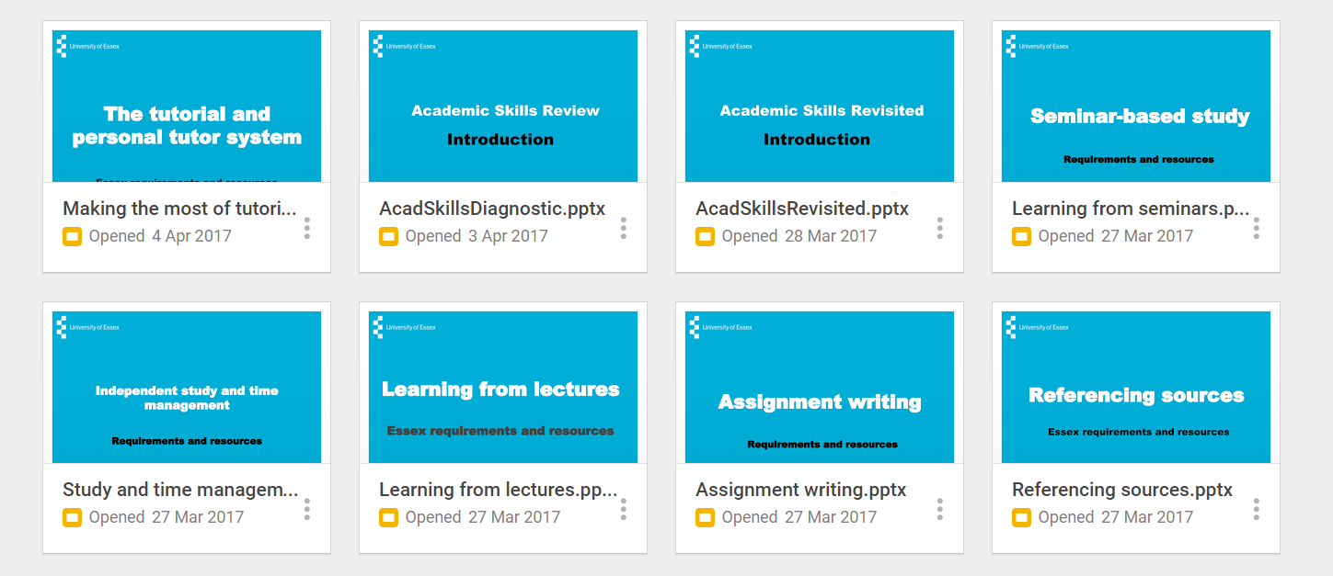
AS-R has embedded information slides

Slide 8
Trialling with 5 host departments
Faculty of Science and Health
Department of Psychology
Department of Health and Human Sciences
Faculty of Social Sciences
Essex Business School
Department of Law
Department of Sociology
Faculty of Humanities
…
Notes:
8
We have 22 departments organised into 3 faculties – Humanities, Science and Health, and Social Sciences. The 5 departments responded with different levels of engagement, but the negotiations were usually quite demanding politically – we needed to make sure we were talking to the right people – those who expected to be consulted, those whose teaching was most affected e.g. Sociology all worked very well.

Slide 9
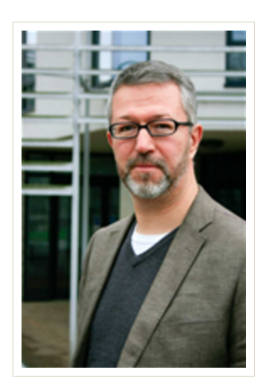
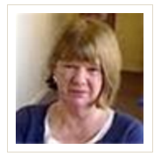
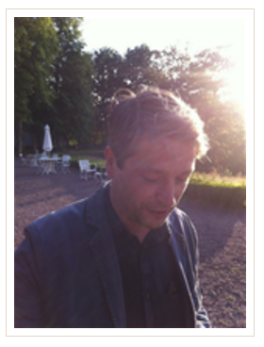
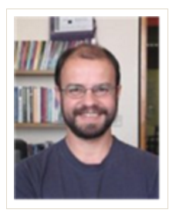
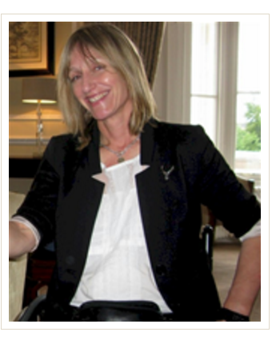
Working with departments to embed the AS-R
Department of Sociology
Head of Department
Employability Development Director
Education Director
Undergraduate Director
1st Year Director
Student Support Officer
……
……
Notes:
9
We have 22 departments organised into 3 faculties – Humanities, Science and Health, and Social Sciences. The 5 departments responded with different levels of engagement, but the negotiations were usually quite demanding politically – we needed to make sure we were talking to the right people – those who expected to be consulted, those whose teaching was most affected e.g. Sociology all worked very well.

Slide 10
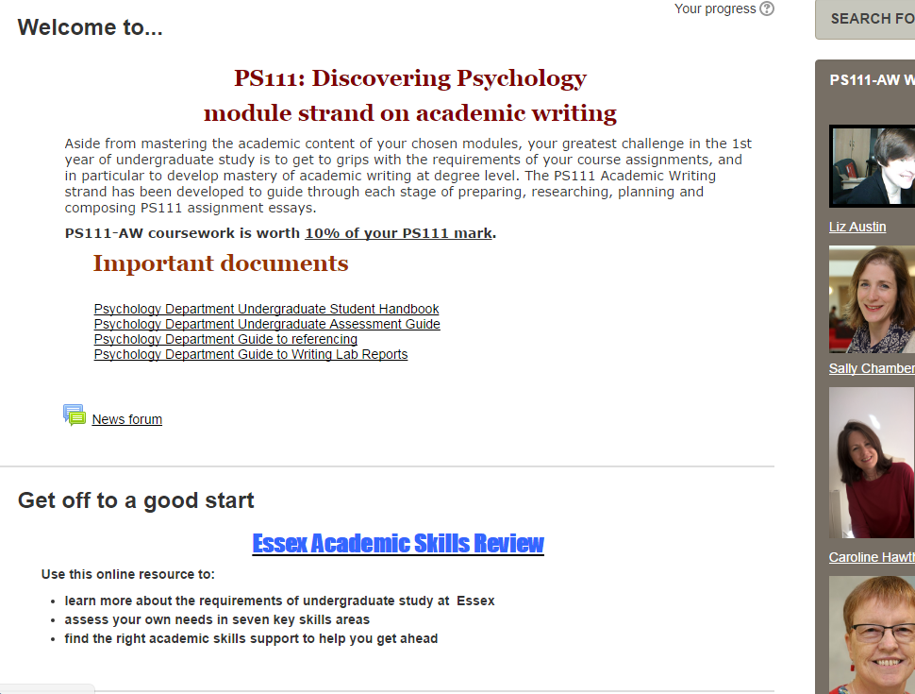
Academic Skills Review – embedded in core modules
Notes:
10
As for all our TDC Taught Programmes activities we have argued to work very closely with departments in designing and embedding the Acad Skills Review.
Here, for example is a module strand that we run for Psychology.
The students can take the review in Freshers Week – we are looking to open it pre-arrival
it is also signposted in the first lesson.
We discuss student ‘learning’ from the review in the 2nd class. Results go to the module leader.
,

Slide 11
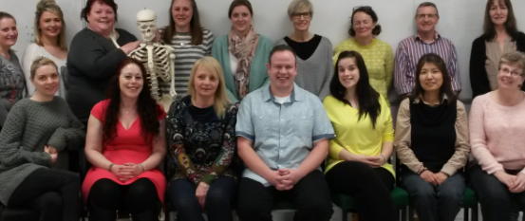
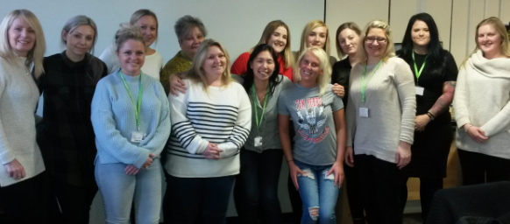
Academic Skills Follow-up: pilot
Nursing degree cohorts in department of Health and Human sciences at the end of 2 terms of study
Notes:
20
Dept that has engaged the most is HHS – run bespoke versions for different cohorts. They have their own embedded literacy and numeracy programme of study. They commissioned follow-up diagnostics based on the original review and we used this for our own focus group purposes.
There is just time to give you a flavour of the findings.

Slide 12
Student profiles
Mature students
Widening participation students
Speakers of English as an additional language
Q: “How satisfied are you with your progress on the course?”
Very pleased 31%
Mostly pleased 69%
A little disappointed 0%
Very disappointed 0%
Notes:
12
Student profile was quite particular
All were mature students
Many from widening participation who had already attended access programmes
Just 3 with English as an additional language
All were feeling very positive about their studies – to credit of the department

Slide 13
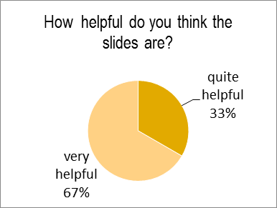
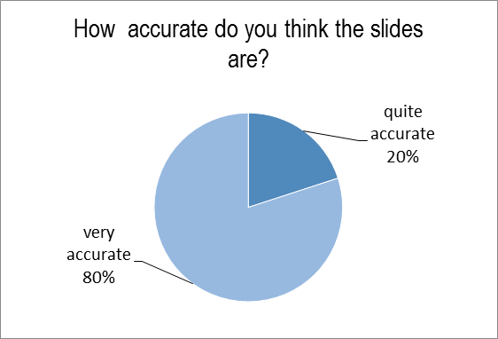
Review of slides
Q: How helpful do you feel the slides are?
Q: How accurate do you think the slides are?
Time management: “Makes work life balance look easier than it actually is. It does not really taken into account any curve balls “
Time management: “I would highlight the need to find out for yourself at the start of every term what work needs to be done, when it needs to be submitted – the need to plan early too, so as not be caught out and surprised”.
Tutorials: “this is one of the most important set of slide for a new student – not covered enough at the start of the course…”
Notes:
Reviewing the slides
They were quite complimentary overall but had clear suggestions for improvement
Big debate on whether the input should be spoken by a student. Maybe that we could include an audio element.
Could have different modes of input – text versus voice over with visuals only
Some debate on whether there was a lost opportunity to teach the skills highlighted
Lot of criticism of the branded appearance – fed up with blue..
Gave input on each of the sections of the following type, which we’ll work on:
So let’s have a look at that section:

Slide 14
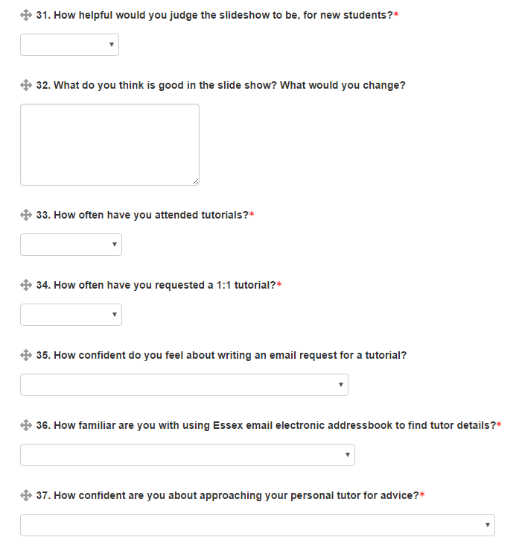
Notes:
Here are the type of questions used to follow up after 2 – terms; focus now on reported levels of confidence and reported practice

Slide 15
Q: How confident you feel about writing an email request for a tutorial?
Notes:
Interested that after 2 terms, and in a dept marked for excellent community spirit between student and staff, still see range of confidence…. That 11.7. represents 8 students

Slide 16
How confident are you about approaching your personal tutor for advice?
I don't have a Personal Tutor. | 7.1%
I would be confident to approach my Persona Tutor, but do not think they can offer much help. | 14.%
I am confident about approaching my Personal Tutor, and find their guidance helpful | 78%
Notes:
16
Responses are interesting – see that even a small group, practices pull apart. With larger numbers in follow-up trial we want to cross reference responses e.g. on levels of satisfaction and reported levels of participation – on the understanding that any eventual relationship may not be causal. Or as my student like to put it, there need not be a casual relationship.

Slide 17
Ways forward..
Trial an audio-visual version of the diagnostic
Transfer to more suitable survey tool allowing feedback to respondent
Develop bespoke versions for more departments and department programmes
Develop items to include more socio-cultural aspects of academic preparedness

