Slide 1
From Page to Pedagogy towards ‘signature profiles’ for EAP
Steve Kirk
Durham University

Slide 2
How do EAP teachers lift a lesson off the page at point of need?
Notes:
This is a question that drives part of my doctoral research, but this question came from practice and the answer matters for practice
…well it turns out they do it in quite different ways (and of course experience is not the same as expertise…)

Slide 3
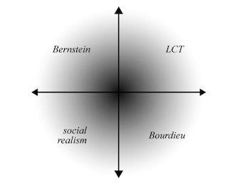
Legitimation Code Theory (LCT)
(Maton, 2014)

Slide 4
Legitimation Code Theory (LCT)
(Maton, 2014)
Semantics
‘gravity’
degree of context embeddedness
‘density’
degree of meaning condensed

Slide 5
Legitimation Code Theory (LCT)
(Maton, 2014)
Semantics
‘gravity’
degree of context embeddedness
‘density’
degree of meaning condensed

Slide 6
Semantic Gravity enacted in practice

Slide 7
The Durham Pre-Sessional
EAP Curriculum

Slide 8
context independent meanings (SG–)
context dependent meanings (SG+)

Slide 9
context independent meanings (SG–)
knowledge of the everyday in the university (SG+)
Notes:
(heading towards the next slide…) Seeing the semantic scale in our curriculum has helped me see and connect what we do in refined ways…

Slide 10
conceptual knowledge (SG–)
research ethics
criticality
stance/position
plagiarism
nominalisation
developing autonomy
module readings are usually available on DUO
in the Business School late assignments receive a mark of zero
knowledge of the everyday in the university (SG+)
Notes:
All of these are part of the ‘demystification’ that is central to what I think is powerful about what we do in EAP (+ e.g. qual/quant; library based/empirical; etc)
We talk with teachers about the ‘conceptual curriculum’ (…these things are of course embedded in texts, in practice, in repeated cycles…but…)
Also making the point that students need to know about these things explicitly (apprenticeship in central – but this is ‘knowing’, not ‘knowledge’…)
Not absolutes on the scale. Depends how these concepts appear in your curriculum…

Slide 11
conceptual knowledge (SG–)
cultural differences in perception of the ownership of knowledge
plagiarism
‘all work must be your own’
knowledge of the everyday in the university (SG+)
Notes:
Not absolutes on the scale. Depends how these concepts appear in your curriculum…

Slide 12
conceptual knowledge (SG–)
nominalisation
knowledge of the everyday in the university (SG+)
Notes:
Not absolutes on the scale. Depends how these concepts appear in your curriculum…

Slide 13
conceptual knowledge (SG–)
‘nominalisation works like an anti-gravity device for knowledge’
nominalisation
‘noun phrases are important in academic writing’
knowledge of the everyday in the university (SG+)
Notes:
Not absolutes on the scale. Depends how these concepts appear in your curriculum…

Slide 14
conceptual knowledge (SG–)
research ethics
relatively wide semantic range
in the Business School late assignments receive a mark of zero
knowledge of the everyday in the university (SG+)
Notes:
‘Signature feature’ of sorts: we have a wide semantic range in our curriculum.
It can create challenges for teachers relatively new to EAP – and particularly if they have not been through PG study themselves…

Slide 15
in curriculum
design | principles
Notes:
SO…HERE’S THE MODULE…AND ASSIGNMENT

Slide 16
why are things structured this way?
‘literature review’
structural analysis task
relevance to your writing assignment?
textual e.g.
(text time)
Notes:
What is a LR…where do you find them…what purpose to they serve...
This helps make visible the knowledge structure of a task sequence…And we’re actually quite good at waving :-) – though not always, and writers differ…
Plotting things in this way with materials writers potentially enables us to see and interrogate differences, effects on learning of different profiles, and to enable change, if need be…

Slide 17
purpose?
reflection
practice
experience of seminars
(text time)
Notes:
(TWO FIELDS – THE FIELD OF THE TEXT AND THE FIELD OF ‘EAP LEARNING’)

Slide 18
in pedagogy
observation & feedback
Notes:
SO…HERE’S THE MODULE…AND ASSIGNMENT

Slide 19
[teacher 1]

Slide 20
[research ethics / critical thinking]

Slide 21
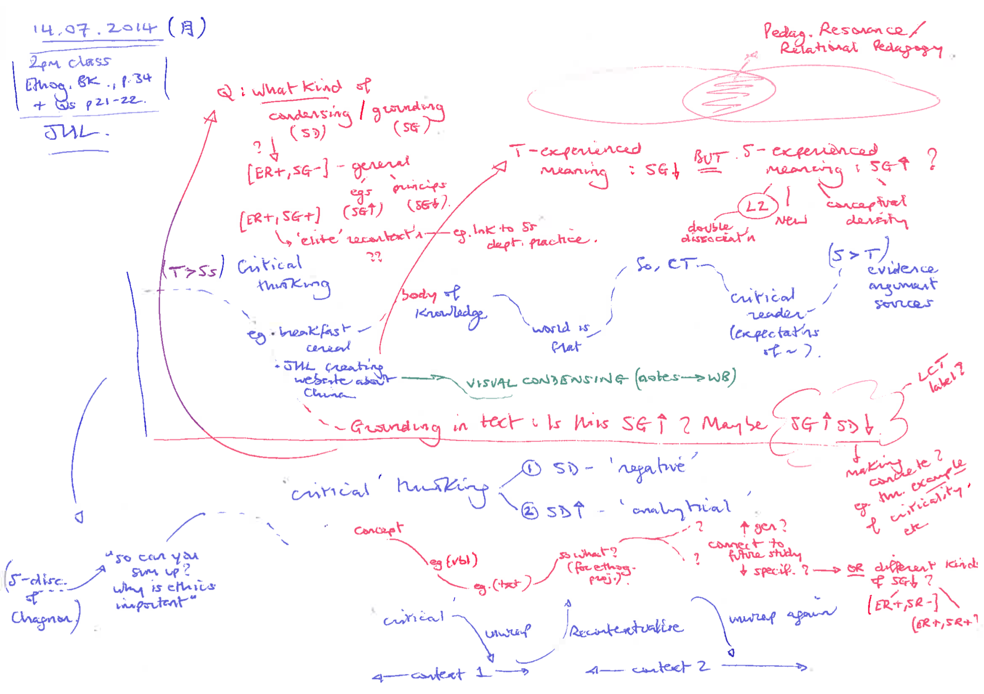
……………………
……………………

Slide 22
“so can you sum up, why is ethics important?”
Student discussion of Chagnon text
(ethics related case study)
(class time)
Notes:
So I did actually wave this live…

Slide 23
conceptual knowledge (SG–)
(Ss > T)
evidence;
arguments;
sources
‘critical
thinking’
‘critical
thinking’
‘body of
knowledge’
‘expectations of you as critical reader?’
e.g.
e.g.
(class time)
knowledge of the everyday in the university (SG+)
Notes:
So I did actually wave this live…

Slide 24
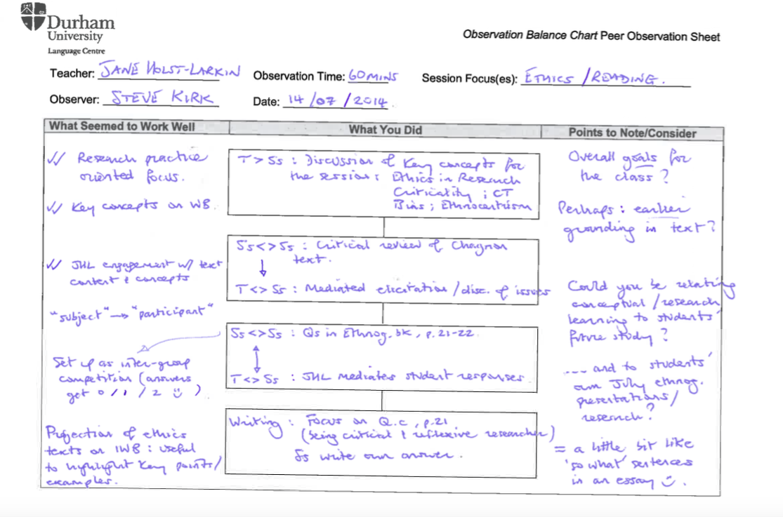
……………………
……………………
“Overall goals for the class?”

Slide 25
……………………
……………………
“Perhaps: earlier grounding in text?”

Slide 26
……………………
……………………
“Could you be relating conceptual/research learning to students’ future study?”
“…and to students’ own July ethnography presentations / research?”

Slide 27
“you need to wave down”

Slide 28
[teacher 2]

Slide 29
[noun phrases for reading]

Slide 30
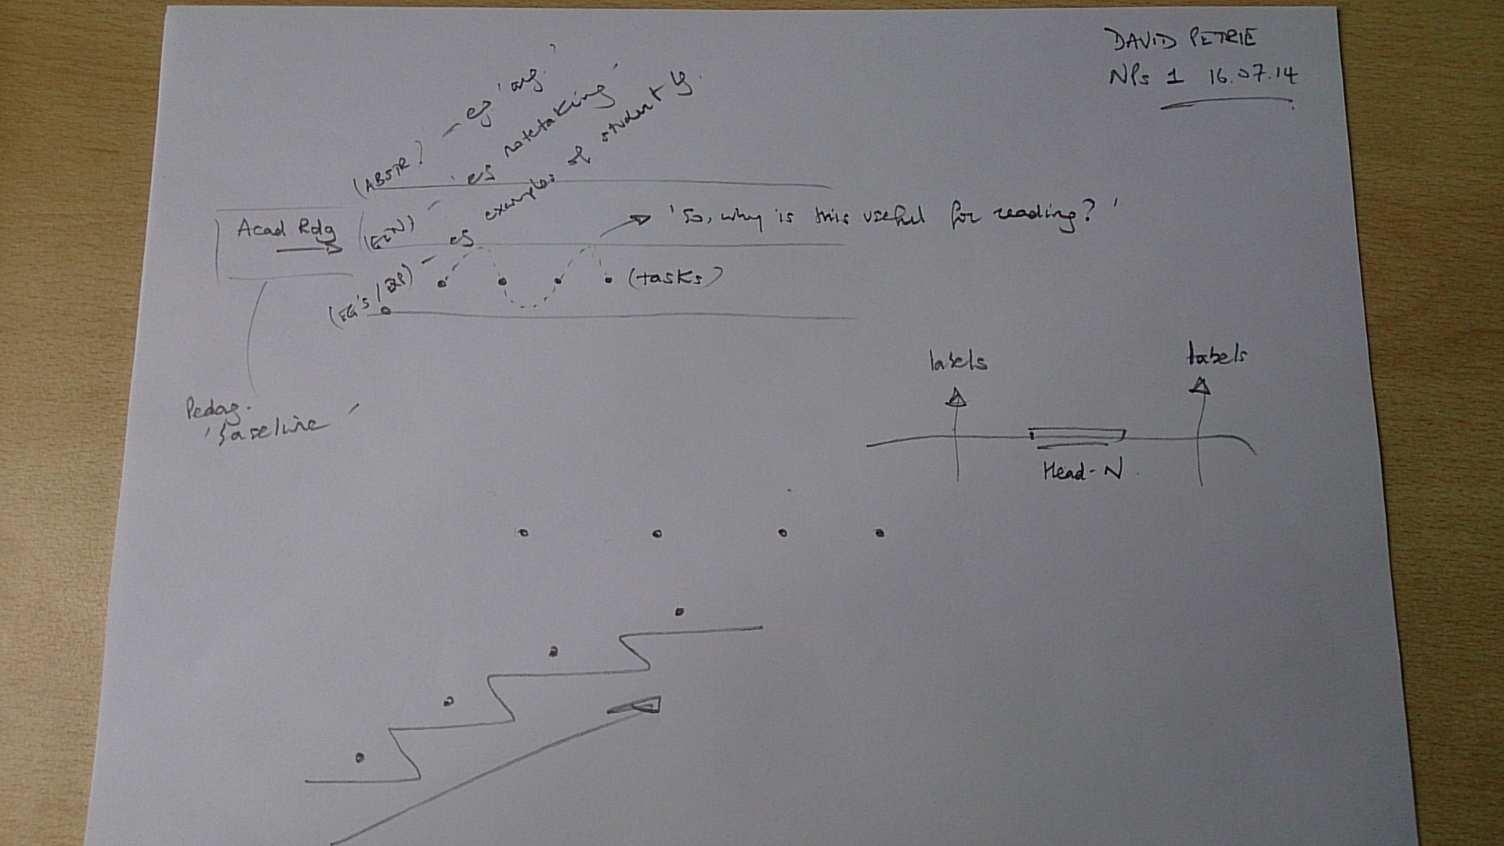
feedback on
teaching observation
……………………

Slide 31
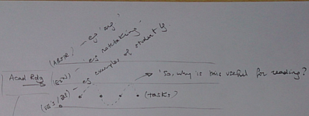
feedback on
teaching observation
“So, why is this useful for reading?”

Slide 32
feedback on
teaching observation
……………………

Slide 33
“What was the purpose of this? You move quickly to the next task without comment”
……………………
……………………

Slide 34
“Why miss out the input sections of the materials?”
……………………
……………………

Slide 35
“Remember to connect tasks to purpose…and to each other. Is there cumulative building across a task sequence?”
……………………
……………………

Slide 36
“you need to wave up”

Slide 37
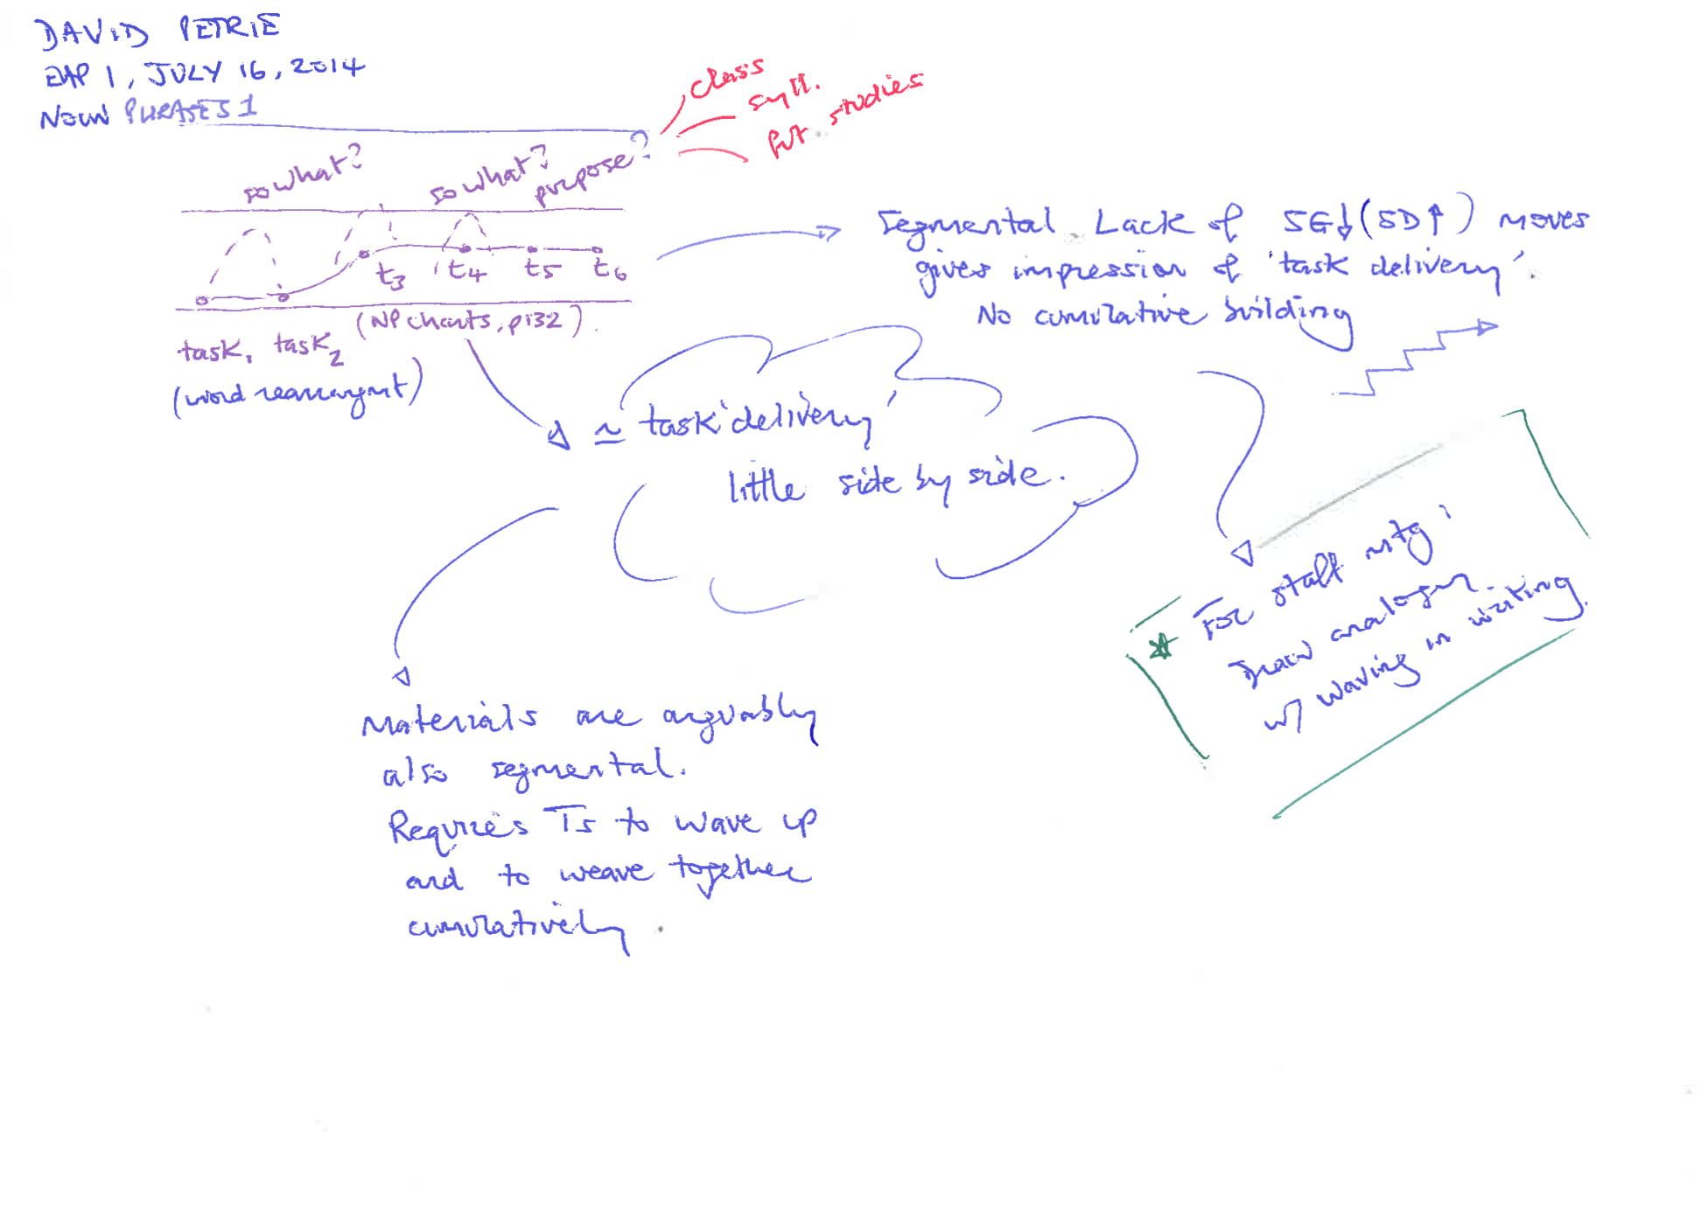
……………………
……………………
“Segmental…gives impression of ‘task delivery’. No cumulative building”
personal, post-session notes

Slide 38
……………………
……………………
“Materials are arguably also segmental. Requires Ts to wave and weave together cumulatively.”
personal, post-session notes

Slide 39
……………………
……………………
“For staff mtg: Draw analogy with waving in writing.”
personal, post-session notes

Slide 40
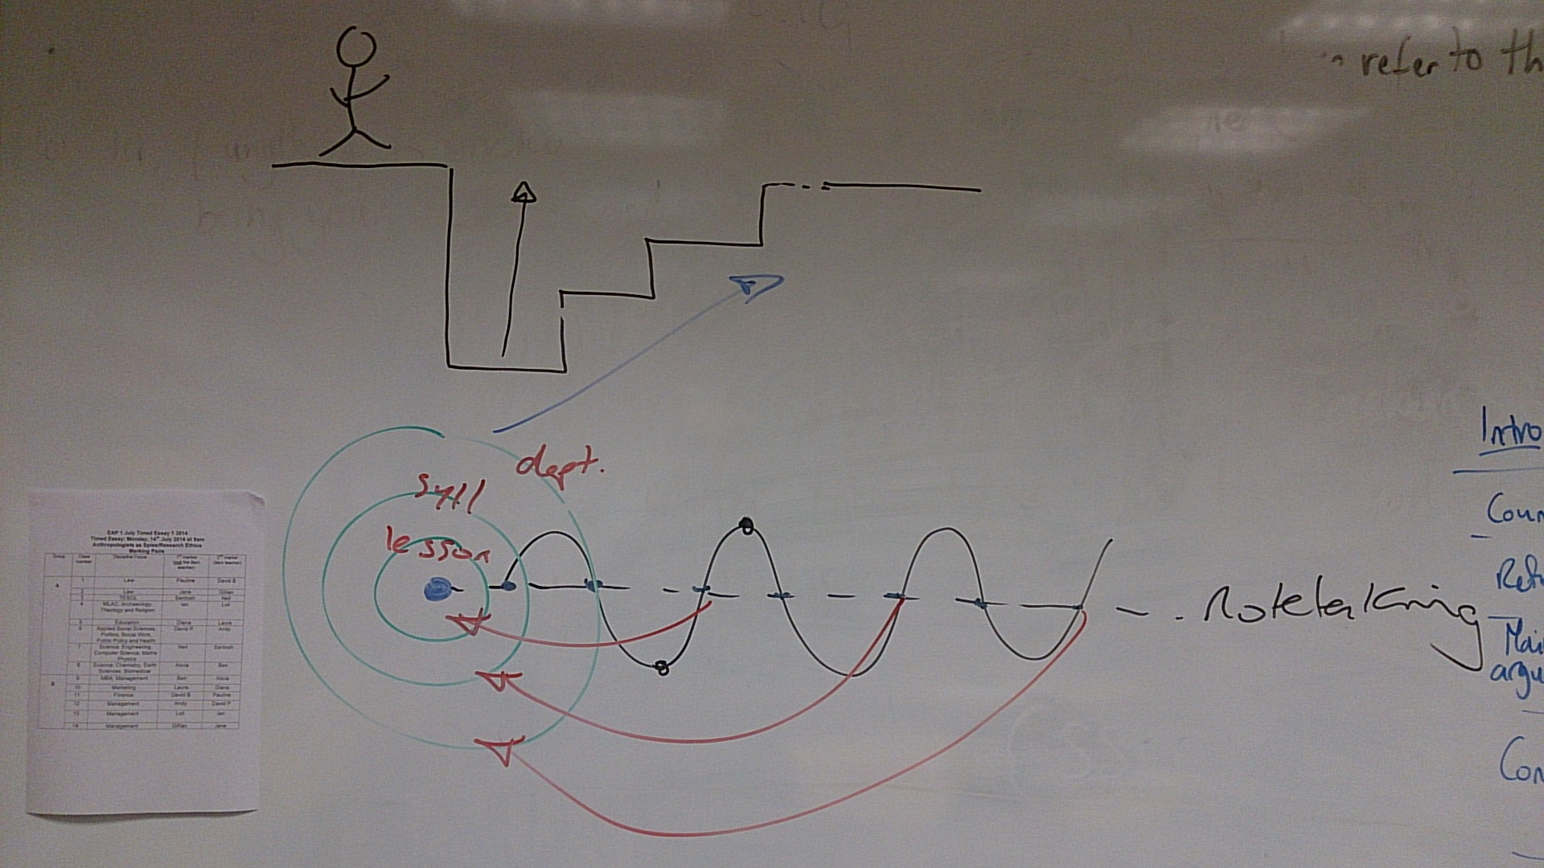
conversation with all teachers
Notes:
As a result of lesson observations: did this for all EAP 1 teachers at staff meeting (17.07.14)

Slide 41
from page to pedagogy
signature profiles

Slide 42
talk
task
text
over class time
task
(talk…)
talk
text
over class time
Notes:
Talk <> text <> task
Text <> talk <> text
Point: wave created between the curriculum artifact and the pedagogy + traces a cumulative wave (with differing entry/exit points)

Slide 43
talk
“connect to students’ departments”
task
text
“concrete takeaways”
over class time
“bring it back to why it matters on this course”
Notes:
Talk <> text <> task
Text <> talk <> text
Point: wave created between the curriculum artifact and the pedagogy + traces a cumulative wave (with differing entry/exit points)

Slide 44
conceptual curriculum
(e.g. criticality; autonomy)
disciplinary values
“the whyness”
task
(talk…)
talk
text
over class time
Notes:
Talk <> text <> task
Text <> talk <> text
Point: wave created between the curriculum artifact and the pedagogy + traces a cumulative wave (with differing entry/exit points)

Slide 45
Closing
summary notes
Notes:
SO…HERE’S THE MODULE…AND ASSIGNMENT

Slide 46
not a search for ‘universals’…

Slide 47
local ‘rules of the game’

Slide 48
local enactments of EAP
…are real
…but historically contingent
(they change over time)

Slide 49
LCT
makes the tacit explicit… enabling greater negotiation of understanding
Notes:
SO…HERE’S THE MODULE…AND ASSIGNMENT

Slide 50
enables a shared metalanguage in planning & pedagogy
Notes:
SO…HERE’S THE MODULE…AND ASSIGNMENT

Slide 51
Makes visible the
organising principles
of our materials & their enactment…
…providing the basis for
development & change
Notes:
SO…HERE’S THE MODULE…AND ASSIGNMENT

Slide 52
thank you

Slide 53
References
Maton, K. (2014) Knowledge and Knowers – towards a realist sociology of education. London: Routledge

Slide 54
s.e.kirk@durham.ac.uk
@stiivkirk

