Slide 1
Unlocking Academic Success: Co-Creation in Boosting Learner Engagement
Dr. Dina Strong & Dr. Aled Rees
King’s Foundations, King’s College London

Slide 2
Challenges in EAP Foundation Year
Deep Learning:
Students face time management challenges (Stasolla et al., 2025)
Pre-Covid passive learning dominates, now disrupted by AI and tech
Need to shift from teacher-led delivery to student-centred learning
Student Engagement:
Motivation gaps and reduced participation (Salayo et al., 2024)
Classroom distractions reduce peer interaction
Whole-class co-creation underused in curricula (Bovill, 2019)
Students feel they’ve “missed out” on how to engage with others (QAA, 2023, p. 19)
Call for learning that “thrives on interaction, connection, and togetherness” (QAA, 2023, p. 17)

Slide 3
Challenges in EAP Foundation Year (continued)
Critical Thinking:
Uncertainty around academic expectations (Cottrell, 2017)
Overreliance on AI tools weakens analytical effort (The Guardian, 2025)
Authentic Materials:
Materials can pose linguistic and cultural challenges (Treve, 2023)
Often misaligned with students’ academic readiness

Slide 4
Co-Creation as Catalyst: Elevating Skills = Engaging Minds
Deep Learning
Active engagement (Bovill, 2019)
Collaborative knowledge building
Student Engagement
Empowerment through partnership (Dollinger & Lodge, 2020)
Inclusive learning environment
Critical Thinking
Exposure to diverse viewpoints supports reflective thinking (Brookfield, 2012)
Opportunities for authentic problem-solving deepen cognitive engagement (Savery, 2006)
Authentic Material Design
Co-created materials ensure relevance to students' lived experiences (Bovill, 2019; Healey et al., 2014)
Practical applications connect learning to real-world contexts (Herrington & Herrington, 2006)

Slide 5
Introduction to co-creation project
Module: Academic Expression & Critical Thinking (AECT)
Students with an overall IELTS of 7.0 and above with no more than 3 subskills below 6.5
4 groups (58 students in total).
Writing overall average lowest (6.0-7.5)
Module Assessment:
Written Essay (40%), Speaking & Listening Exam (40%), Reading Exam (20%)
Module learning outcomes (include but not limited to:)
Apply critical thinking skills to evaluate and utilize arguments, data, concepts and theories from academic sources to build and support a well-constructed line of argument.
Produce written and oral work that adheres to disciplinary conventions in a range of academic fields, acknowledging differences between them.
Find and select academically appropriate sources on a range of topics.

Slide 6

Overview of co-creation project
Integrate 3 student > student co-creation tasks into AECT lessons and seminars to support academic essay writing
Task 1: Co-created reconfiguration of the CRAAP test
Task 2: Co-created essay revision guide (in the form of a poster / PPT and a quiz)
Task 3: Co-created problem & solution essay checklist

Slide 7
Task 2: Co-created Revision Guide & Quiz for Formative Essay
Formative Assessment:
Students write 600-word formative essay in class under exam conditions.
They received feedback on their use and application of most of the skills that had been covered so far on the module:
Thesis statements
Argumentation
Paraphrasing
Synthesis
Citations
Academic Style
Hedging
Co-creation Task (in-class):
In groups, students create a revision guide in the form of a poster / PPT and a quiz on one of the skills to share with other students.
Groups presented their revision guide to the class, answered any questions and delivered the quiz.
The revision guides, quizzes and answers were shared with everyone on class Teams Channel

Slide 8

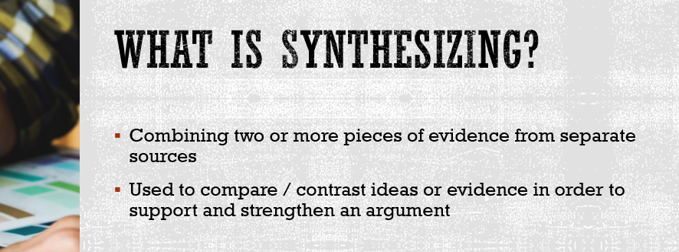

Task 2: Co-created Revision Guide & Quiz for Formative Essay

Slide 9
Task 3: Co-created Essay Checklist for Summative Essay
Co-creation Task (in class):
In groups, create a detailed essay checklist that can be used to revise, edit and proofread your essay to ensure that you are including and covering all things necessary to submit a good essay.
Step 1: Decide the most logical flow of the essay and identify the principal structural/organisational components of the essay.
Step 2: Think of a series of questions related to each of these components that will ensure that you are submitting a strong, complete and well-organised essay
Step 3: Formulate the questions to give a YES / NO answer.
Step 4: Share your checklist with another group and provide feedback. Has anything been missed out?

Slide 10
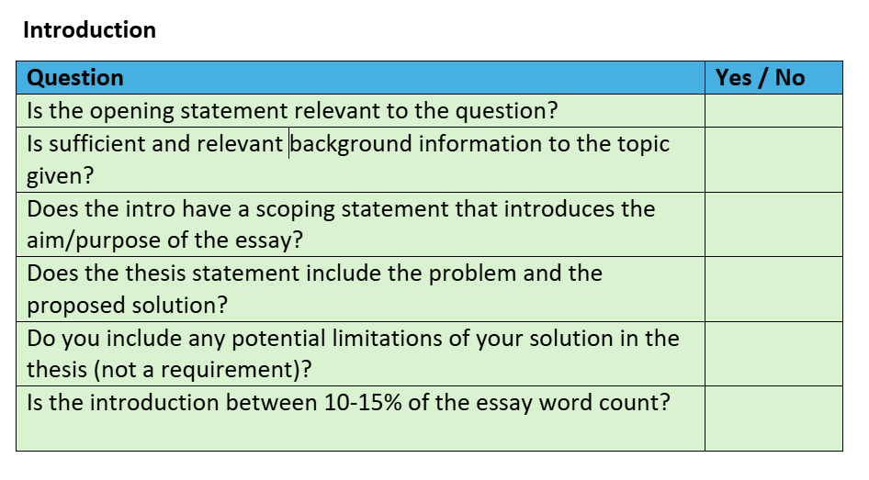
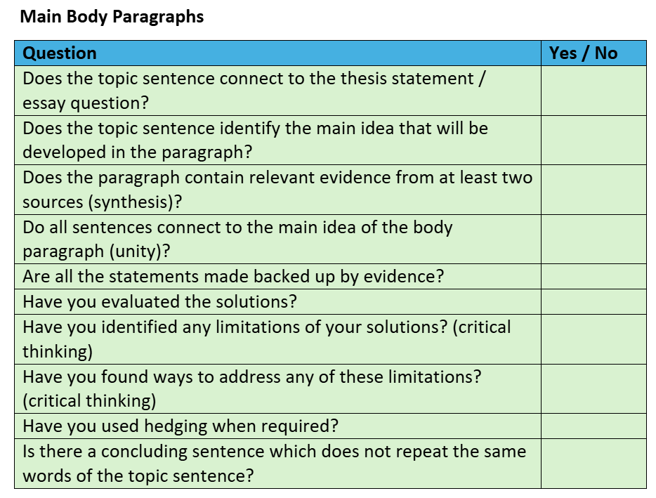
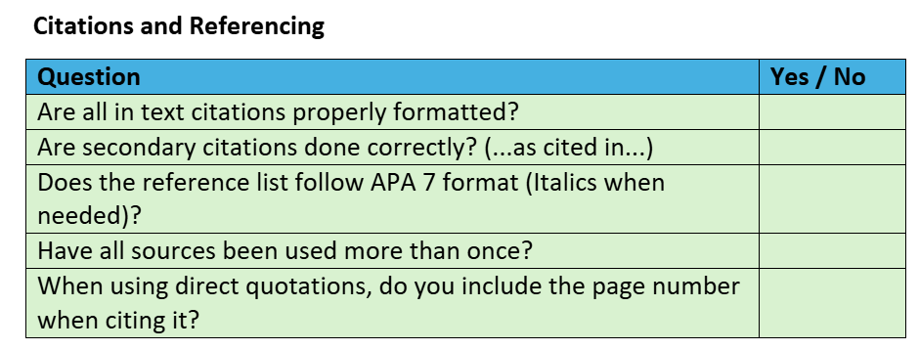
Task 3: Examples of co-created summative essay checklist

Slide 11
Task 1: CRAAP test co-creation
Co-creation Task:
Make the CRAAP Test more accessible and understandable to international foundation year students
Independent Group Work before Class:
Step 1: Review the current CRAAP criteria
Step 2: Adding new criteria to CRAAP test
Step 3: Reviewing and editing CRAAP cue questions
Step 4: Review the format of CRAAP test
Step 5: Create a new, updated version of CRAAP test
Classroom Activity:
Step 6: Present the new CRAAP test and answer questions from classmates
Step 7: Exchange CRAAP tests with another group to test each other's versions on sources
Step 8: Following the presentation and comments from other groups, reflect on the new CRAAP test and make final changes

Slide 12
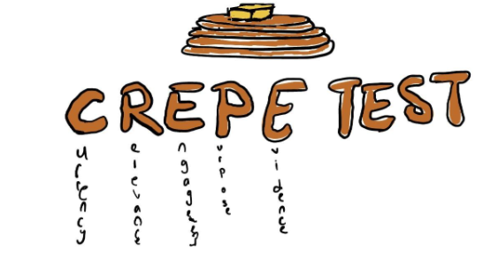
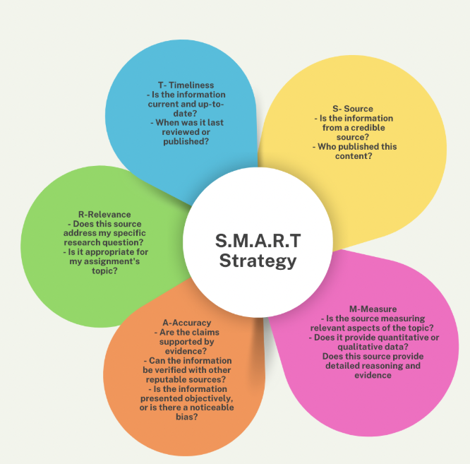
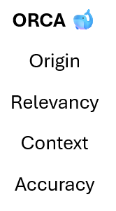
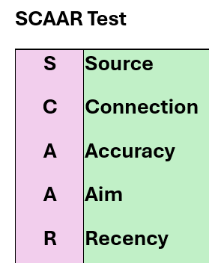
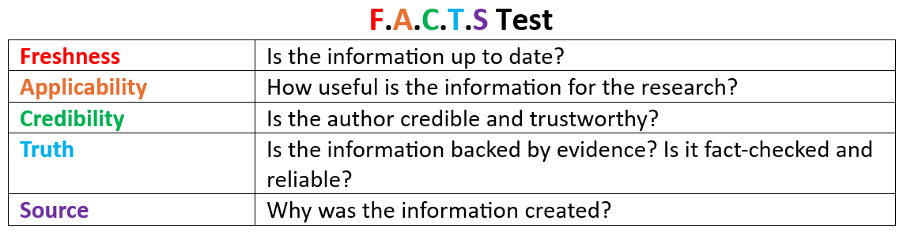
Task 1: Examples of updated CRAAP test

Slide 13
Student peer-review and evaluation of updated CRAAP tests
Following the presentation and questions, groups exchanged their CRAAP tests and provided written
comments, feedback and suggestions.
Appropriacy for the Target Audience:
“Liked the application of colours, acts an easier visual aid for KIF students to apply”
"I feel like freshness sounds a little odd, however I do understand how this word could be a bit easier for KIF students to understand"
"Source - my group also chose to use this as a new category. I think it is a better term to have KIF students look at the broader origins of a piece of information and not just the author"
"Recency makes more sense since currency could be misinterpreted since it also means money"
Depth of Source Evaluation
"While evaluating a source, we should be more thorough with more steps, rather than taking away steps since more steps of evaluation ensures that the source is reliable"
Memorability:
"I feel like there are too many things to consider in each category. Yes, there are less criteria to look at now, which is simpler but at the cost of more sub-questions for each criteria which complicates it once again"
“Separating transparency and objectivity is good as it allow for the capture of bias and further analysis. I think generally the changes are good, but it makes it longer which may make it less rememberable, but it also gives students a better checklist”

Slide 14
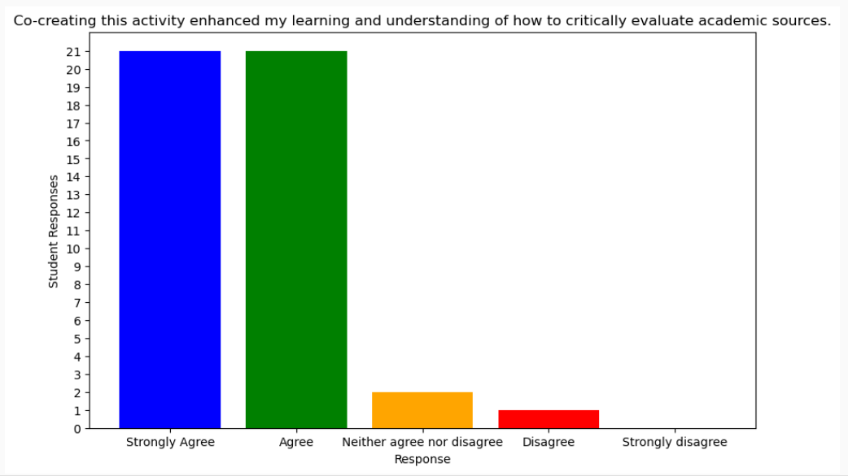
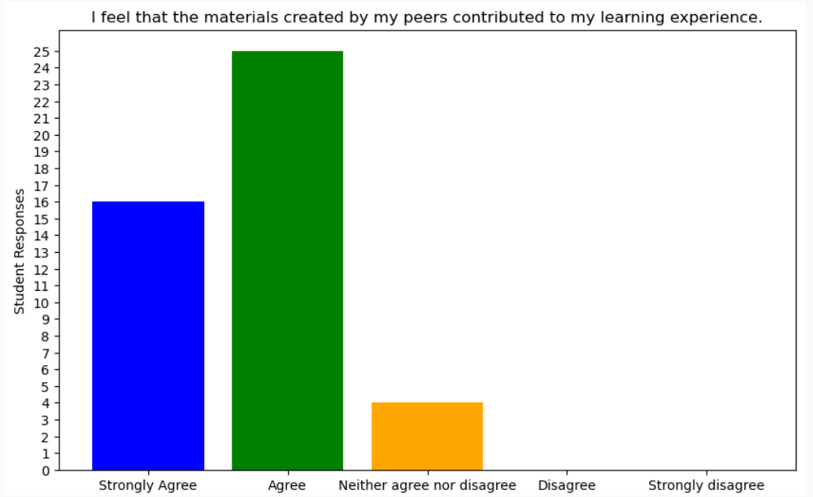
Student Feedback on CRAAP co-creation task
Co-creating this activity enhanced my learning and understanding of how to critically evaluate academic sources.
I feel that the materials created by my peers contributed to my learning experience.

Slide 15
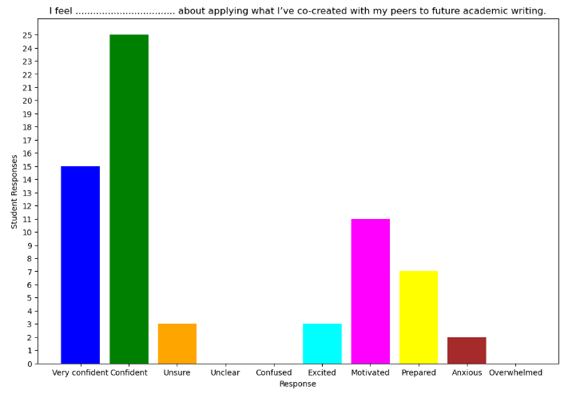
Student Feedback on CRAAP co-creation task
Fill in the gap to complete the sentence. Select all that apply:
I feel ................................ about applying what I’ve co-created with my peers to future academic writing.

Slide 16
Student Feedback on CRAAP co-creation task
Complete the sentence with the options below. Select all that apply.
Co-creating materials on evaluating academic sources has made me feel ...........
Chosen response | Student Responses
More interested in the topic | 18
More motivated to learn | 22
More involved with the topic | 28
Better connected to the topic | 18
No different about the topic | 3
Less interested in the topic | 0
Confused about the topic | 1

Slide 17
Written student feedback on CRAAP co-creation task
Critical thinking & access to different perspectives
“It broadened my understanding of different perspectives and others’ point of view”
“It was useful to judge the other groups works to think about is this enough to use or not in order to understand the sources”
“Feedback from them helped me think more critically about why we had chosen these categories”
"This helped me think critically about what each category really means and how we can remember it"
Deep learning
“Deepened understanding on how to critically evaluate sources”
“It was a great way to dive deeper in the topic”
“I really did benefit from class discussion when each group explained their work”
“I thought it was challenging to memorize steps. However, after this activity, I have grasped the concept”
“When I first learned the CRAAP test I had to look to the definitions of each one when using it. Now that we did this activity, I remember all of it very well it helped me to stick it to my brain”

Slide 18
CRAAP insights from TII essay tutor feedback
Areas of Strength | Areas of Development
"You demonstrate a great use of sources." | "You have used two extra sources which is good that you are searching for extra support to your ideas, but the first one is irrelevant and the second is not exploited enough given that it contains evidence very pertinent to your argument about sharenting."
"Good use of sources. You effectively synthesised ideas from multiple sources." | "This is a rather old source considering the changing nature of this topic..."
"Some good use of evidence from sources" | "One of your additional sources lacks relevance.."
"You exploit the sources to a good degree."
"Really good to include this kind of data from an additional source to strengthen the argument along with the voices from the various authors in the source pack."

Slide 19
Conclusion: Co-Creation in Learning
Positive Outcomes:
Students appreciated the co-creation approach, noting its lasting impact.
Exposure to diverse perspectives enhanced analytical skills.
Authentic tasks boosted student involvement.
Challenges:
Some students felt uncertain, as this method differed from their prior experiences.
Hesitancy regarding the reliability of peer-created content.
Recommendations:
Incorporate more co-created materials to foster creativity and deeper learning.
Offer guidance to ease the transition into peer-led learning.
Engage students directly in co-designing curricula and assessment methods.

Slide 20
References
Bovill, C. (2019). Co-creation in learning and teaching: The case for a whole-class approach in higher education. Higher Education, 79(6), 1023–1037. https://doi.org/10.1007/s10734-019-00453-w
Brookfield, S. D. (2012). Teaching for critical thinking: Tools and techniques to help students question their assumptions. Jossey-Bass.
Cottrell, S. (2017). Critical thinking skills: Effective analysis, argument and reflection (3rd ed.). Palgrave Macmillan.
Dollinger, M., & Lodge, J. M. (2020). Co-creation strategies for enhancing student engagement in higher education. Higher Education Research & Development, 39(2), 219–233. https://doi.org/10.1080/07294360.2019.1670149
Healey, M., Flint, A., & Harrington, K. (2014). Engagement through partnership: Students as partners in learning and teaching in higher education. Higher Education Academy. https://www.advance-he.ac.uk/knowledge-hub/engagement-through-partnership-students-partners-learning-and-teaching-higher
Herrington, J., & Herrington, A. (Eds.). (2006). Authentic learning environments in higher education. IGI Global. https://doi.org/10.4018/978-1-59140-594-8
Quality Assurance Agency for Higher Education (QAA). (2023). The future of learning and teaching in higher education: A student perspective. Gloucester: QAA. https://www.qaa.ac.uk/membership/collaborative-enhancement-projects/student-experience/student-experience-and-student-expectations-in-a-post-pandemic-teaching-and-learning-environment
Salayo, R., Chen, K., & Al-Muhandis, A. (2024). Engagement and attention in post-pandemic classrooms: A multi-institutional study. Journal of Higher Education Innovation, 18(2), 55–72.
Savery, J. R. (2006). Overview of problem-based learning: Definitions and distinctions. Interdisciplinary Journal of Problem-Based Learning, 1(1), 9–20. https://doi.org/10.7771/1541-5015.1002
Stasolla, M., Deng, T., & Reid, L. (2025). Time management and learning autonomy in the age of AI. Educational Research Review, 40, Article 100567.
The Guardian. (2025, March 2). Universities warn that AI tools are ‘eroding student thinking’. https://www.theguardian.com/education/2025/mar/02/universities-warn-that-ai-tools-are-eroding-student-thinking
Treve, D. (2023). Language and culture in academic materials: Bridging the gap. International Journal of Academic Development, 28(1), 33–45.

