Slide 1

Staff perspective of student voice and its (in)authenticity in reflective writing for summative assessment
Micky Ross University of Glasgow
Tom Raymond London South Bank University
Aneta Marren University of Glasgow
Alexander Vaniev University of Glasgow

Slide 2
Rationale for study
Need for institutional provision for reflective writing
  Institution asynchronous cross-disciplinary resource did not exist at the time.
  Agreement that this should be informed by institutional needs rather than generic
  Need to develop a stronger understanding of current reflective writing practice at institution.
  Better understand needs of students involved in reflective writing for summative assessment at institution.
  Improve student reflective writing skills assignments and assessment literacies across disciplines.
Sense that reflective writing was widely used across institution
Actual usage unknown
Strong proponents of reflective writing for summative assessment
Research questions
What are the reasons for introducing reflective writing for summative assessment?
What support is provided for student who undertake reflective writing for summative assessment?
What is the staff experience of reflective writing for summative assessment?
(What is the student experience of reflective writing for summative assessment?)
Notes:
Tom

Slide 3
Literature
Main reasons for setting reflective writing for summative assessment
Usefulness of recording learning; Self-assessment and autonomy – especially for professional practice (Chan, Lee, 2020)
Support provided to students
Reflective writing assessment criteria; writing workshops; peer/tutor feedback
Staff experience
Concerns over reliability; validity and performativity (Hargreaves, 2004; Hobbs, 2007; Moniz et al, 2015); concerns over consistency of marking (Jindal-Snape, Holmes, 2009); discussion over value of rubric (Stewart and Richardson, 2000); ethical considerations over power imbalance between staff and student – loss of voice
Student experience
Develop learning and connect to real world experiences; being unfamiliar with emotional forms of writing and reflection; revisiting traumatic experiences; ethical concerns over exposing vulnerabilities and power dynamics (Marsh, 2013)
Notes
Limited research literature on reflective writing for summative assessment – 22 of 33 gathered in systematic review addressed RQs
See systematic literature review (Ross et al., 2024)
Notes:
Micky

Slide 4
Methods and analysis
Web scraping
  Systematic data collection method that automates retrieval/processing of large amounts of publicly available web data
  (Mitchell, 2018)
  The summative assessment descriptions of the institutional course catalogue web pages (n = 5155)
Questionnaire (staff)
  Questionnaire gathered data from university teaching staff (n=109) using 5 point strongly agree to strongly disagree Likert scale
  Participants were recruited via internal university networks such as the scholarship for teaching and learning net work.
  Descriptive quantitative analysis (Cohen et al., 2018) was applied to data
  Focus groups (students)
  Questions discussed across 3 focus groups (n=11) related experiences in reflective writing process.
  Participants were master's and PhD-level students who were recruited through their course tutors.
  A visual, based arts approach was employed as a form of thematic analysis – see findings.
Ethics
  All ethical approval was gained before data collection
Notes:
Tom

Slide 5
Findings: web scraping
Summary of findings:
393 out of 5155 (~8%) of courses had at least one reflective writing assignment in their assessment.
Courses taught in social sciences, arts and humanities, and veterinary science/medicine tended to have more reflective writing assessment elements
PGT courses tended to have the largest share of reflective writing assignments, followed by UG Honours.
Essays, portfolio, reflective reports, journal/diaries, logs/blogs most common
Notes:
Tom

Slide 6
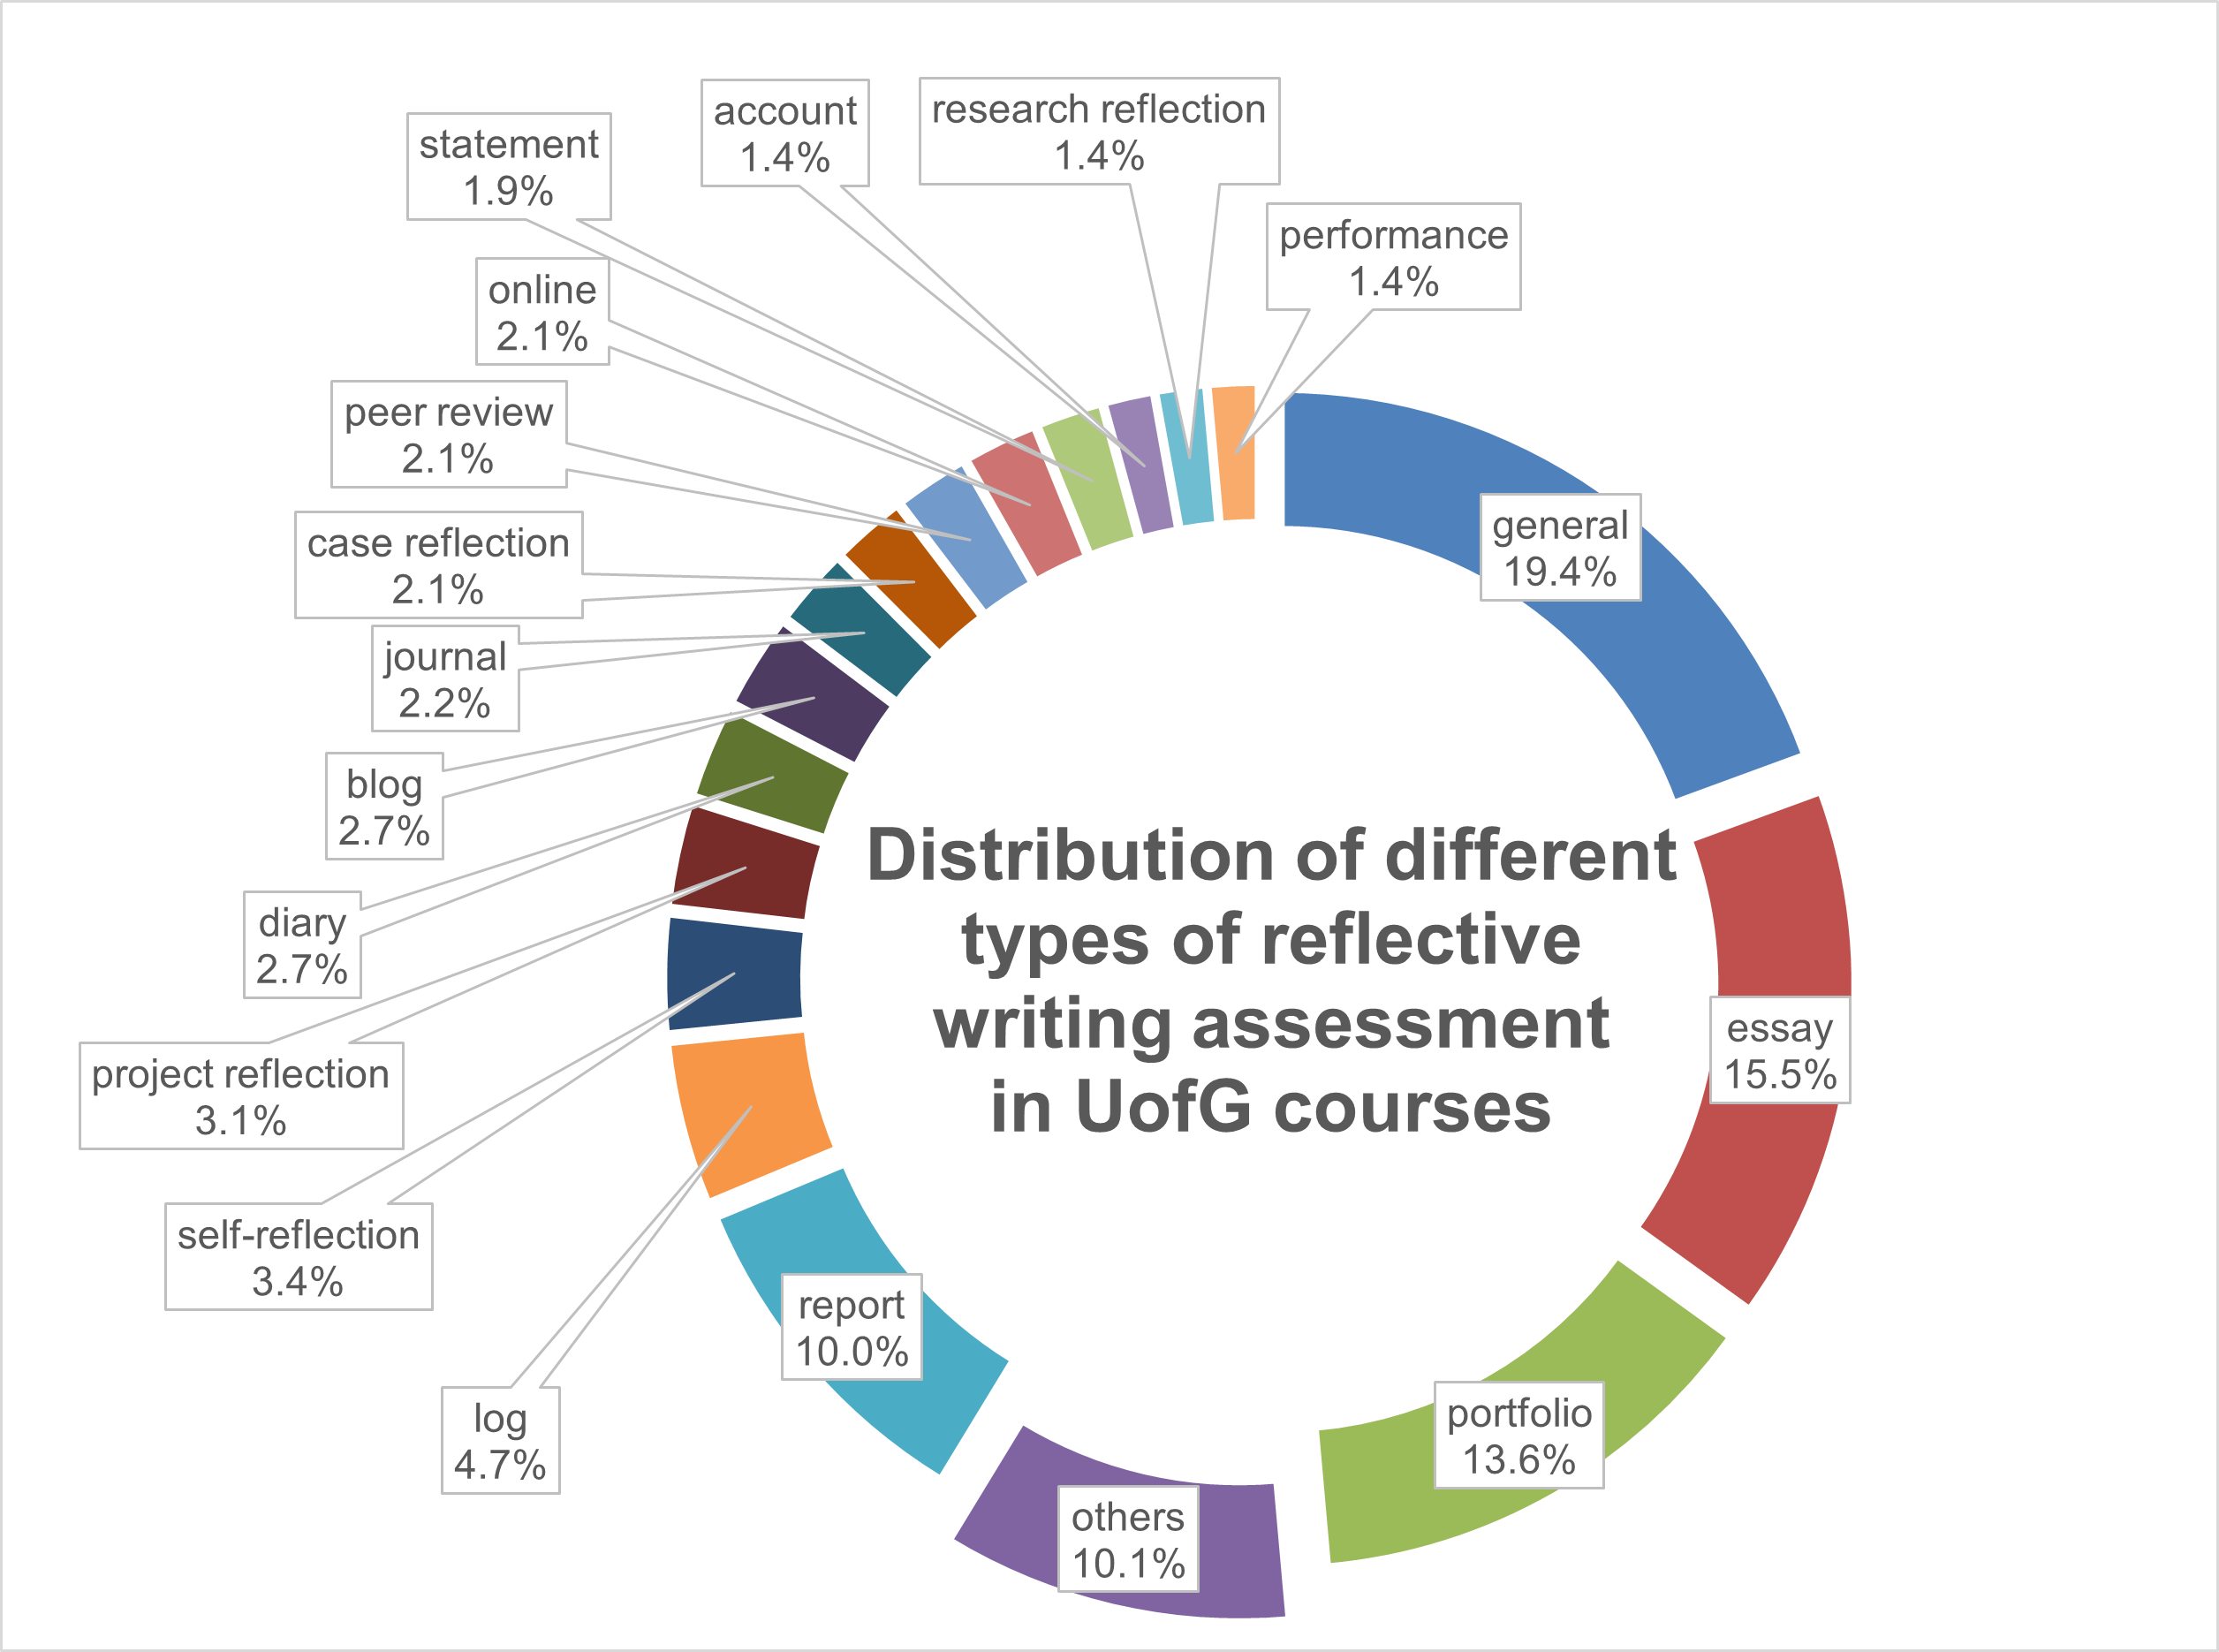
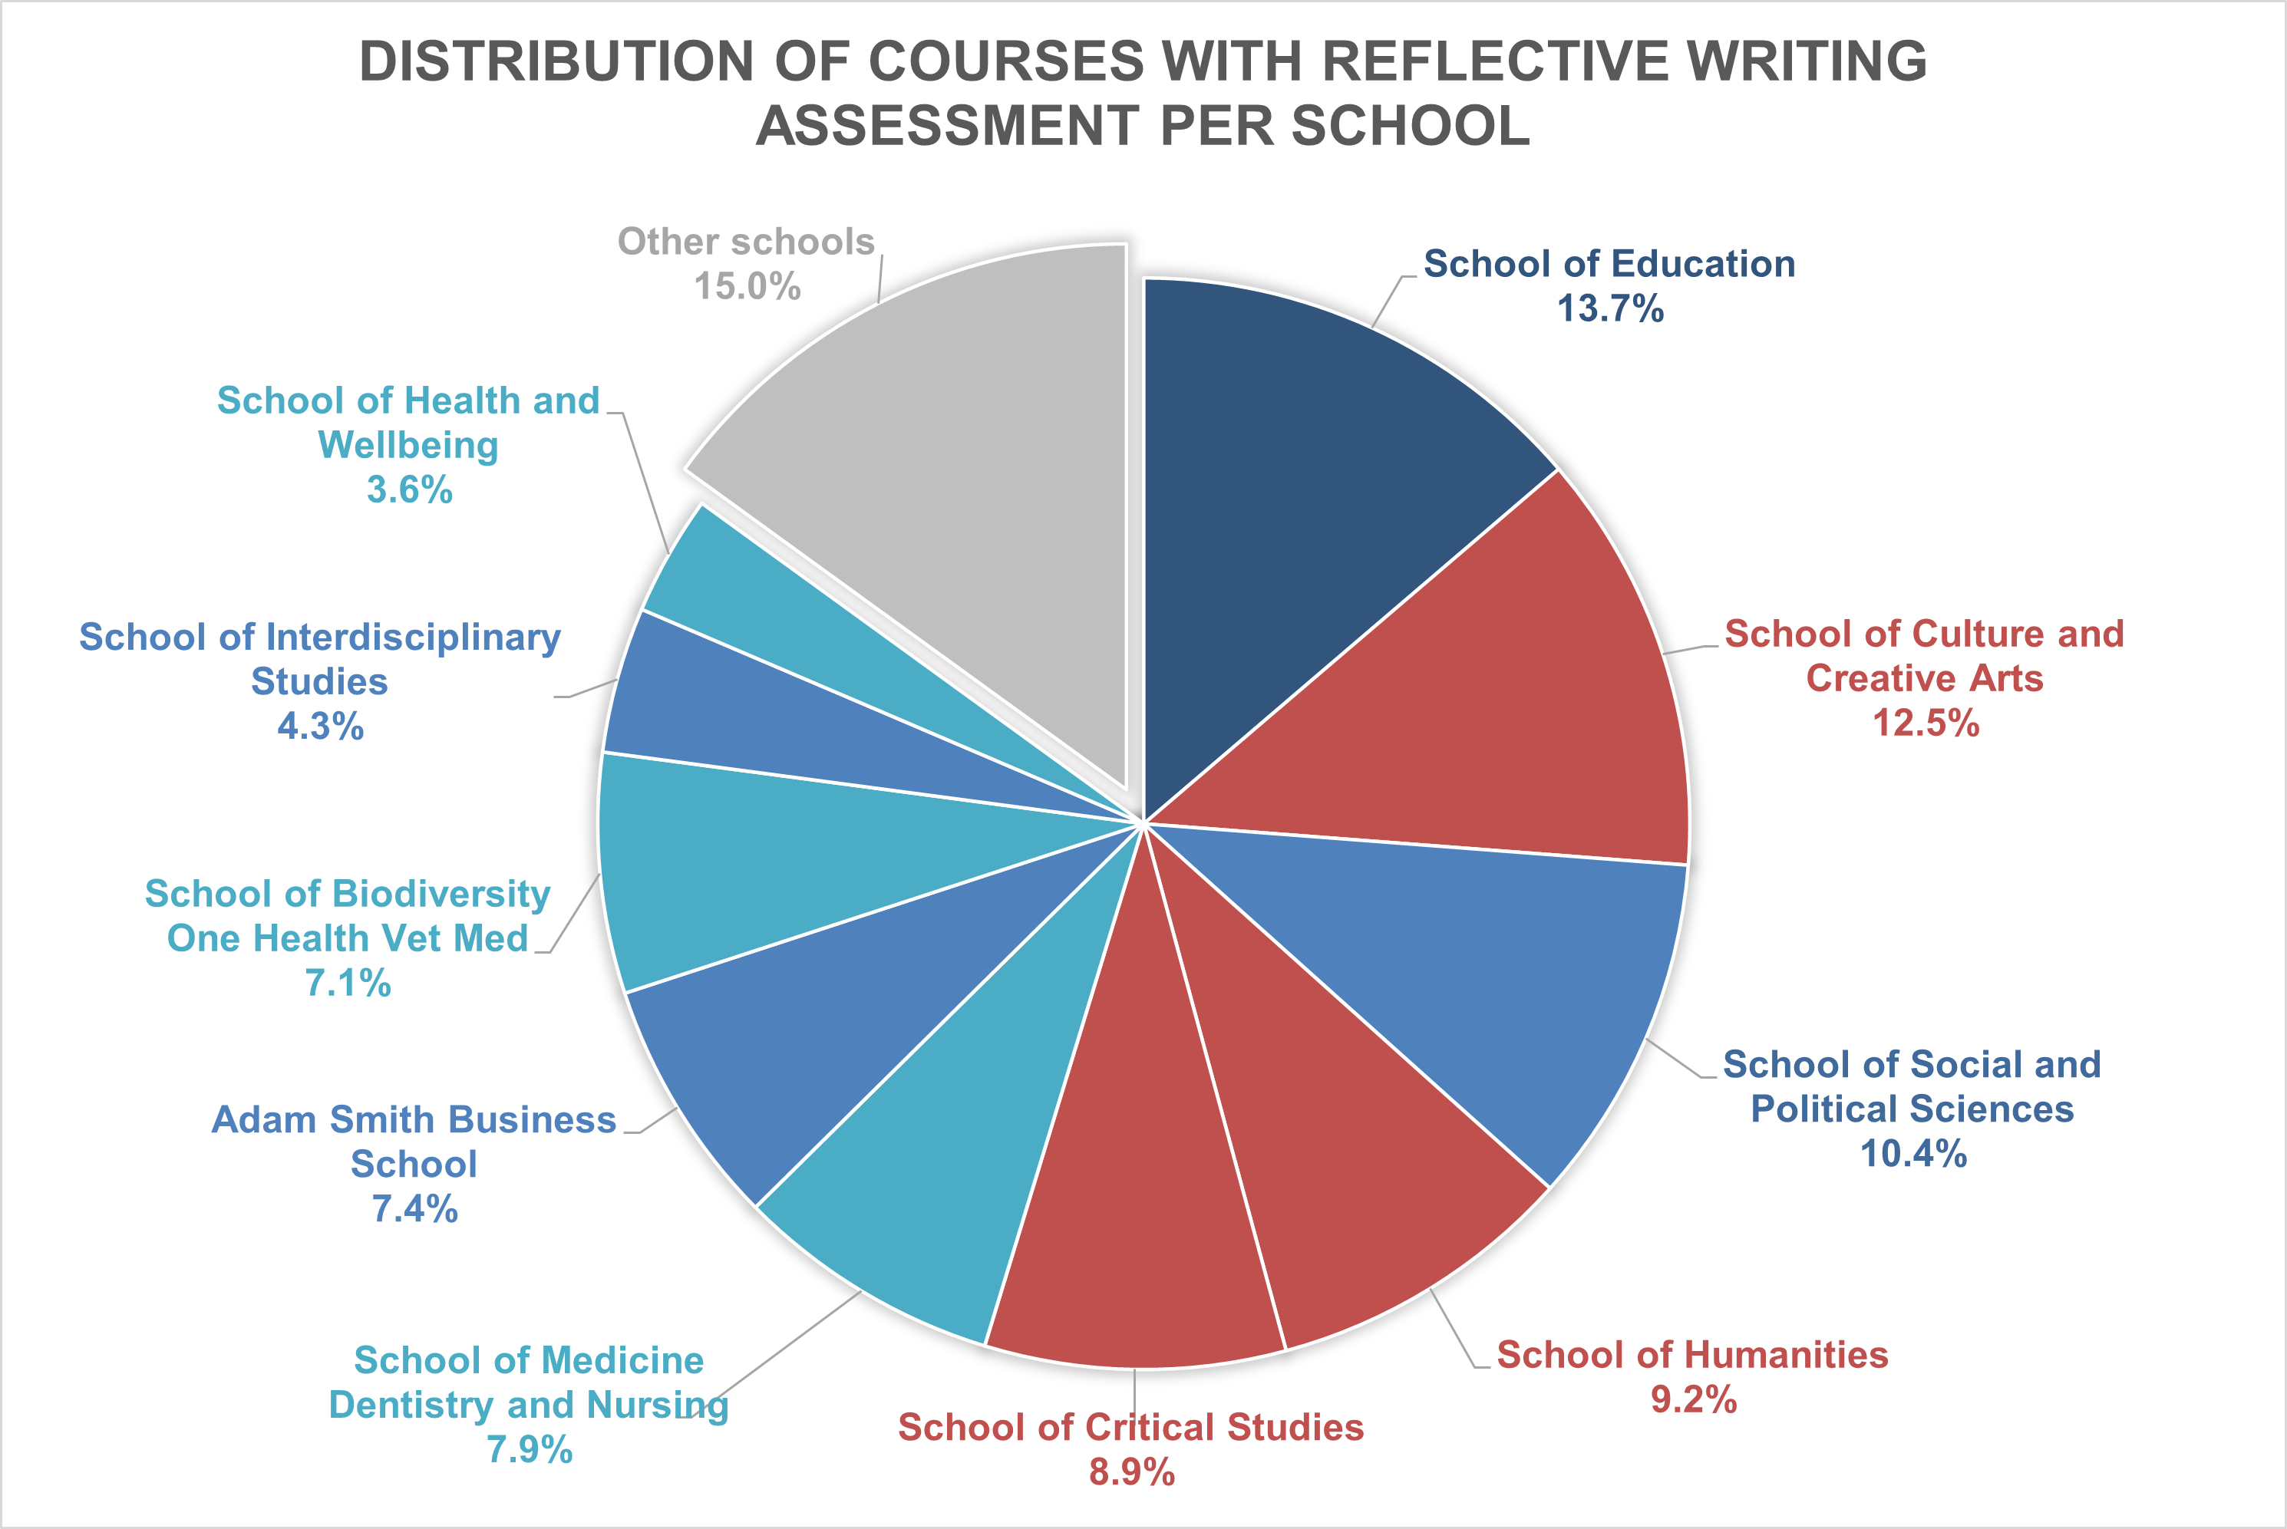
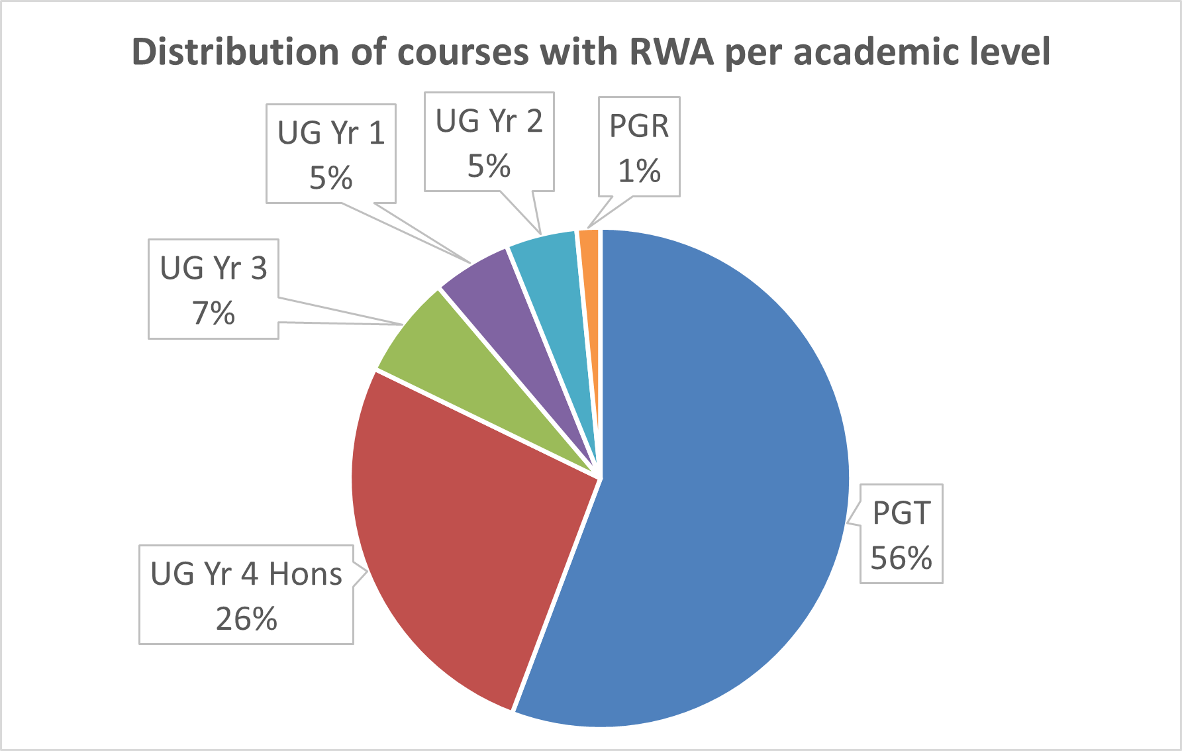
Notes:
Tom

Slide 7
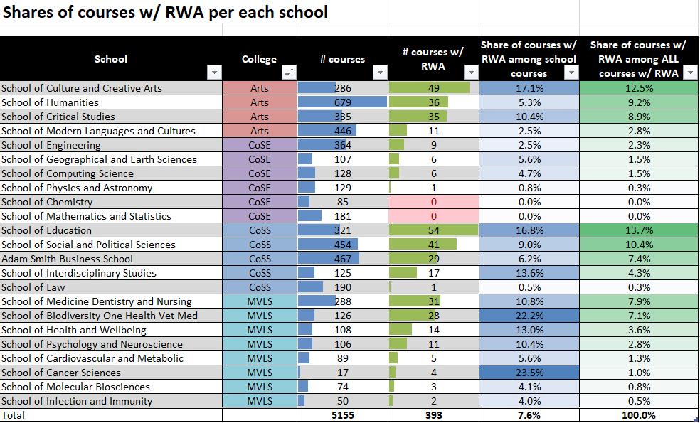
Notes:
Tom

Slide 8
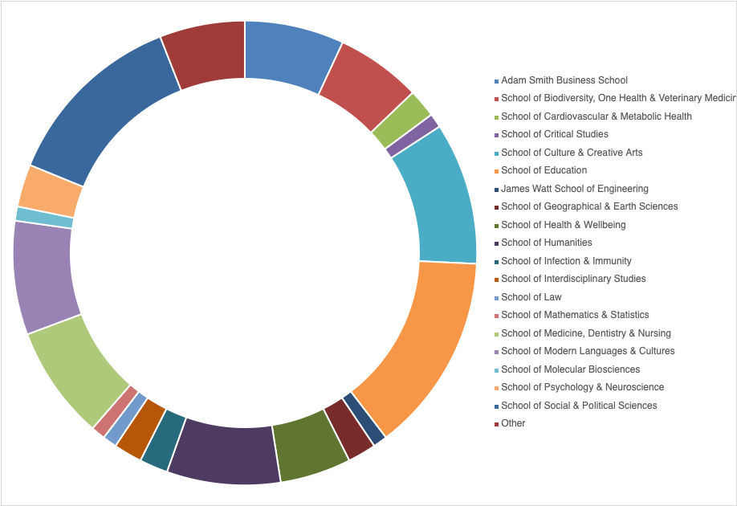
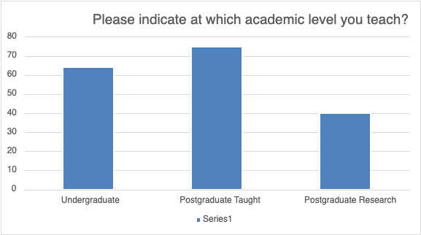
Findings: questionnaire: who responded?

Slide 9
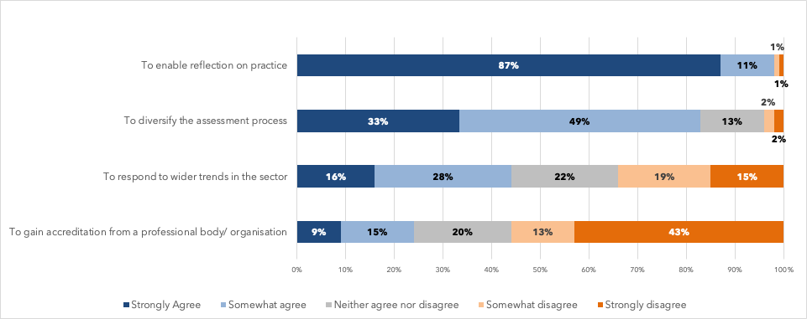
Findings: I use reflective writing for summative assessment for the following reasons:

Slide 10
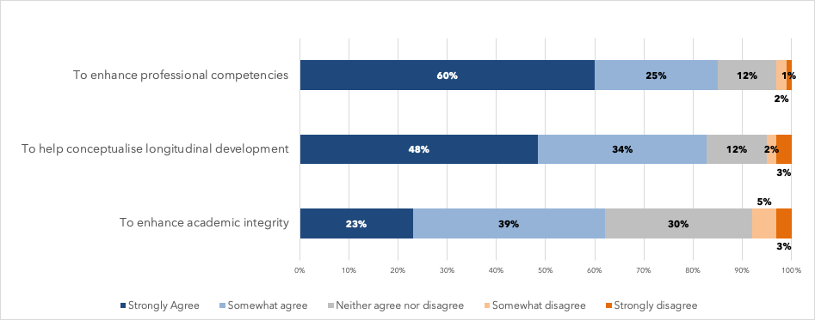
Findings: I use reflective writing for summative assessment to enhance student learning in the following ways:

Slide 11
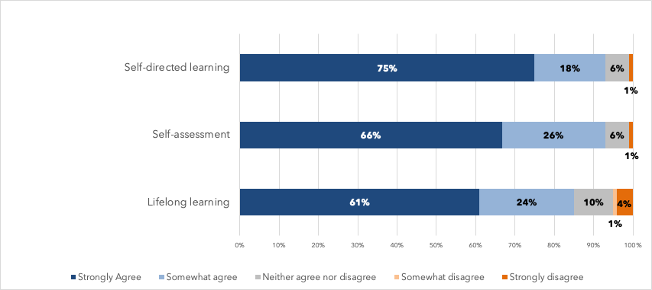
Findings: I use reflective writing for summative assessment to enable the following forms of autonomy in my students

Slide 12
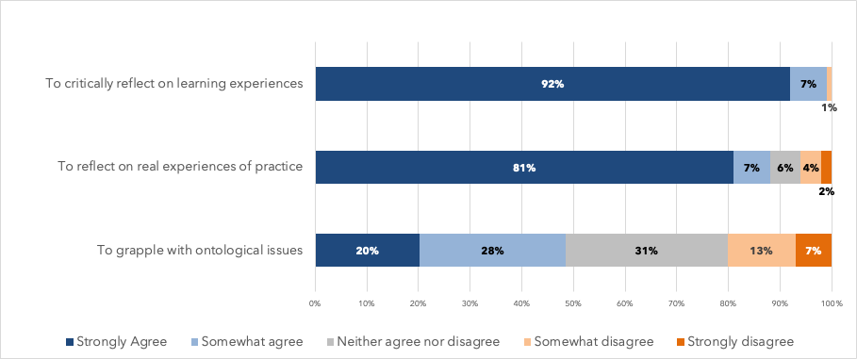
Findings: I use reflective writing for summative assessment to help my students

Slide 13
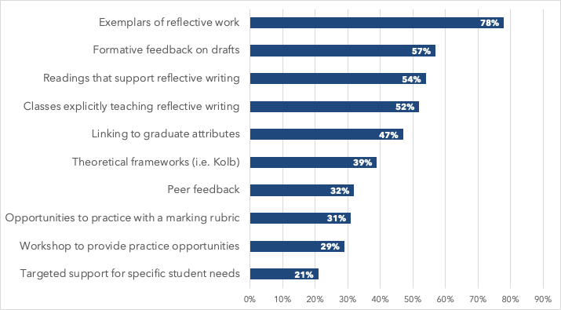
Findings: supporting reflective writing for summative assessment

Slide 14
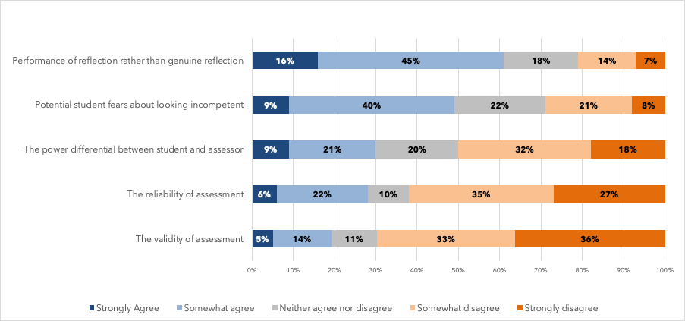
Findings: Reflective writing for summative assessment concerns me due to:

Slide 15
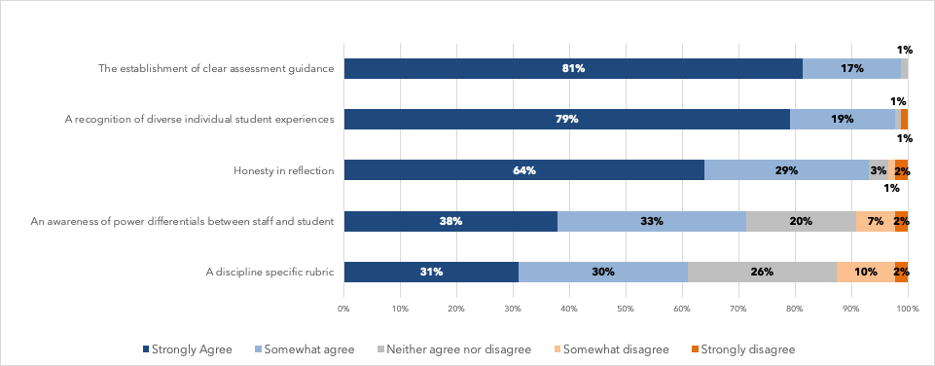
Findings: the following issues need to be addressed when using reflective writing for summative assessment

Slide 16
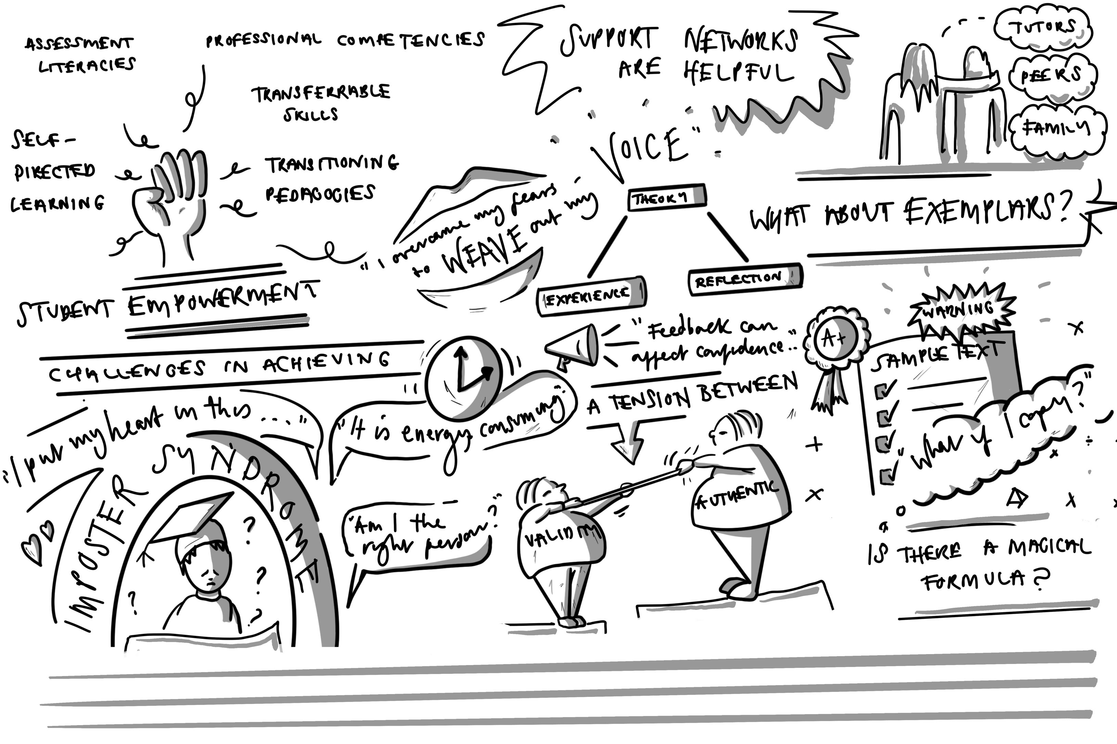
Findings: qualitative student data
Thematic visual arts-based analysis.
Notes played a role in initiating discussion about the key themes covered in each focus group.
These images were also developed for use on the institution's resource.
Notes:
Tom

Slide 17
Findings: qualitative student data
Finding your voice and imposter syndrome
Student concerns over use of first person in academic writing:
finding it weird
not feeling they had the authority to speak with their own voice.
Experiencing imposter syndrome.
“I was speaking to my supervisor, and I told her one of the things I really shy away from doing is to write in the first person… I said, ‘You know it makes me feel too opinionated in the in the paper.’ And when you become too opinionated, you really cannot differentiate, you know, between fact. Because in academia you are not... I'm being told from my undergrad that you are not an authority.”
Notes:
Tom

Slide 18
Discussion and conclusions:
Reasons for setting reflective writing for summative assessment
Fairly clear and mirror the literature – many benefits to reflective assessment
Supporting reflective writing for summative assessment
Various approaches that mirror literature (exemplars, formative feedback, and workshops)
Staff experience of summative assessment that may affect the authenticity of voice
Data mixed on concerns over power differential - 30% of staff concerned
Majority of staff were not concerned over reliability and validity of assessment however at the same time a clear majority were concerned over student performativity in reflective assessment
~50% concerned that students may worry about looking incompetent
Student experience of summative assessment that may affect the authenticity of voice
Data indicates many feel assessment is more performative than genuine.
Assessment literacies: lack of purpose in assignments prevented students from finding voice.
Notes:
Tom

Slide 19
Questions for consideration
If students perform reflection and are inauthentic in terms of voice, to what extent is reflective writing for summative assessment valid?
Criticality was an important reason for setting summative assessment. What do we mean by criticality in reflection? To what extent are our meanings aligned? How does it relate to voice?
To what extent are power dynamics or ethical issues silencing student voice and/or creating the conditions for performativity?
Notes:
Micky

Slide 20
References
Chan, C. K., & Lee, K. K. (2021). Reflection literacy: A multilevel perspective on the challenges of using reflections in higher education through a comprehensive literature review. Educational Research Review, 32, 100376.
Cohen, L., Manion, L., & Morrison, K. (2018). Research methods in education. Routledge.
Hargreaves, J. (2004). So how do you feel about that? Assessing reflective practice. Nurse education today, 24(3), 196-201.
Hobbs, V. (2007). Faking it or hating it: can reflective practice be forced?. Reflective practice, 8(3), 405-417.
Jindal‐Snape, D., & Holmes, E. A. (2009). A longitudinal study exploring perspectives of participants regarding reflective practice during their transition from higher education to professional practice. Reflective Practice, 10(2), 219–232. https://doi.org/10.1080/14623940902786222
Marsh, C. (2014). ‘It’s quite weird to write … you feel like a nut job’: the practical and emotional consequences of writing personal reflections for assessment in psychology. Reflective Practice, 15(2), 190–202. https://doi.org/10.1080/14623943.2014.883310
Mitchell, R. E. (2018). Web scraping with Python: Collecting more data from the modern web (2nd edition). O’Reilly Media.
Moniz, T., Arntfield, S., Miller, K., Lingard, L., Watling, C., & Regehr, G. (2015). Considerations in the use of reflective writing for student assessment: issues of reliability and validity. Medical education, 49(9), 901-908.
Ross, M., Bohlmann, J., & Marren, A. (2024). Reflective writing as summative assessment in higher education: A systematic Review. Journal of Perspectives in Applied Academic Practice, 12(1).
Stewart , S. and Richardson , B. 2000 . Reflection and its place in the curriculum: Should it be assessed? . Assessment and Evaluation in Higher Education , 25 (4) : 370 – 380

Slide 21
Thanks, and questions
Micky Ross
Micky.Ross@glasgow.ac.uk
Tom Raymond
Tom.Raymond@lsbu.ac.uk

