Slide 1

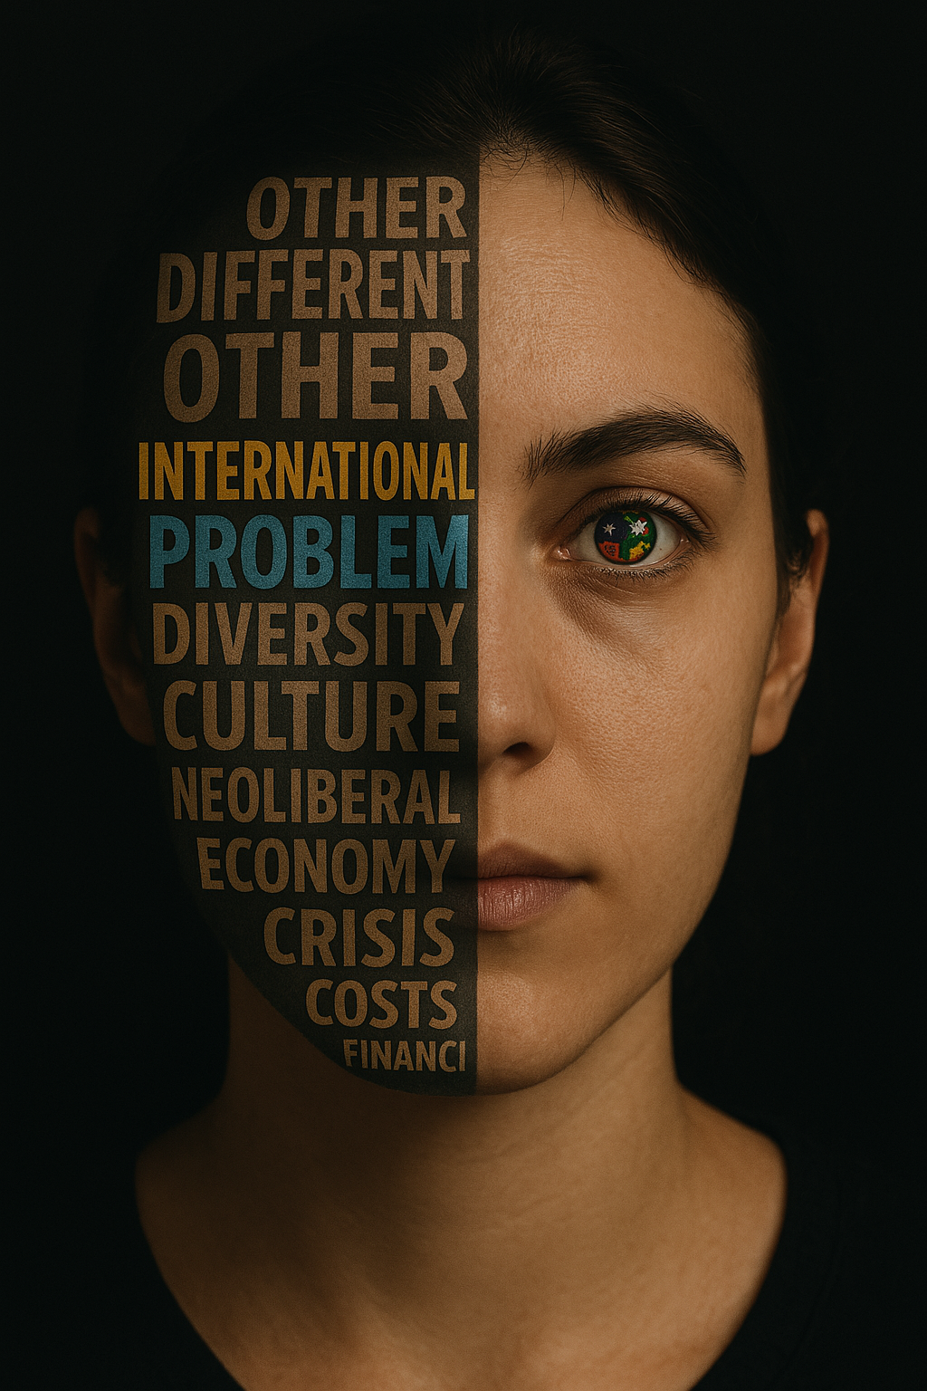
'How does it feel to be a problem?'
Situating the international label within a struggling sector
Ramzi Merabet, The Language Centre, University of Leeds
BALEAP2025

Slide 2

Basic Assumptions
​- That everyone working with students wants to change something (inspired by Ding 2016; Monbec & Ding, 2024). ​
- That, in the eyes of educators, this change is innocent and well-intentioned. ​
- That, while enacting change, one might make things worse. ​

Slide 3
Internationalisation is exploitative and ethically problematic.
Key Arguments
Labels and markers of nationality, ethnicity, and culture reify deficit and dehumanise individuals​.
We are engineering our own demise as a sector by tolerating exploitative internationalisation.

Slide 4

2022-23: 2.19 million (Home) versus 750000 (International).
25% of the student population is labelled international.
Upward trend 2018-2023 with the first ever decline reported in 2023-24 academic year.
£27.6 bn in tuition income in UK HE in 2022-23.
44% of tuition income comes from international students.
Upward trend over the last five years.
Data from Higher Education Statistics Agency (2018-2024)

Slide 5
Higher Education Institutions are increasingly adopting a “neoliberal rationality that challenges the very idea of a public good” (Brown, 2015, p.119).
Knowledge-provision is “recast as a service and educators as service providers” (Feldman & Sandoval, 2018, p.216).
HE Institutions as “business enterprises obsessed with income, growth and outputs” (Fleming, 2021, p.10).
A student-as-consumer approach (Bunce et al., 2017), a market driven HE education (Tomlinson, 2017), an ‘Edu-Factory' (Fleming, 2021, p.15), an edu-business (Luke, 2010).

Slide 6
23
24
25
26
27
28
29
30
31
32
33
34
35
36
37
38
39
40
41
42
43
44
45
“a foreigner who pays to get the degree”
“take my money and give me a certificate”
“they do know that these people are willing to pay this amount of money to gain access to education in the UK”
“they are using us a little bit … to gain something for themselves”
“you are paying for that certificate”
“they know that those coming from a third world country would do whatever it takes to have the certificate”
“we are bringing in a lot of money”
“why do you take from A more than you take from B? just because of nationality. It is business, education has become business now”

Slide 7
The problem is that the label allows us to look at students as a problem.
The label facilitates looking at students labeled international as a homogeneous group.
It allows us to use the mighty 'THEY'
… but they don't speak good English
Her English is surprisingly good for an international student...
… Well, there is a limit to criticality since they are international
He does think very critically despite being international...
… My classroom is not diverse at all, I only have Chinese
They are dead-silent, just what you expect from Japanese students …
… But how can you integrate the Chinese ones if they have a collectivist culture

Slide 8


“There is no doubt that international students offer positive economic benefit, including cross-subsidising the education of domestic students and research” (Alan Manning, MAC, my emphasis)
“International students bring enormous financial benefits to every corner of the United Kingdom” (London Economics, p.47).​
“The benefit of hosting non-EU HE students is 14.8 times greater than the total cost”.​
Illustration from HEPI
Extracts from Migration Advisory Committee and London Economics.
“to the university, I'm just a number. So, as an individual, you're just a number in the system”

Slide 9
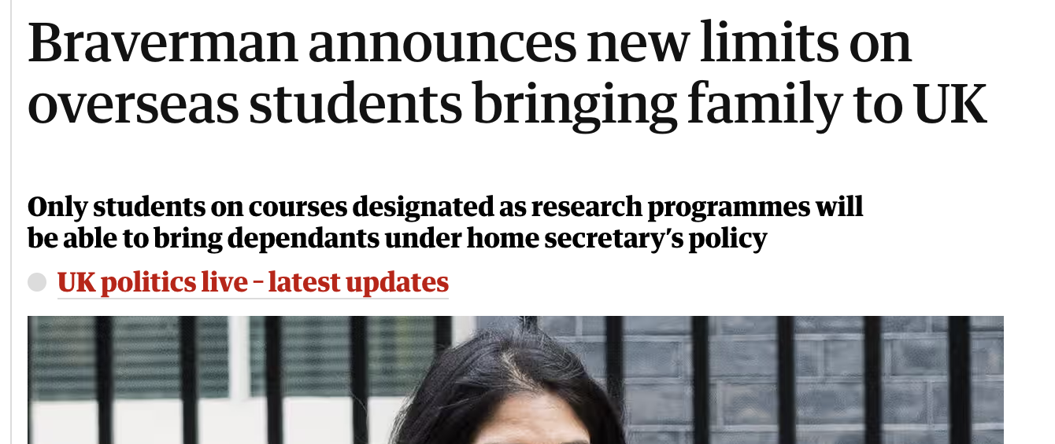
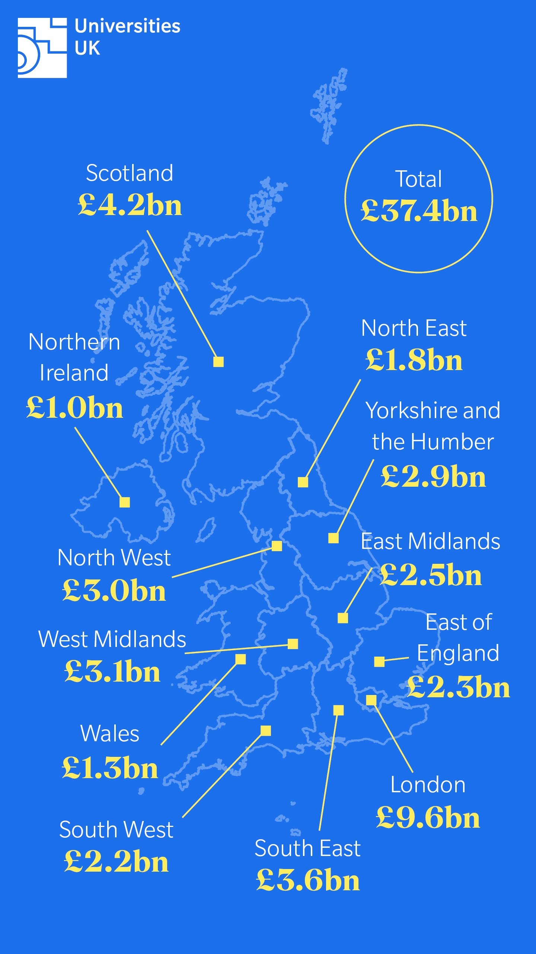

X Post and illustration by Universities UK | Headline from the Guardian
We legitimise one’s very being through the lens of neoliberalism.

Slide 10


“The process of integrating an international, intercultural or global dimension into the purpose, functions or delivery of post-secondary education” (Knight, 2004, p.11) to “enhance the quality of education and research for all students and staff, and to make a meaningful contribution to society” (de Wit et al., 2015, p.29).
"A process that strives to systematically exploit non-UK-domiciled students by mobilising nationality as a marker of inherent difference, maintaining a state of differential treatment, subscribing to deficit narratives, and exploiting students financially to prevent the collapse of neoliberal educational institutions" (Merabet, 2024).
Notes:
https://www.officeforstudents.org.uk/media/nn2fnrkx/financial-sustainability-november-2024.pdf

Slide 11
The label as a starting point in research
A starting point that adopts preconceptions and facilitates homogenisation.
The label is positioned within powerful institutions that have the power and legitimacy to "order meaning" (Sewell Jr., 2009, p.172).
“The typical cultural strategy of dominant actors and institutions is not so much to establish uniformity as it is to organize difference. They are constantly engaged in efforts not only to normalize or homogenize but also to hierarchize, encapsulate, exclude, criminalize, hegemonize, or marginalize practices and populations that diverge from the sanctioned ideal. By such means, authoritative actors attempt, with varying degrees of success, to impose a certain coherence onto the field of cultural practice” (Sewell Jr., 2009, p.172).

Slide 12
The label as a starting point in research
The international label is largely used to homogenise, rather than to describe a homogeneous group.
The label organises difference and prevents us, as agents that 'order meaning', to engage with structural disadvantages. Therefore, the narrative where those labelled international “are construed as persons outside our idea of ‘community’ and shared values, as persons who are defined into legal systems by their status as outsiders rather than as potential citizens” (Kneebone, 2005, p. 8) is hardly challenged. In contrast, it is reinforced.
Organised difference becomes a default attribute.
This gets worse when we mobilise this organised difference to create an essentialist, demonised, or exoticised image of those labelled international (Dervin, 2011; Holliday, 2011, 2021, 2025).

Slide 13
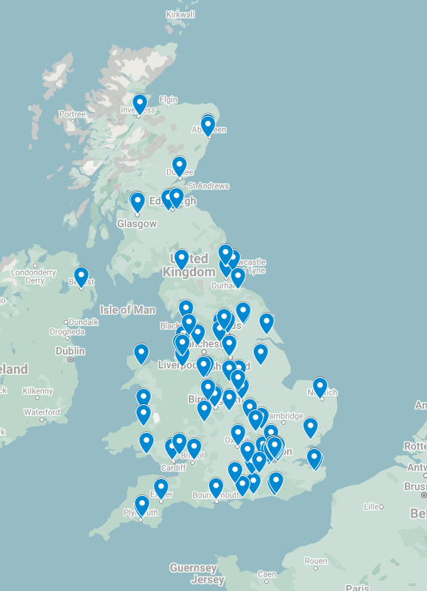

UCU interactive map of redundancies
Modelling done by the Office for Students predicts a 23% decline in international enrollments in 2025-26 academic year (OfS, 2024, p.1).
A net income reduction of £3.5bn (OfS, 2024, p.3).
The same report expects around 72% of providers to face a financial deficit.
Trump could reverse this, but should we care?
Screenshot of an interactive map (UCU website)
Notes:
https://www.officeforstudents.org.uk/media/nn2fnrkx/financial-sustainability-november-2024.pdf

Slide 15
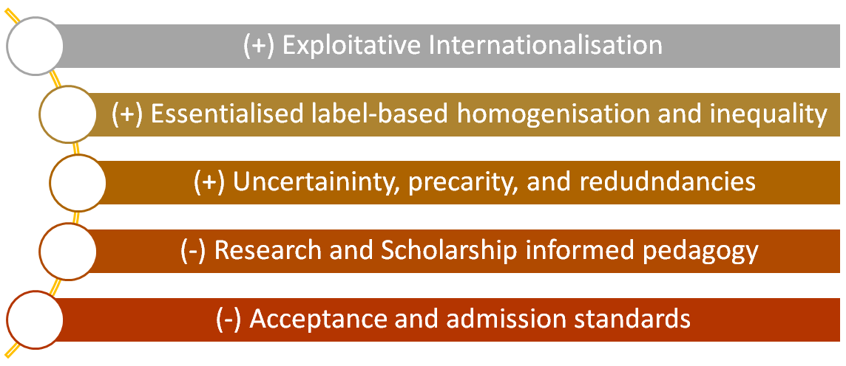
Hyper-internationalisation is "a non-sustainable process of excessive reliance on international students to the point where the decisions that inform teaching and learning are no longer based on substantial scholarship and research but rather dictated by the financial bottom line and the managerial decisions that university actors are obliged to implement to mitigate financial issues, eventually jeopardising excellence and quality indicators upon which the sector is presumably leading" (Merabet, 2024).

Slide 16
EAP: Ethics for Academic Purposes
A plea to uphold absolute alterity
"The strangeness of the Other, his irreducibility to the I, to my thoughts and my possessions, is precisely accomplished as a calling into question of my spontaneity, as ethics" (Levinas, 1961/1991, p.43).
"The relation between the same and the other is not always reducible to knowledge of the other by the same, nor even to the revelation of the other to the same" (Levinas, 1961/1991, p.28).
"He is not a mere object to be subsumed under one of my categories and given a place in my world" (Levinas, 1961/1991, p.13).
Looking at students labelled international through the lens of absolute alterity makes them irreducible as subjects, for any attempt to explain/organise difference may result in objectifying the Other.
Ethics, rather than ontology, as the first philosophy.

Slide 17

EAP: Ethics for Academic Purposes
A plea to reconceptualise research with students labelled international
"The alterity of the Other does not depend on any quality that would distinguish him from me, for a distinction of this nature would precisely imply between us that community of genus which already nullifies alterity" (Levinas, 1961/1991, p.194) Contrary to many current publications that attempt to explain difference.
Deficit narratives are the product of naïve explanations that aim to organise difference.
Research/scholarship/practices that mobilise essentialist conceptualisations of culture (e.g., Hofstede's Cultural dimensions, cultural adaptation and competence models such as Bennett's and Deardorff's) reify these deficit narratives and create a pseudo-objective understanding of difference.
Even postmodern/constructivist research is known to orientate towards organising difference (See Holliday and MacDonald's (2019) discussion around Postpositivist Recidivism).
Or ask me to elaborate during the Q/A

Slide 18
EAP: Ethics for Academic Purposes
A plea to reconceptualise research with students labelled international
Current critical research already shows the “strong geographical boundaries to social justice, with international students falling outside the nationally defined realm of demands for educational equality” (Brooks, 2018, p.756).
In addition to working towards acknowledging absolute alterity, there is an urgent need to homogenise less, to stop wasting resources on research that departs from the assumption that those labelled international are expected to adapt/integrate/assimilate, etc. See Mittelmeier's recent critique of integration, 2025, or delve deeper into critiques of integration/adaptation -> (Baumann, 2000; Dervin, 2011; Ferri, 2018; Hannerz, 2009; Amadassi & Holliday, 2017; Matsuo, 2015; Phillips, 2007)
The space has never been homogeneous. It does not make sense to treat it as such in our encounter with students labelled international.

Slide 19
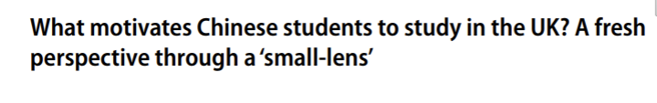
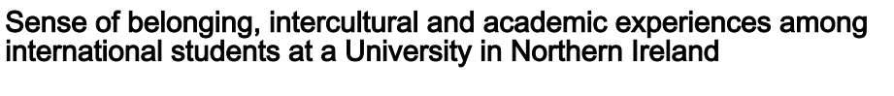
EAP: Ethics for Academic Purposes
A plea to stand to neoliberalism in higher education
Exploitative internationalisation is increasingly affecting the sustainability of the UK's HE sector.
If we are to really address this existential issue, we should start by questioning how we position students labelled international.
We should also push against research that, in my view, only serves to emphasise neoliberalism in HE, which ultimately positions students as "an object of knowledge […] rather than an equal partner" (Buckner & Stein, 2020, p.162)

Slide 20

References
Ahmed, S. 2006. The Nonperformativity of Antiracism. Meridians (Middletown, Conn.). 7(1), pp.104–126.
Amadasi, S. and Holliday, A. 2017. Block and thread intercultural narratives and positioning: conversations with newly arrived postgraduate students. Language and Intercultural Communication. 17(3), pp.254-269. DOI:10.1080/14708477.2016.1276583
Bauman, Z. 2000. Liquid Modernity. Cambridge: Polity Press.
Bennett, M. 1993. Towards ethnorelativism: A developmental model of intercultural sensitivity. In: Paige, M. ed. Education for the intercultural experience. Yarmouth, ME: Intercultural Press, pp.21-71.
Brooks, R. 2018. The construction of higher education students in English policy documents. British Journal of Sociology of Education. 39(6), pp.745- 761. DOI:10.1080/01425692.2017.1406339
Brown, W. 2015. Undoing the demos: Neoliberalism’s stealth revolution. New York: Zone Books.
Buckner, E. and Stein, S. 2020. What Counts as Internationalization? Deconstructing the Internationalization Imperative. Journal of Studies in International Education. 24(2), pp.151-166. https://doi.org/10.1177/1028315319829878
Bunce, L., Baird, A. and Jones, S. E. 2017 The student-as-consumer approach in higher education and its effects on academic performance, Studies in Higher Education. 42(11), pp.1958-1978. DOI:10.1080/03075079.2015.1127908
Cena, E., Burns, S. and Wilson, P. 2021. Sense of Belonging and the Intercultural and Academic Experiences Among International Students at a University in Northern Ireland. Journal of International Students, 11(4), pp. 812–831. doi:10.32674/jis.v11i4.2541.
Consoli, S 2024, 'What motivates Chinese students to study in the UK? A fresh perspective through a ‘small-lens’', Higher Education, vol. 88(4), pp. 1589-1610. https://doi.org/10.1007/s10734-024-01184-3
de Wit, H., Hunter, F., Howard, L. and Egron-Polak, E. 2015. Internationalisation of higher education: A study for the European Parliament. https://www.europarl.europa.eu/RegData/etudes/STUD/2015/540370/IPOL_ STU(2015)540370_EN.pdf
Deardorff, D. K. 2011. Assessing intercultural competence. New Directions for Institutional Research. 2011(149), pp.65-79. doi:10.1002/ir.381
Dervin, F. 2011. A plea for change in research on intercultural discourses: A ‘liquid’ approach to the study of the acculturation of Chinese students. Journal of Multicultural Discourses. 6(1), pp.37-52. DOI:10.1080/17447143.2010.532218
Ding, A. 2016. EAP as pharmakon: Are we all neoliberals now? https://teachingeap.wordpress.com/2016/02/19/eap-as-pharmakon-are-we-all-neoliberals-now/

Slide 21
References
Feldman, Z. and Sandoval, M., 2018. Metric power and the academic self: Neoliberalism, knowledge and resistance in the British university. tripleC: Communication, Capitalism & Critique. 16(1), pp.214-233.
Ferri, G. 2018. Intercultural Communication-Current Challenges and Future Directions. London: Palgrave Macmillan.
Fleming, P. 2021. Dark Academia: How universities die. United Kingdom: Pluto Press.
Hannerz, U. 1999. Reflections on Varieties of Culturespeak. European Journal of Cultural Studies. 2(3), pp.393-407.
Hofstede, G. 2001. Culture’s Consequences: Comparing Values, Behaviours, Institutions and Organisations across Cultures. London: Sage.
Holliday, A. 2021. Contesting Grand Narratives of the Intercultural. United Kingdom: Taylor & Francis.
Holliday, A. 2025. The varicultural, translanguaging and deCentring. Language and intercultural communication., pp.1–14.
Holliday, A. and MacDonald, M. N. 2019. Researching the intercultural: intersubjectivity and the problem with postpositivism. Applied Linguistics. 41(5), pp.621-639. https://doi.org/10.1093/applin/amz006
Kneebone, S. 2005. Women Within the Refugee Construct: ‘Exclusionary Inclusion’ in Policy and Practice — the Australian Experience. International Journal of Refugee Law. 17(1), pp.7-42, https://doi.org/10.1093/ijrl/eei002
Knight, J. 2004. Internationalization remodelled: Definition, approaches, and rationales. Journal of Studies in International Education. 8(1), pp.5-31.
Lévinas, E. 1979. Totality and infinity : an essay on exteriority. The Hague ; M. Nijhoff Publishers.
Luke, A. 2010. ‘Educating the Other: Standpoint and Theory in the “Internationalization” of Higher Education’, in Unterhalter, E. and Carpentier, V. (eds) Global Inequalities and Higher Education: Whose Interests Are We Serving? New York: Palgrave Macmillan, pp. 11–27.
Matsuo. 2015. A Critique of Michael Byram’s Intercultural Communicative Competence Model from the Perspective of Model Type and Conceptualization of Culture. Review of Literature & Humanities, 44(2).
Merabet, R. 2023. Belonging, being, and interculturality: A narrative exploration of the experiences endured by students labelled international in a British university. PhD thesis, University of Leeds.
Merabet, R. 2024. Students we label international: an urgent call to reconceptualise research with international students. Equality, Diversity and Inclusion, Vol. ahead-of-print No. ahead-of-print. https://doi.org/10.1108/EDI-01-2024-0048
Mittelmeier, J. 2025. Against ‘Integration’ in Research and Practice with International Students. Journal of Studies in International Education, 0(0). https://doi.org/10.1177/10283153241308744
Monbec, L. and Ding, A. 2024. Recovering language in higher education : social justice, ethics and practices First edition. Cham: Palgrave Macmillan.
Phillips, A. 2007. Multiculturalism without culture. Princeton: Princeton University Press.
Tomlinson, M. 2017. Student perceptions of themselves as 'consumers' of higher education. British Journal of Sociology of Education. 38(4), pp.450-467. DOI:10.1080/01425692.2015.1113856
William H. Sewell Jr. 2009. Logics of History : Social Theory and Social Transformation. The University of Chicago Press.

Slide 22
Thank You!
Ramzi Merabet, The Language Centre, University of Leeds
Contact: r.merabet@leeds.ac.uk
BALEAP2025

