Slide 1
Learners’ Collaborative
Video-Production:
Key competencies for the Attention Economy Era
Dr Sylvia Karastathi
Head of Teacher Support, LANGUAGECERT
Ionian University, Greece

Slide 2
Overview:
Collaborative Video Production and Critical Media Use: An Example of Practice
Background: The Crisis of Attention
Media Literacy: EAVE Resources
Reflections on Classroom Practice

Slide 3
Why Video Production Skills in the Language Curriculum?
My Context

Slide 4
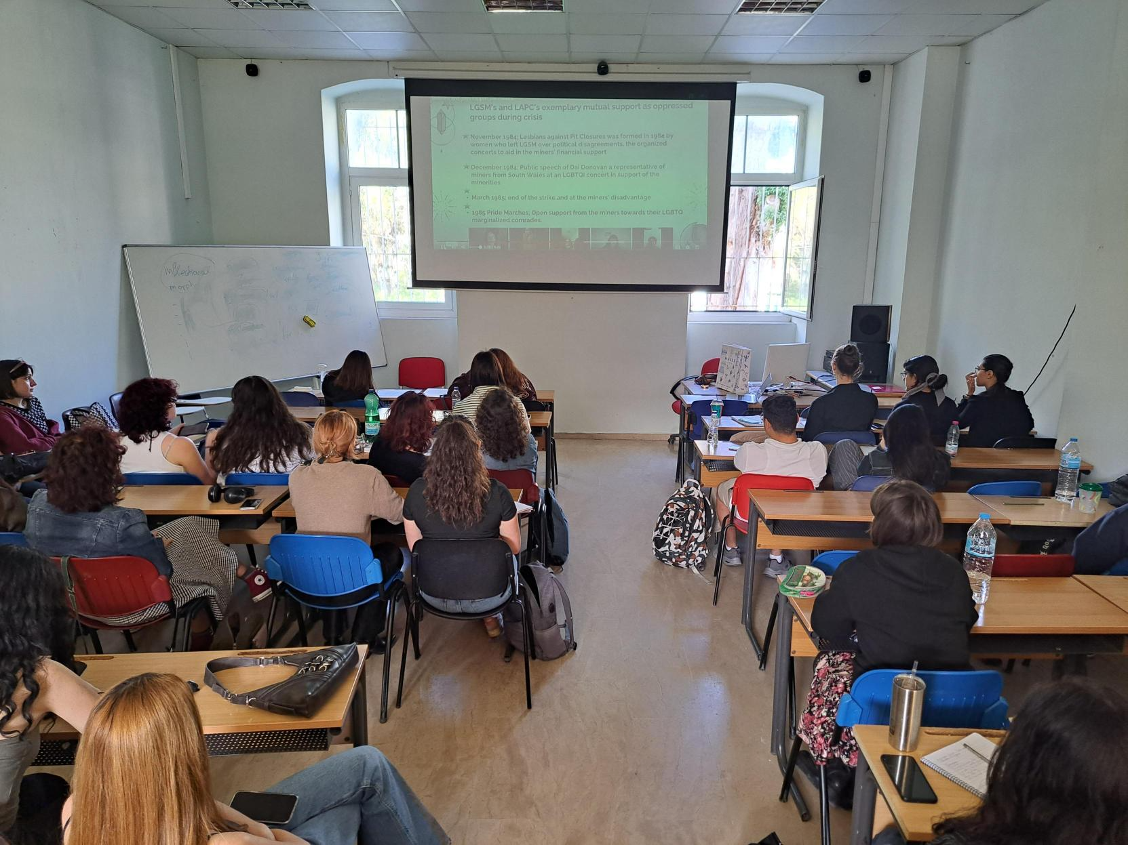
My Context
Cultural awareness for future translators
Department of Foreign Languages, Translation and Interpreting
2nd Year Students (19 - 20 years old)
Greek L1 and English as L2 (C1 and above) either French or German as L3
Aim is to raise cultural awareness of aspects of Anglophone Cultures which will later impact their translation skills
12 weeks – 2h per week
Assessment: 50% Oral Group Presentation / 50% Individual Written Assignment
Notes:
I want to start by talking about a project that I worked on with my students at University.
I teach 2nd Year Students at the Department of Foreign Languages, Translation and Interpreting
Greek L1 and English as L2 (C1 and above) either French or German as L3
Course: Anglophone Cultures - Aim is to raise cultural awareness of aspects of Anglophone Cultures, which will later impact their translation skills
As part of their Assessment:
50% Oral Group Presentation
50% Individual Written Assignment - Reflective Writing
Although it was a practice they found useful – I realised that it was impossible to sustain their attention during other teams presentations
Not generally rude
But their presentations were not engaging enough – were not seasoned presenters and the audience was a particulalry distracted one – they had so much interesting input to attend to in their phones – impossible to compete with
Resistance to use classroom time to watch other students present - I could see that something had changed in the students

Slide 5
The Attention Crisis
Notes:
I have talked about my context and what I witnessed and I am sure may resonate with some of you – it is a big topic and I am going to just sketch some thoughts
dramatically shifted the balance between the availability of information and the ability of humans to process information. During the last century information was a scarce resource. Now, human attention has become the scarce resource where as information (of all types and qualities)abounds. (p. 1)
The appropriate allocation of attention is a key factor determining the success of creative activities, learning, collaboration and many other human pursuits.

Slide 6
William James on Attention (1890)
Everyone knows what attention is.
It is the taking possession by the mind, in clear and vivid form, of one out of what seem several simultaneously possible objects or trains of thought.
Focalization, concentration, of consciousness are of its essence.
It implies withdrawal from some things in order to deal effectively with others, and is a condition which has a real opposite in the confused, dazed, scatterbrained state which in French is called distraction, and Zerstreutheit in German.
James, 1890
Notes:
William James (considered by many the founder of American psychology) devoted a chapter in his Principles of Psychology to human attention and observed:
Attention plays an essential role in task performance and interaction.
Attention makes it possible for us to pursue goals without being distracted by the immense variety of available alternative stimuli and actions and undeniably mediates our interaction with the world.

Slide 7
The Attention Economy
Universities exist to ‘uncover, capture, produce, and preserve” information. …But universities have never been simply data-mining and storage operations. They have always taken as their central activity the conversion of data into useful knowledge and into wisdom.
They do this by creating attention structures that we call curricula, courses of study. …They decide how we pay attention to the world of information….’ (p. 13)
Lanham, Richard A., The Economics of Attention: Style and Substance in the Age of Information (Univ. Chicago Press, 2006).

Slide 8
Who is to blame for the “attention crisis”?
“The truth is that you are living in a system that is pouring acid on your attention every day, and then you are being told to blame yourself and to fiddle with your own habits while the world's attention burns.”
Johann Hari, Stolen Focus: Why You Can't Pay Attention—and How to Think Deeply Again
Notes:
Johann Hari is a British journalist who has written for The Guardian, New York Times, 3 month retreat with no internet
He quotes studies where American students focus on a task for 60 sec - office worker focus 3 min
our inability to focus is a personal failure to exert enough willpower over our devices. The truth is even more disturbing: our focus has been stolen by powerful external forces that have left us uniquely vulnerable to corporations determined to raid our attention for profit
factors range from technology to food to sleep – not as a personal failing but seeing it as a reality -
Precommitment – bind a future version of you -
Illusion of multi-tasking – which is a computer skill and applied it to human cognition – switch cost effect

Slide 9

Byung-Chul Han on Attention and Boredom
The Burnout Soceity
We owe the cultural achievements of humanity—which include philosophy—to deep, contemplative attention. Culture presumes an environment in which deep attention is possible. Increasingly, such immersive reflection is being displaced by an entirely different form of attention: hyperattention.
A rash change of focus between different tasks, sources of information, and process characterizes this scattered mode of awareness. Since it also has a low tolerance for boredom, it does not admit of the profound idleness that benefits the creative process. (p. 13)
Notes:
diagnosis of our current predicament, Byung-Chul Han is well known for his diagnoses of digital-age ills, especially how we exhaust ourselves via screen addiction and the continual pursuit of achievement.
Walter Benjamin calls this deep boredom a “dream bird that hatches the egg of experience.”

Slide 10
How to embed structures of attention in a teaching context?
From passive viewers to active makers
Notes:
Decided to change the assessment to video oral presentations
Robust positive research findings on significant improvements from other disciplines (management ie. study by Namin et al 2021)
Suitable for modern educational environments with hybrid deliveries
Matched student expectations (Generation Z students b. 2004) and was perceived as engaging and innovative
Live oral presentations is a usual assessment tool in higher education - the novel element here was that the deliverable was a video recording

Slide 11
Reasons for Selecting Video Presentations
Robust positive research findings on significant improvements from other disciplines (management ie. study by Namin et al 2021)
Suitable for modern educational environments with hybrid deliveries (Fjørtoft, H. 2020)
Matched student expectations (Generation Z students b. 2004) and was perceived as engaging and innovative after student consultation

Slide 12
Shaping the curriculum for Media Literacy
Course: Anglophone Cultures
Course goals: To increase students' awareness of cultural aspects and specificities among different Anglophone Cultures and question the cultural levelling beneath their notion of 'English’
Curriculum based on Visual Cultural Artefacts: Film, Songs and Video
Themes Examined: The American Dream, Colonialism, Segregation
Notes:
The Curriculum is a structure of attention
Focus on Visual Artefacts as examples of cultural production to explore themes

Slide 13



THE PURSUIT OF HAPPYNESS (2006) REVOLUTIONARY ROAD (2008) AND THE GREAT GATSBY (2012)
Notes:
We looked at how the American Dream intersects with gender and race and we worked on media literacy analysing film language with the help of resources and frameworks from EAVI

Slide 14
21st Century Europe requires citizens to gain new skills; it is no longer sufficient to be able to read, write and count. It is now absolutely necessary that they learn how to read and write in the context of new media.
Media Literacy
EAVI – the European Association for Viewers Interests
Notes:
EAVI – the European Association for Viewers Interests – is an international non-profit organisation based in Brussels, advocating for media literacy and full citizenship. EAVI empowers citizens to critically engage with media, EAVI works to ensure that media users across Europe have the skills and competencies needed to navigate the ever-evolving media landscape responsibly.

Slide 15



Resources on Digital Wellbeing

Slide 16
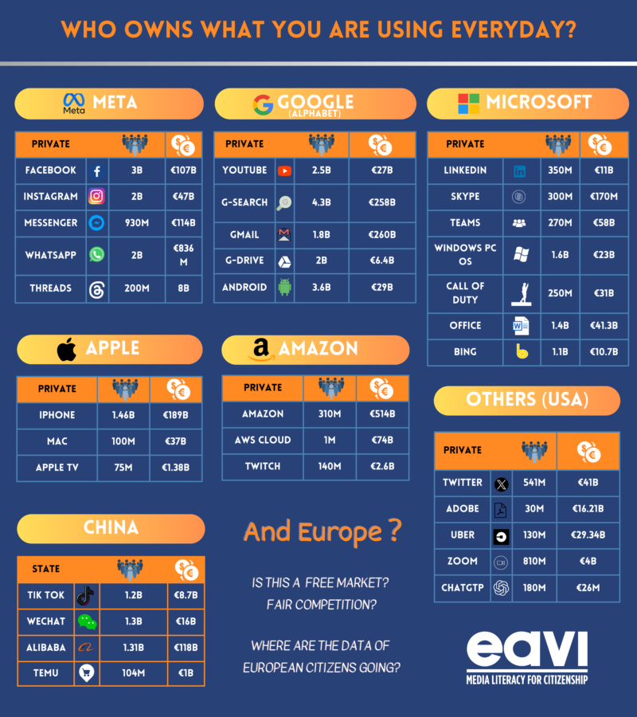
Who profits from your attention?

Slide 17
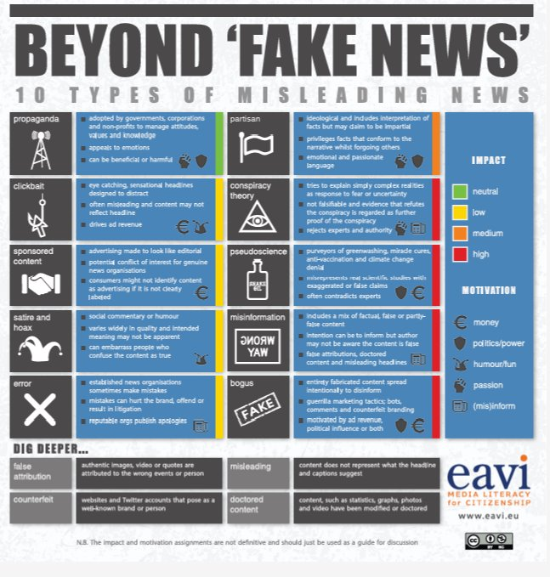
Examples of infographics

Slide 18
Learners' Collaborative Video Production
Emerging themes
Students are active in their own bids for attention – creating a video as a crafted space of attention
Student selected artefacts that mattered to them - capacity for self-regulation and choice
Reflected on the work needed on the visuals and mastering the technology
The most challenging thing remained working as a group – responsibility/ roles / accountability

Slide 19
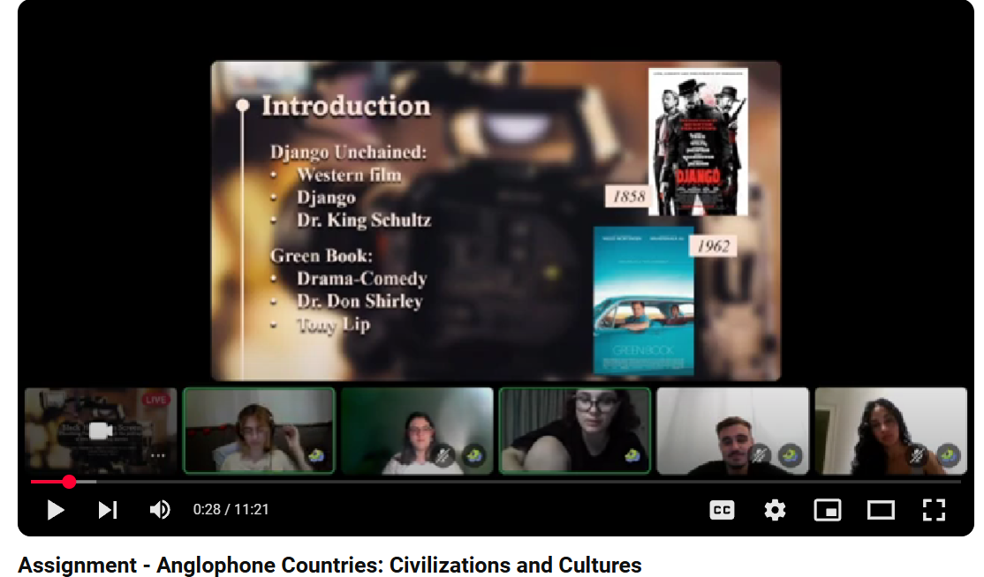
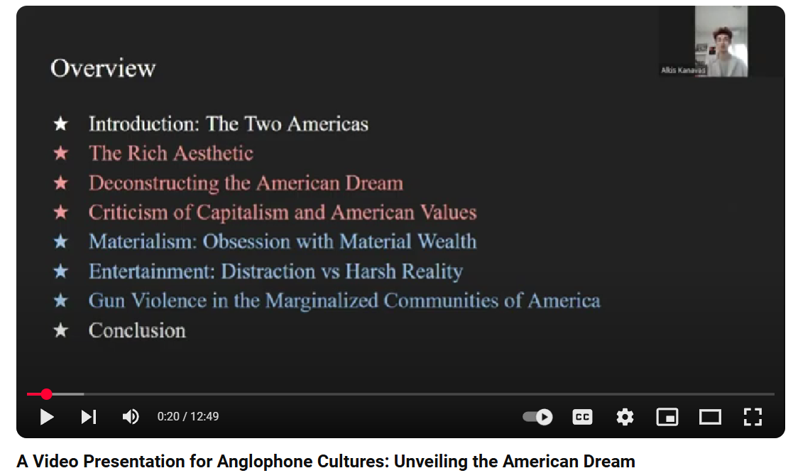
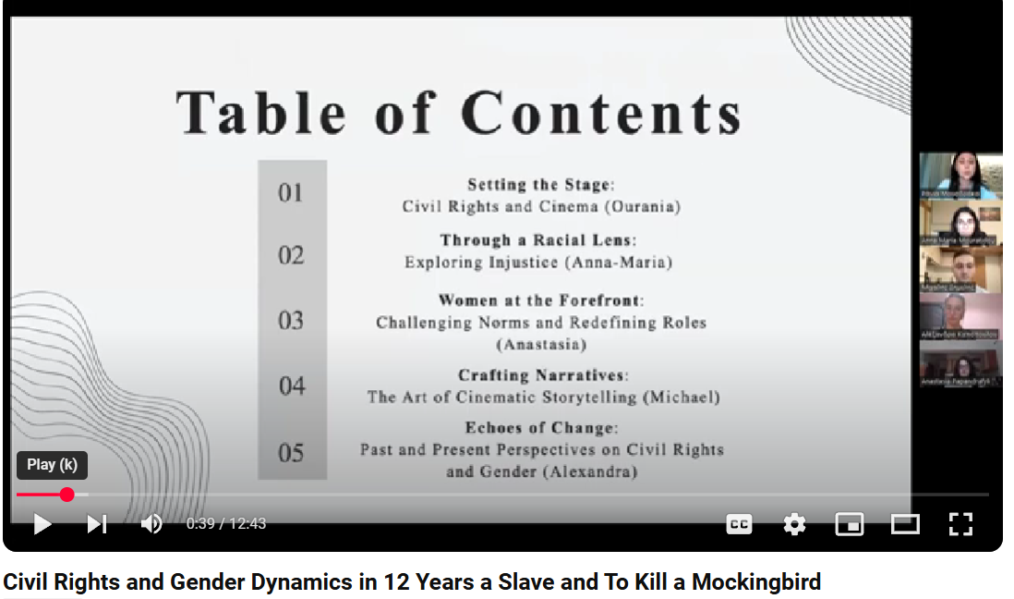
Students Video Presentations - Overview

Slide 20
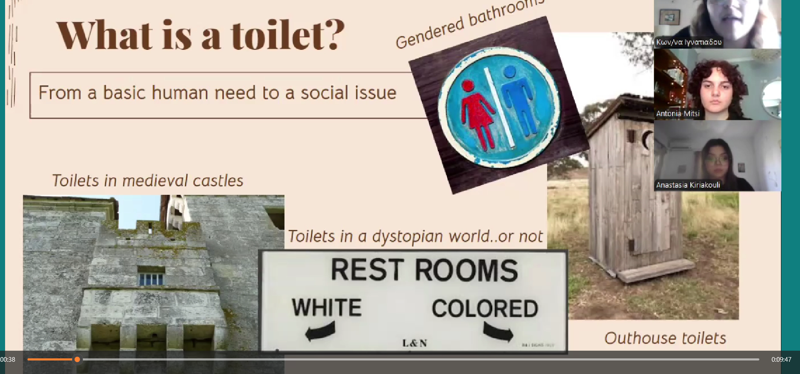
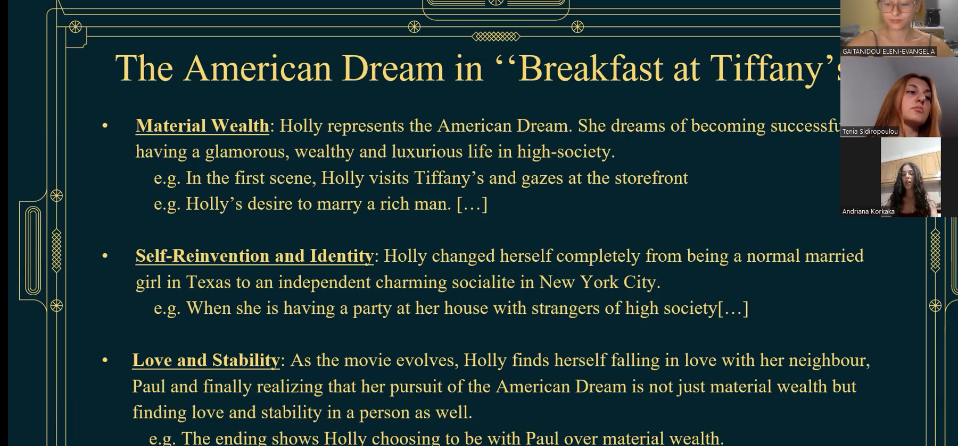
Creating their first visual texts
Notes:
Different levels of maturity: working with 'American Dream in Great Gatsby and Breakfast at Tiffany's – treating it like a visual essay
But stronger groups put a lot of work on the visuals and found interesting angles – so this presentation is called Flusing Away Injustice: Exploring the symbolism and social commentary of toilets in the films 'Hidden Figures' and 'The Help'

Slide 21
Reflective Writing – Returning to Deep Contemplative Attention
You are expected to produce a Reflective Account of about 800 words on the following topic:
Select one or more concepts discussed in class and in the presentations ( e.g. the values of the American Dream, race relations, class and social relations, gender roles, migrant experience, identity) within the context of Anglophone Countries and especially film texts and other cultural representations (songs, art) and connect it to some of your past personal experiences. Unfold your thoughts in a reflective manner, commenting on how what you have encountered in the texts studied in class relates to your thoughts and experiences beyond it.

Slide 22
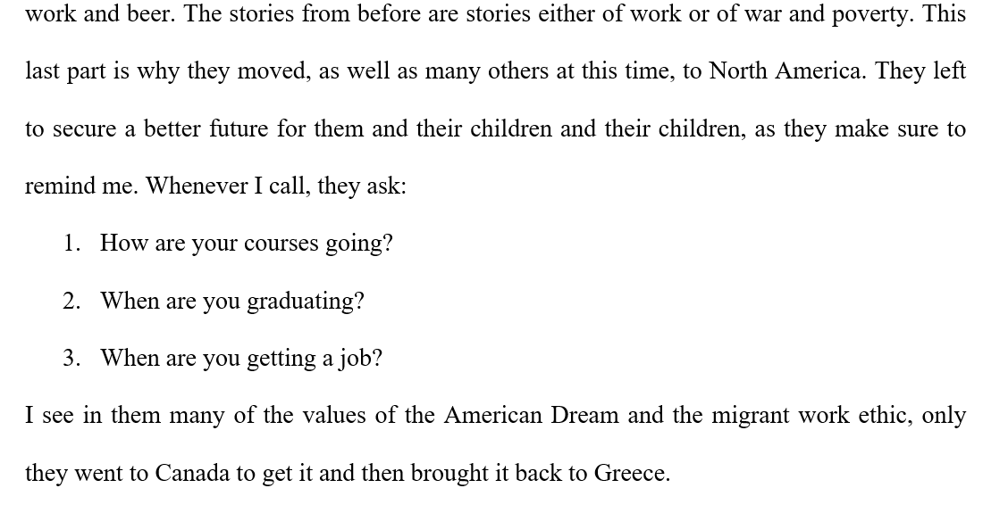
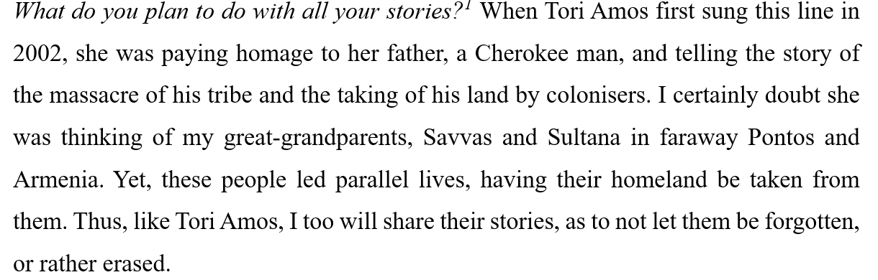
Students’ Capacity for Reflection and Contemplation
Notes:
Reflective work by Dora and Margarita

Slide 23
Students’ Views on the value of video production
I learnt that the end result needed more visually intriguing stuff and I would be more mentally prepared. It was a very innovative process of assessment
personal freedom of creativity as a team we were asked to successfully communicate a clear message on a topic
that we were given the opportunity to embrace ourselves and overcome some insecurities about the visual part of the presentation
challenged the way we had to think and form the presentation in a digital environment.
It helps us realize how we appear to other people and how we must present our content.
Notes:
In response:
How does this presentation prepare you for participating in digital communication environments?

Slide 24

“The liberation of human attention may be the defining moral and political struggle of our time.”
James Williams, Stand Out of Our Light: Freedom and Resistance in the Attention Economy
Notes:
Winner The Nine Dots Prize rewards original thinking in response to contemporary societal issues. a doctoral candidate researching design ethics at Oxford University, he worked for over ten years at Google
we need to recognise the fundamental impacts of our new information environment on our lives in order to take back control.
Schools and universities have been locations where society has allowed space for the cultivation of deep contemplative thinking – we should be resisting modes of education that gamefy to induce dopamine-learning and model practices and behaviours that restore and honour our abilities for deep contemplative thinking.

Slide 25
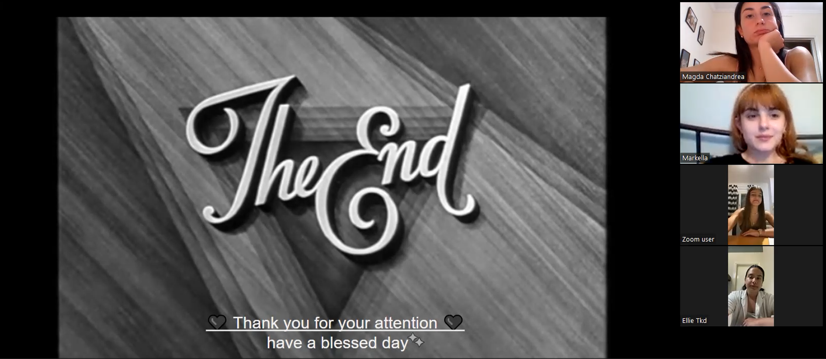

Slide 26
Reading on Attention
Matthew B. Crawford, The World beyond Your Head: On Becoming an Individual in an Age of Distraction (New York: Farrar, Straus and Giroux, 2015), 89–112.
Byung-Chul Han, The Burnout Society, translated by Erik Butler (Stanford: Stanford Briefs, 2015)
Jenny Odell, How to Do Nothing: Resisting the Attention Economy (New York: Melville House, 2019).
Williams, James, Stand Out of Our Light Freedom and Resistance in the Attention Economy (Cambridge University Press, 2018)

Slide 27
References
Dressen-Hammouda, D. and Wigham, C.R. (2022) ‘Evaluating multimodal literacy: Academic and professional interactions around student-produced instructional video tutorials’, System, 105, p. 102727. doi:10.1016/j.system.2022.102727.
Fjørtoft, H. (2020) ‘Multimodal Digital Classroom Assessments’, Computers & Education, 152, p. 103892. doi:10.1016/j.compedu.2020.103892.
Murphy, K. and Barry, S. (2015) ‘Feed-forward: Students gaining more from assessment via deeper engagement in video-recorded presentations’, Assessment & Evaluation in Higher Education, 41(2), pp. 213–227. doi:10.1080/02602938.2014.996206.
Namin, A. et al. (2021) ‘Improving student presentation skills using asynchronous video-based projects’, Journal of Management Education, 45(6), pp. 987–1010. doi:10.1177/1052562920978805.

Slide 28

Comments and Questions

Slide 29

Teacher Development
Webinars
Enhancing memory skills in exam preparation classes
with Georgia Papamichailidou
Technology’s Impact on Attention Retention and EFL Learning
with Joanna Paolinelli
Using visual literacy strategies to develop attention in the language classroom
with Kieran Donaghy
Balancing the Brain: Creating the Conditions for Learning
With Anna Hasper
Find your next webinar

