Slide 1



From Vision to Reality:
The Journey of Building a Remote,
Multi-campus EAP Department
from Scratch
BALEAP 16th of April 2025
Collaboration, Co-creation, and Community: the transformative potential of EAP
Louise Skeet Head of English Language Hub (UK)
Amanda Welfare Senior EAP Lecturer (Berlin)

Slide 2


Initial challenges and getting started
Collaboration
Impact and lessons learned
Overview

Slide 3
Initial challenges and getting started

Slide 4


Slide 5
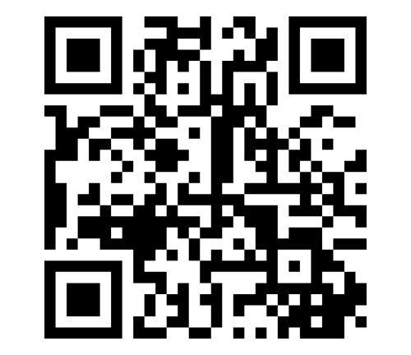
5 minutes
What were the priorities?
Discuss the initial priorities in pairs
Rank them in order of importance and urgency on Mentimeter
Code: 1214 0931
https://www.menti.com/al84kcon1j7g

Slide 6
Logistical Complexities
Blended and distance learning
Four enrolment intakes per academic year
Managing provision across seven campuses
Nuance the EAP offering for the differing student needs in each campus

Slide 7
Getting started

Slide 8
Needs analysis
Who are our students and what EAP support do they need?
Why does the university need an EAP department?

Slide 9


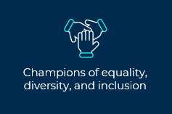
Who are our students?
Student profile: UK versus Berlin
What EAP support do they need?
__________________________________________________________
61% students in Arden’s UK campuses are EAL speakers
academic writing
Berlin campus
98%
international students
23,000 students

Slide 10

Why does the university need EAP?
Education piece – what is EAP?
Differentiating services from existing provision
Preventing encroachment
Endorsement from academic colleagues

Slide 11
Setting up in-sessional through collaboration

Slide 12
Collaboration with Berlin staff to set up our course
Priorities in Berlin:
Complete a tailored needs analysis (intercultural issues, pastoral needs, language variations)
Develop a digital course
Administration (?)
Education (EAP and our department)
Scalability
collaboration

Slide 13

Who did I collaborate with?
1. Head of Berlin Campus
2. Student Support / Administrative Staff
3. Academic staff
4. Digital Learning Designers
5. German Language Dept.
6. Careers
All of them

Slide 14
Integrating into the Berlin campus community
Head of Campus | Understanding the campus Give input about students‘ needs
Collaboration lead to being part of the academic
community
Student Support / Administrative staff | Admin support (registers, VLE) Establish our processes
Academic staff | Buy-in and support Encourage students to engage Awareness of EAP
Be open to collaboration you might not have considered
Digital Learning Designers | Co-create materials by digitalising them
German Language Dept. | Awareness raising Joint marketing and events Dedicated Languages Room
Careers Dept. | Co-create bespoke workshops with a language focus
Scalability

Slide 15
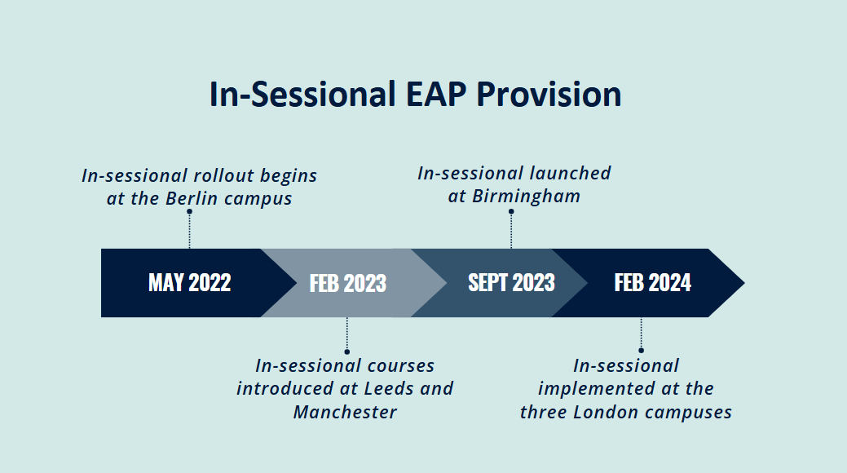
Image by Rachael Forde, Arden University (2025)

Slide 16


Impact
Discuss with a partner:
In your experience, what impact does EAP have on student’s academic outcomes and on student experience?

Slide 17
Impact on student outcomes
There is a clear correlation between students engaging with EAP provision and improved academic outcomes.
Module results
Higher engagement with EAP correlated with higher grades at the modular level.
Final-degree outcome
0% of students with no engagement in EAP support achieved a distinction at graduation.
25% of students who regularly engaged with EAP support achieved a distinction at graduation.

Slide 18
Impact on student experience
Student A:
“After finishing my studies 20 years ago, that course helped me to 'divert my brain to the proper tracks' - to start thinking and writing in more academic style of English.”
Student B:
“This course has been transformative for me, not only in terms of improving my writing skills but also in helping me feel more confident and capable in my studies overall.”
Student C:
“I would love to contribute to promoting these lessons to engage all non-native students!”

Slide 19
Institutional Impact
Institutional awareness of how EAP can improve student outcomes.
Increased institutional awareness of second language learners' needs.
Expertise sought: EAP input into various cross institutional projects such as such as improving assignment briefs.
Teacher training course.
Recognition from faculty staff: “I wanted to personally thank the ELH for helping a particular student of mine….She has made an immense amount of progress with her writing and reading, and it has been an absolute pleasure to see as her lecturer - so thank you so much! Today she discussed how her experiences so far with the ELH have been “brilliant” (her words)”.

Slide 20
Lessons learned

Slide 21


Lessons learned
The importance of tirelessly repeating the same message (tenacity wins).
Having an open mind to collaborate and co-create.
Beyond EAP including in recruitment
The importance of presence and visibility – campus community.
The importance of fostering institutional cheerleaders.
Find your institutional cheerleaders

Slide 22


Thank you

Slide 23
Louise Skeet
lskeet@arden.ac.uk
https://www.linkedin.com/in/louise-skeet-english-language/
Amanda Welfare
awelfare@arden.ac.uk
https://www.linkedin.com/in/mandywelfare
Stay in touch

