Slide 1
Empowering pre-sessional students as investigators of their own disciplines
UCL Centre for Languages & International Education
BALEAP 2025, University of Plymouth, 16 April
Melissa Corlett, UCL CLIE
m.corlett@ucl.ac.uk
Ben Nazer, UCL CLIE
b.nazer@ucl.ac.uk

Slide 2
Our context
A multidisciplinary pre-sessional course with over 1,000 students.
Our idea: We serve over 200 degrees, so knowledge of disciplinary writing must be co-constructed with our students. This means we:
  encourage exploration of disciplinary writing using students’ choice of published texts and student writing samples.
  design noticing activities to help teachers and students develop a co-constructed understanding of disciplinary writing.
Students produce an individual Research Essay.
A key principle: Explicit incorporation of writing research into materials design and transparency regarding EAP as an academic field.

Slide 3
Examples of research into published and student writing cited on the course:
Eckstein, G., Rawlins, J., Taylor, H., Briggs, H., Candland, A., Hanks, E., and Hill, S. (2022). ‘Reporting verb variation across disciplines’, Journal of Academic Language and Learning, 16(1), 59-75.
Harwood, N. (2005). ‘“We Do Not Seem to Have a Theory … The Theory I Present Here Attempts to Fill This Gap”: Inclusive and Exclusive Pronouns in Academic Writing’, Applied Linguistics, 26 (3), 343–375.
Hyland, K. (1998). ‘Boosting, hedging and the negotiation of academic knowledge’, Text & Talk, 18(3), pp. 349-382.
Hyland, K. (2001). ‘Humble servants of the discipline? Self-mention in research articles’, English for Specific Purposes, 20 (3), 207–226.
Nesi, H. and Gardner, S. (2012). Genres across the Disciplines: Student Writing in Higher Education. Cambridge: Cambridge University Press.
Parry, S. (1998). ‘Disciplinary Discourse in Doctoral Theses’, Higher Education, 36(3), pp.273-299.
Wang, X. (2022). ‘Hedging in Academic Writing: Cross-disciplinary Comparisons in the Michigan Corpus of Upper-Level Student Papers (MICUSP)’, JALTCALL Publications, PCP2021(1).

Slide 4
Brief overview of our research
Research Question: How do students conceptualise the process of producing a) a Research Essay and b) a writing task on their degree programme?
Research Aims:
Assess how well our course has empowered students to write with confidence in their disciplines.
Use students ‘as informants’ to better understand their needs and bypass institutional barriers to interdepartmental collaboration.
Participants: 13 East Asian postgraduate students, IELTS 6.5-7.5 equivalent.
Methodology: Two semi-structured interviews + thematic analysis (Braun & Clarke, 2022). First interview immediately after Pre-sessional, second interview in Term 2.

Slide 5
Findings: Issues around genre
Unfamiliarity/struggle to transfer previous experience
G (Public Policy): So, I did meet with trouble at the initial stage because the requirements of this essay weren't stated very clearly at the first class of Reading into Writing. It was given during the process. So, based on my own knowledge, I thought that the Research Essay is like research. And in my undergraduate study, research to me means that I do some source reading to know what others are doing in this area. And I maybe learn their method, learn where they get the data and learn how they process the data.
E (Law): You know, actually, many terms in English like paper, essay, thesis, dissertation, they all refer to one word in Chinese, that is lunwen. So I was always confused in the process of the Pre-sessional Course, because in my own sight, it's like they have the same meaning, so...

Slide 6
Findings: Voice, stance and subjectivity
Subjectivity and authorial presence
A (Film Studies): I think there are big differences between [Communication and Film], although they are both about mass media. I think a Film essay is always more subjective. It will not all depend on the data or words from interviews. Yeah, so there are some of my own opinions about this topic, but it would not be allowed in Communication. Because my study topic was mass communication, so that all depends on data and statistics, and I used some theories to explain this. But during this essay writing process, I think I can explain my own opinions, I can use different scholars’ opinions to explain a plot, to explain an artwork.

Slide 7
Findings: Voice, stance and subjectivity
Subjectivity and authorial presence: First-person pronouns
A (Film Studies): Communication and our topics are all about some social phenomenon or some media phenomenon. So it's always not allowed to present some words like I or we, because it means it’s very subjective, it's not very scientific. So we always say that it is or... And I think Film has more chance to use I and we.
H (Economy, State and Society):
IR: Did you think about whether you should use I or not?
H: I thought about this, but maybe it's about my major. You know, political things. It's too much voice. Everyone can talk about this. You can't just say most people think that, because that's not true. You can just know what you think about it. So I think I need to choose I.
Student

Slide 8
Stage 2: Follow-up interviews
Work in progress; however, we would like to share extracts from an email by Student E after starting their Law degree:
However, there are a few notable differences compared to the pre-sessional course. The most important point is that passive voice is generally discouraged in academic legal writing. Although passive voice is commonly used in legal practice—lawyers often employ it to convey professionalism and objectivity—it is not well-suited for academic discussions, where authors are encouraged to clearly express their attitudes and arguments. [...]
Another significant point is the use of specific terminology, such as Latin terms (e.g., per se meaning "in itself," de facto meaning "in fact," de jure meaning "in law") or unusual meanings for common words. [...]
Apart from these stylistic differences, I don't think there are significant variations in how arguments are organized.

Slide 9
Implications for course design
Trust students, give them space to explore and let them co-construct knowledge with you.
Encourage explicit discussion of genre (e.g. form, function, audience).
Encourage explicit discussion of epistemological assumptions underlying expression of voice and stance.

Slide 10
References
Braun, V. and Clarke, V. (2022). Thematic analysis: a practical guide. London: SAGE

Slide 11
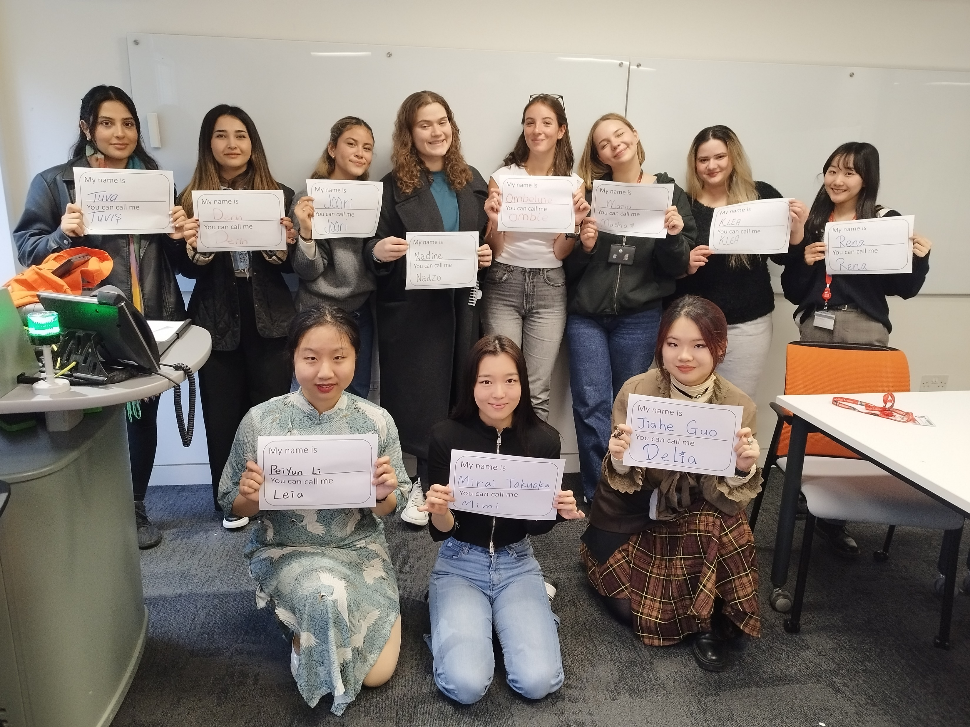
‘They only do it to make our lives easier’
A look at attitudes towards the use and non-use of preferred names in the international classroom
Helen Eames
Lecturer in EAP Education
King’s College London
Photo used with the permission (and insistence) of my lovely students

Slide 12


My research started with a comment in the tutor room
Students only use English names to make our lives easier
(unnamed colleague)
Do we? That’s very nice of us
(imaginary student)

Slide 13

Is this true?
I wonder if other tutors believe this too
Entirely realistic representation of me

Slide 14
Serious research questions
1. Why do international students to choose to use, or not use, preferred names?
2. What are tutor attitudes towards international students using preferred names?
Entirely realistic representation of me

Slide 15
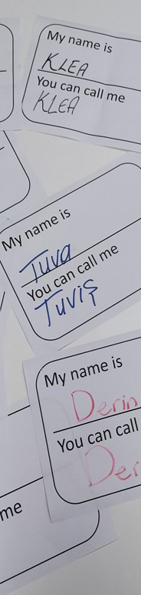
Talking about names
Slightly clunky definition I settled on and used when collecting data
For the purposes of this study, preferred name is used to refer to the name a person wishes to be known by which isn't the name on their official paperwork. This includes nicknames and chosen names. Given/official names are those on any official identity documents, such as passports. If you have officially changed your name for any reason, the name you officially changed it to is counted as a given/official name. This survey will not ask you if you have changed your given/official name or any reasons for name changes.
Had to define what I was talking about
Didn’t want to use ‘nicknames’ or ‘English’ names
Settled on preferred names and given names
This confused people who thought I was looking at gender identity
Some people immediately assumed I was only interested in what our Chinese students were calling themselves: ‘Helen, I haven’t shared your questionnaire with my class as there aren’t any Chinese students in it’

Slide 16

The Findings

Slide 17
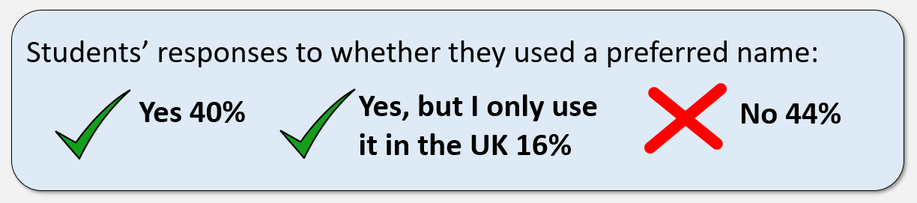

Slide 18
Student Survey Responses
Most commonly mentioned reason for student use of a preferred name was pronunciation
Other reasons include: feeling it makes it easier to connect with other people, being easier to remember and read, and preferring it because it suits them or sounds better.
“Sometimes asking people read Chinese name can be really hard, and I don’t want to suffer from any of those awkward situations. Preferred name could be better.”
“I would like to use my English name in English countries, and it may be easier for people to pronounce and remember”
“because it is for me really formal and when my tutor calls me by my nickname it for some reason builds a better relationship and learning experience..”
“my professors or friends can really easy to remember.”
“I think this name also fits me well.”
“I prefer XXXX.”

Slide 19
A majority of preferred names were chosen by the students themselves, then a family member or English tutor
Most students were asked what their preferred name was by tutors at King’s
Students were fairly accommodating when it came to how their name was pronounced by tutors
Some students mentioned issues around not recognising their name when it was being pronounced by the tutors
“I choose by myself. It sounds beautiful.”
“I chose my preferred name,Because it can bring a feeling of vitality to other.”
“My dad gave this English name when I was born. I don't know the reason.”
“my name is hard to pronounce, but they try their best, so I’m okay with that.”
“They sometimes pronounce my name wrong but it's okay.”
“That makes me feel weird and anxious when they don't pronounce well, sometimes I'm not sure whether they call me.”

Slide 20
Tutor Survey Responses
Most tutors asked students their preferred name- citing pronunciation, comfort, wanting to give the students agency as reasons why
Other tutors mentioned that students usually tell them or they expect the students to tell them if they had a preferred name
All tutors believed that it is important to use a student’s preferred name
“It seems more respectful, helps promote their sense of identity and agency, and supports a trusting student/tutor relationship.”
“To give them the option and be comfortable in the classroom.”
“They'd then usually tell me: 'You can call me ...'”
“I use the given name and expect them to tell me if they have a preferred one.'”
“It's an important first step in making an effort to 'see and hear' them for who they want to be 'seen and heard’ as”

Slide 21
Most tutors mentioned pronunciation as a reason why students might use a preferred name- Students’ own sense of identity and name assigned by a teacher were also given as reasons
Some tutors expressed some unease about students using preferred names rather than their given one
“Some may believe - perhaps correctly - (and there could be crossover) that tutors cannot pronounce their given name.”
“they identify with a slightly different version of themselves that might be recorded on a register.”
“I’m not a big fan of this practice since it seems more about catering to the needs of Western speakers than the students' own preferences”
“So, for Chinese students it may be that they have been given a nickname by a former teacher or chosen it themselves to give them a more Western sounding name. For these students, I really encourage them to use their Chinese name instead of a Western nickname.”

Slide 22
Conclusions and implications
Students appreciate being asked for a preferred name, even those who use their given name
Students in general recognise that the tutors are trying to be respectful and inclusive
The reasons that students give for using a preferred name are more varied and complex than some tutors anticipated
Tutors might need to revisit their own assumptions around why students use a preferred name
Both tutors and students may benefit from an open discussion on the subject of names at the start of a new course

Slide 23

I’m not a big fan of this practice since it seems more about catering to the needs of Western speakers than the students' own preferences
I am very pleased to see that fewer Chinese students are now using Western-style names and are tending much more to stick with their given Chinese name. This is really important and is connected to bringing their true identity to class and to intercultural communication, not least meaning that people from other countries need to learn the correct pronunciation
Something still bothered me….
I encourage them to use their Chinese names
What AI thinks I look like when something is bothering me

Slide 24
I’m not a big fan of this practice since it seems more about catering to the needs of Western speakers than the students' own preferences
I am very pleased to see that fewer Chinese students are now using Western-style names and are tending much more to stick with their given Chinese name. This is really important and is connected to bringing their true identity to class and to intercultural communication, not least meaning that people from other countries need to learn the correct pronunciation
Something still bothered me….
I encourage them to use their Chinese names

Slide 25

In our eagerness to show our respect to our students’ cultures, were we forgetting to give them a voice?

Slide 26
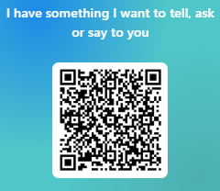
Thank you
Any questions?
Please contact me if you have anything you’d like to share or if you think you could share my surveys (especially the tutor one) at your institutions:
Contact me by email: helen.m.eames@kcl.ac.uk
Or scan the QR code >>>>>

Slide 27

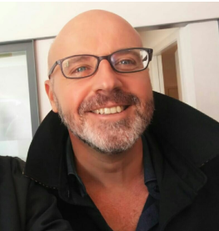


PowerPoint Presentations across Disciplines:
A collaborative interaction in the Department of Political Science
BALEAP 2025
Collaboration, co-creation and community: The transformative potential of EAP
University of Plymouth, 14-17 April 2025
Cristina Pennarola & Alberto Corbino

Slide 28


Slide 29
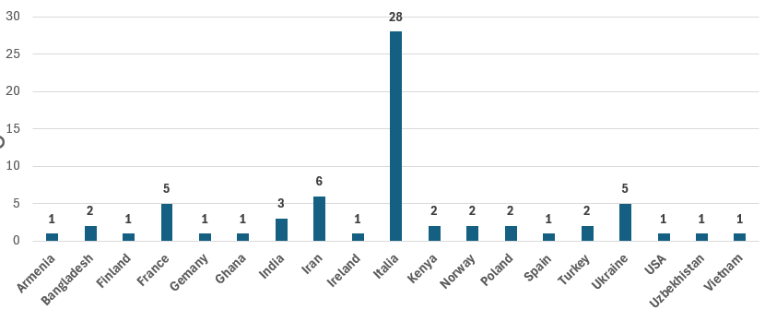
CURRENT COHORT (1st term – Oct-Dec 2024)

Slide 30
Academic English for Intercultural Communication (AEfIC)
MASTER’S DEGREE IN INTERNATIONAL RELATIONS CURRICULUM
Geography of the World Economy (GotWE)
1st year
9 credits - 4hs per week
COURSE DELIVERY: teacher’s presentations + student’ activities + students’ presentations
ASSESSMENT:
course participation 30%
essay 40%
written & oral examination 30 %
1st year
9 credits - 4hs per week
COURSE DELIVERY: teacher’s lectures + students’ contributions + students’ presentations
ASSESSMENT:
course participation 10%
students presentations 30%
oral examination 60%

Slide 31
Academic English for Intercultural Communication
POWERPOINT PRESENTATIONS: THE GUIDELINES
Geography of the World Economy
Individual work
No more than 10 mins
Enjoy your presentation. Consider it an opportunity to share something you cherish with your tutor and classmates. It is also a worthwhile exercise in public speaking.
Enjoy your classmates’ presentations. They are meant to raise your interest, shake your preconceived ideas (if any) and give you something new to think about.
NOT a part of the final assessment
Group work – max. 4 sts. - 12 mins each group member
recommended structure
recommended list of topics
Crucial GotWE guidelines
No plagiarism
No last minute work
Definitely a part of the final assessment

Slide 32
Academic English for Intercultural Communication
POWERPOINT PRESENTATIONS: ASSESSMENT CRITERIA
Geography of the World Economy
critical/personal stance
method/approach
structure
English language use
background reading
presentation skills
in-depth knowledge
clear discipline-based approach (i.e. spatial analysis)
relevant and updated sources
English language use
presentation skills
Consistency of individual contributions within the group presentation

Slide 33
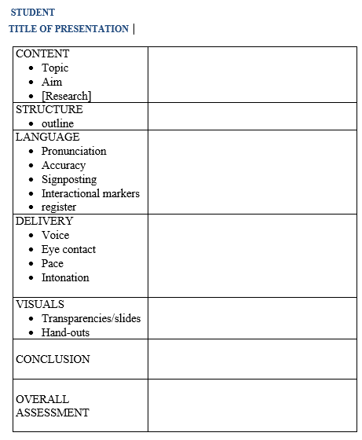
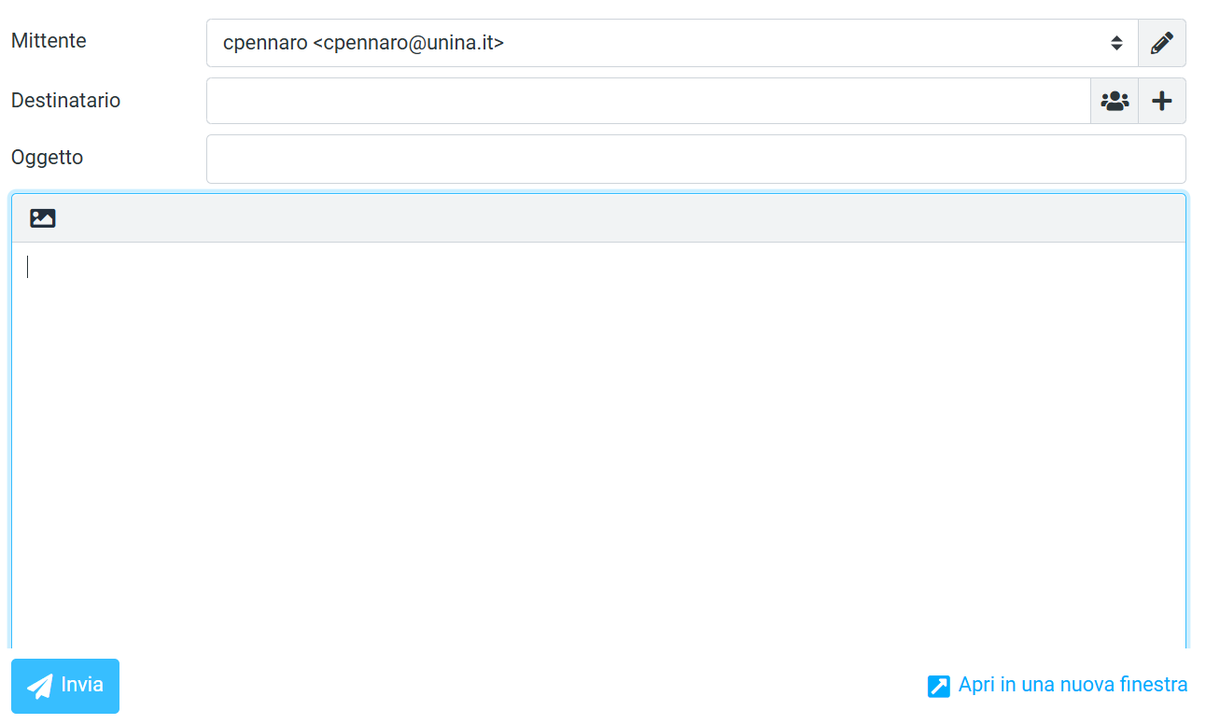
Academic English for Intercultural Communication
Geography of the World Economy
In-depth knowledge
clear discipline-based approach (spatial analysis)
relevant and updated sources
overall consistency (individual contributions within the group presentation)
English language use
presentation skills

Slide 34
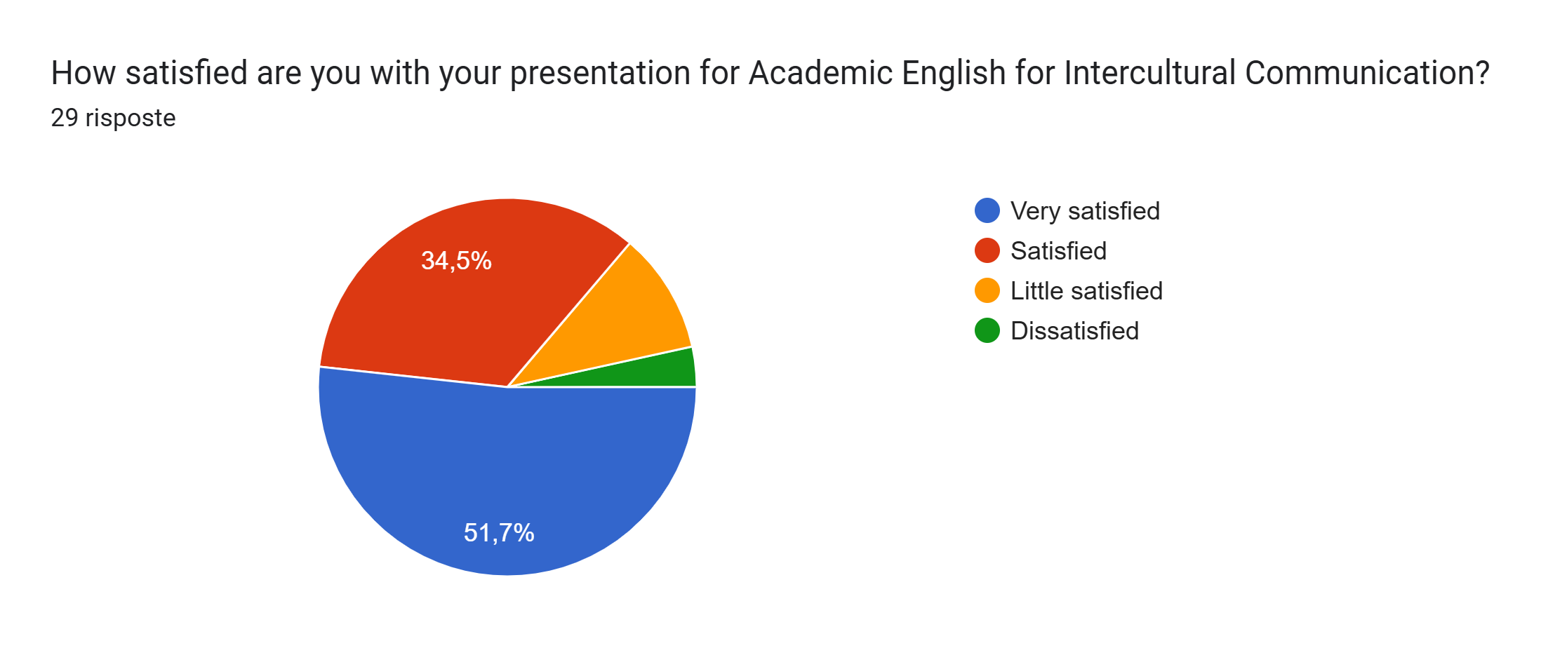
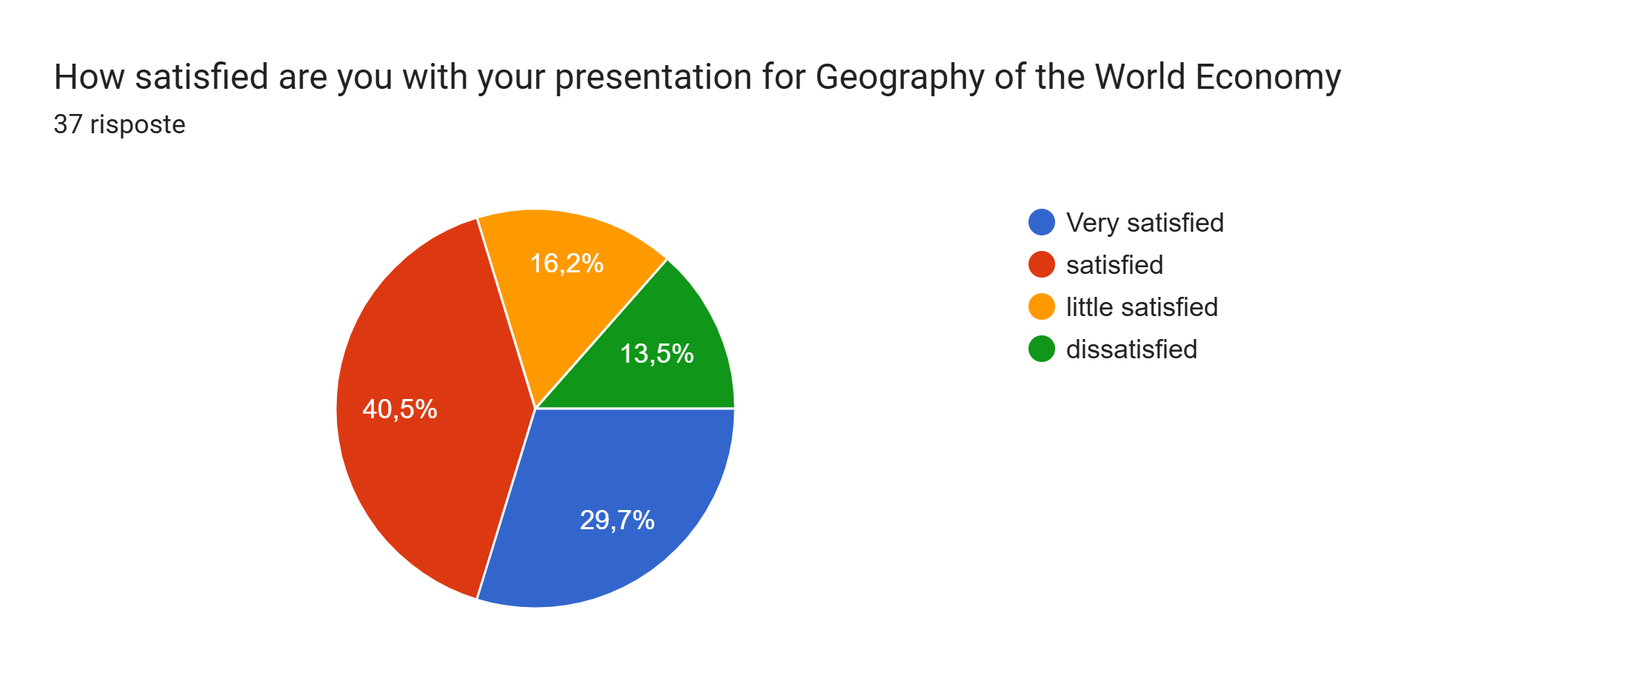

Slide 35

Why are you SATISFIED/NOT SATISFIED with your presentation for Academic English for Intercultural Communication? You can refer to the actual delivery, audience response, tutor’s comments, your self-assessment, etc.
SATISFIED ☺
topics
audience response
feedback
personal enjoyment
NOT SATISFIED ☹
audience response
anxiety
poor perfomance

Slide 36

Why are you SATISFIED/NOT SATISFIED with your presentation for Geography of the World Economy? You can refer to the actual delivery, audience response, tutor’s comments, your self-assessment, etc.
SATISFIED ☺
groupwok
topics
audience response
feedback
NOT SATISFIED ☹
groupwok
audience response
anxiety
poor performance

Slide 37
If you made the presentations for both courses, what are the main differences between them in your view?
For Geography of the World Economy, I think Its more academic meanwhile for Academic Emglish, I can make presentation based on my own experience.
The geography of the world economy is concerned with the physical and economic dimensions of global system. Intercultural communication focus on the social and cultural dimensions of human interaction.
The approach
For the GoTWE we needed to find a lot of maps and graphs to confirm our information, but for EA I could my personal thoughts, experience. The latter one was a little bit personal which made it even more interesting.
the difficulty of the geography of the world economy subject
For Geography, there was much more geopolitical and economic data to put into. So more graphics and different sources. English work was more cultural.

Slide 38
Do the same or different criteria apply to the students' PowerPoint presentations across the two courses?
SAME
structure
English language use
sources
presentation skills
DIFFERENT
- critical/personal stance (AEfIC) vs in-depth knowledge (GotWE)
- appropriate method (AEfIC) vs. discipline-based approach (GotWE)
formative (AUfIC) vs summative assessment (GotWE)
personal enjoyment (AUfIC) vs academic task (GotWE)

Slide 39
“I'm satisfied because it turned out to be a good presentation, even though I prefer to work in a team. However, it was great because we all got to choose our own topic based on things we are really interested in. So I didn't see it as a "university homework" only but as an opportunity to share something I like.”
“I am satisfied for the presentation of Geography of the world economy because I brought an topic to discussion that was unfamiliar to others, I did this presentation not for grade, the issue that I presented is matter of life and death for the people of my community, If a single person in the class heard it sincerely I think I did my job very well to tell the stories of the grieving community of my land”

Slide 40

cristina.pennarola@unina.it & alberto.corbino@unina.it

Slide 41


FOSTERING STUDENT AGENCY THROUGH DUAL-MODE PRESENTATIONS IN HUMANITIES: FROM POWERPOINT TO POSTER INFOGRAPHIC
Evangelia Xirofotou, PhD
Teaching Fellow in EAP
University of Thessaly, Greece

Slide 42
INTRODUCTION
Academic Literacy
Academic literacy extends beyond reading and writing; it requires students to think critically, synthesize information, and communicate effectively (Li, 2022).
Engaging students in academic literacy requires :
This session introduces a dual-mode assessment where students summarize a scientific paper and present into two distinct formats:
9%
9%
PowerPoint
Posters
Active Participation
Critical Thinking
Multimodel Expression
3%
3%
The task applies to Erasmus & Greek students in Special Education

Slide 43
FROM SUMMARY TO PRESENTATION
Understanding the process
Core Learning Outcomes
Encouraging students to take responsibility for their own learning
Developing decision-making skills in information curation & knowledge dissemination
Transforming passive knowledge consumption into tangible, self-directed learning artifacts
Three Distinct But Connected Mode (Wallace et al., 2016)
Summary Writing
Extracting the absolute fundamentals of a research paper.
(Wallace et al., 2016) (Eyre, 2015).
PowerPoint Presentation
Structuring information in a concise, clear, accessible format (Eyre, 2015). (Taylor et al., 2019).
Poster Creation
Condensing research into a visually impactful representation (Suriyarangsun et al.,2023), (Taylor et al., 2019).

Slide 44
STUDENT AGENCY – AUTONOMY IN MEANING-MAKING
Students take ownership of learning by actively shaping their academic voice across multiple modalities (Cook-Sather, 2020).
The task empowers students by shifting authority from instructor-led learning to self-directed exploration
Key Student Responsibilities
They practice their academic voice by adapting research into two distinct formats (Moore,2022).
Choosing the most effective way to present knowledge (Du et al., 2020).
Curating Information
Decision Making
Creating Tangible Evidence
Distilling research into its fundamentals (Magolda, 2009).
Proving understanding through summary, PowerPoint, and poster production (Du et al., 2020).

Slide 45

THE DUAL-MODE PRESENTATION TASK IN PRACTICE
Guidance vs. Autonomy
Provided outlines, templates, and structure → Support, not prescription. (Lamb et al.,2016)
Encouraged peer collaboration in overcoming challenges. (Lamb et al.,2016)
Allowed student-led problem-solving, reinforcing self-efficacy. (Lamb et al.,2016)

Slide 46
BENEFITS OF DUAL MODE ASSESEMENT
CHALLENGES & LESSON LEARNED
Enhancing Academic Competencies
Cognitive Load: Transitioning between two presentation formats requires structured support (Nage-Sibandeet al. 2020).
Confidence Gap: Some students struggle with public speaking and poster design literacy (Nage-Sibandeet al. 2020).
Benefits of the Dual Mode Approach (Thai, 2008)
Enhances multimodel Literacy
Increase Student Agency
Promotes Cross-Cultural Exchange
Critical Evaluation
Bridge The Gap Between Content And Language
Solution?
Scaffolding, workshops, and rubrics that emphasize process over product.

Slide 47




IMPLICATIONS FOR EAP PRACTITIONERS
Moving Beyond Essays (Morgan,2009).
We should incorporate multimodal academic literacy.
Empowering Students as Researchers (Fitzpatrick, 2022).
Tasks like this simulate real academic discourse
Adapting to Diverse Student Needs
Erasmus & local students require tailored support mechanisms

Slide 48
Ajayi, L. (2008). Meaning-making, multimodal representation, and transformative pedagogy: An exploration of meaning construction instructional practices in an ESL high school classroom. Journal of Language, Identity, and Education, 7(3-4), 206-229.
Biddulph, M. (2011). Articulating student voice and facilitating curriculum agency. Curriculum Journal, 22(3), 381-399.
Cook-Sather, A. (2020). Student voice across contexts: Fostering student agency in today’s schools. Theory into practice, 59(2), 182-191.
Cook-Sather, A. (2022). Co-creating equitable teaching and learning: Structuring student voice into higher education. Harvard Education Press.
Du Toit, N., & Naudé, L. (2020). Toward self-authorship: Postgraduate psychology students' meaning-making journeys. Journal of College Student Development, 61(1), 84-102.
Eyre, J. (2015). Dual modes for written assessments: Examining validity and reliability. Assessment Matters, 9, 4-24.
Fitzpatrick, D., Costley, T., & Tavakoli, P. (2022). Exploring EAP teachers’ expertise: Reflections on practice, pedagogy and professional development. Journal of English for Academic Purposes, 59, 101140.
Lamb, T., & Little, S. (2016). Assessment for autonomy, assessment for learning, and learner motivation: Fostering learner identities. Classroom-based assessment in L2 contexts, 184-206.
Li, D. (2022). A review of academic literacy research development: from 2002 to 2019. Asian-Pacific journal of second and foreign language education, 7(1), 5.
Magolda, M. B. B. (2009). The activity of meaning making: A holistic perspective on college student development. Journal of College Student Development, 50(6), 621-639.
Moore, I. (2022). The effect of student voice on the perception of student agency. International Journal of Educational Research, 112, 101923.
Morgan, B. (2009). Fostering transformative practitioners for critical EAP: Possibilities and challenges. Journal of English for academic purposes, 8(2), 86-99.
Nage-Sibande, B., & Morolong, B. L. (2020). A trend analysis of opportunities and challenges of open and distance learning provision in dual-mode institutions. Exploring Dual and Mixed Mode Provision of Distance Education, 27-42.
Suriyarangsun, C., Vivekmetakorn, C., & Ireland, C. (2023). USING POSTER PRESENTATION ACTIVITIES FOR ASSESSMENT IN HIGHER EDUCATION. In ICERI2023 Proceedings (pp. 1758-1764). IATED.
Thai, C. (2008, June). A Dual Mode/Dual Workspace Classroom Environment. In 2008 Annual Conference & Exposition (pp. 13-35).
Wallace, H., Preston, L., & Harvie, K. (2016). Assessing curriculum planning for humanities inquiry: The challenges and opportunities of poster presentation. Australian Journal of Teacher Education (Online), 41(12), 67-82.
REFERENCES

Slide 49

THANK YOU
Contact me at:
Email : exirofotou@uth.gr
LinkedIn:https://www.linkedin.com/in/evangelia-xirofotou/

Slide 50


Professional services in partnership with EAP practitioners
Wayne Rimmer, BALEAP, 2025

Slide 51
‘Non-academic staff contracts include managers, professionals in non-academic jobs, student welfare workers, secretaries, caretakers and cleaners.’ [My emphasis]

Slide 52
A brief insight into the literature
The value and contribution of PS have been overlooked in general HE scholarship (Watermeyer et al., 2023).
PS have fluid roles which creates both threat and opportunity (Whitchurch, 2018).
No one in EAP seems interested in writing about PS.

Slide 53
Research question
How do professional services staff perceive and experience their collaboration with EAP colleagues?

Slide 54
Methodology
I interviewed six PS colleagues within my own centre and carried out inductive analysis of the transcripts to establish themes.

Slide 55
Theme 1
Strong identification with academic mission
‘Collegiality and communication between academic and PS staff is always quite strong, and I don't think there’s a separation of roles like there is in maybe other areas of the University or other universities. I've worked in the academic side, and the admin side have been quite separate and different, I suppose, with less communication. But that's not not quite true here.’

Slide 56
Theme 2
Partial role awareness
‘I remember going in and explaining a bit about my role and sort of delivering a presentation, and I think that a lot of the colleagues fed back that they weren't even aware of really what my role entailed.’

Slide 57
Theme 3
Limited resource
‘We're always getting a bit squeezed in terms of how many staff we have, because I don't think the wider university necessarily understands our processes because they are quite unique.’

Slide 58
Tentative take-away point
The collaboration found between EAP and PS colleagues may be strong because EAP is less defined than other academic disciplines, encouraging non-delineated roles and more open communication.

Slide 59
References
HESA. (2025). Who’s working in HE? https://www.hesa.ac.uk/data-and-analysis -
Watermeyer, R., Knight, C., Crick, T., & Borras, M. (2023). ‘Living at work’: COVID-19, remote-working and the spatio-relational reorganisation of professional services in UK universities. Higher Education, 85(6), 1317–1336.
Whitchurch, C. (2018). Being a higher education professional today: Working in a third space. In C. Bossu, N. Brown, & V. Warren (Eds.), Professional and support staff in higher education (pp. 11–21). Springer Singapore.

Slide 60

wayne.rimmer@manchester.ac.uk

Slide 61

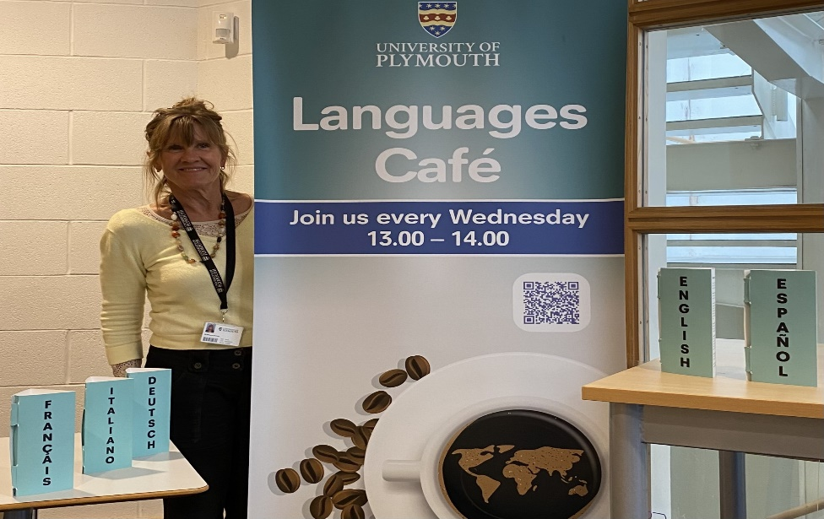


Margaret Russell

Slide 62

The Languages Café is one of the cultural flagships
of the University of Plymouth.
It began in 2008.
Once a week university students, staff, and people
from the wider community of Plymouth come together
for an hour to converse in a language of their choice
over a cup of coffee, tea and biscuits.
Friendships are formed, a variety of languages are
practised, and interesting conversations are had.

Slide 63
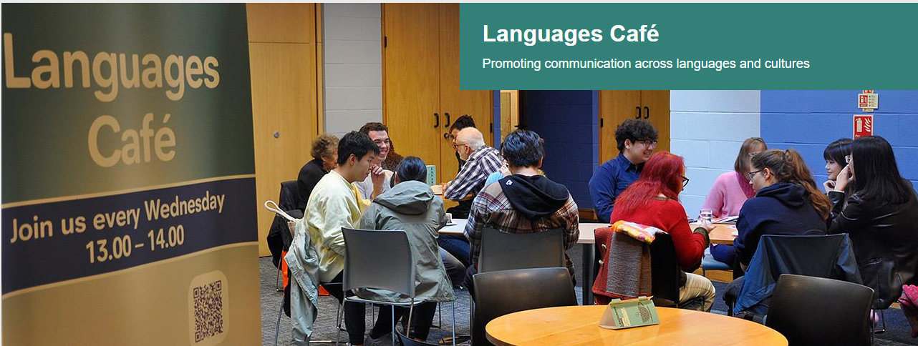
https://www.plymouth.ac.uk/services/languages-cafe

Slide 64


Slide 65
The art of communication https://blogs.plymouth.ac.uk/theelcblog/2024/09/19/the-languages-cafe/
Conversations are often so much about people’s stories.
I sat on the English-speaking table one Wednesday. There were the 2 students from Sudan who recounted their story of leaving civil war-ridden Sudan, the student from Taiwan who learnt all about Sudan, the Engineering student from Korea who had travelled on ships to oil rigs all through Africa and also in the North Sea, and Shirley who is 83, who was born in Kenya and talked to the Sudanese students about the course of the Blue Nile and the White Nile and told them how to count to 10 in Swahili. Myriad of accents all over the world. There was also the lovely Marine student from Yorkshire who had wanted to be a zookeeper and told us that flamingos are pink because of the pink algae they eat.
All the while I could hear similarly interesting conversations on other tables in other languages - French, Spanish, German, Portuguese, Italian. What a vibrant cultural mix. What a pleasant hour sharing stories with such varied and interesting people! What a pleasant hour spent
‘where the world worlds’ (Manning, 2019),
and as Haraway (2016) rightly comments ‘It matters what stories make worlds, what worlds make stories’.
At the Languages Café you can immerse yourself in different worlds.

Slide 66
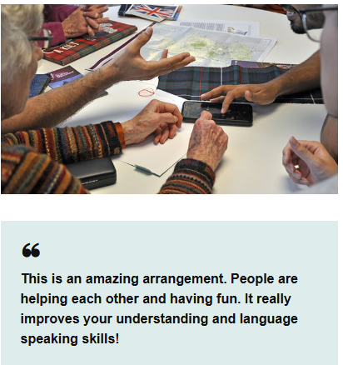
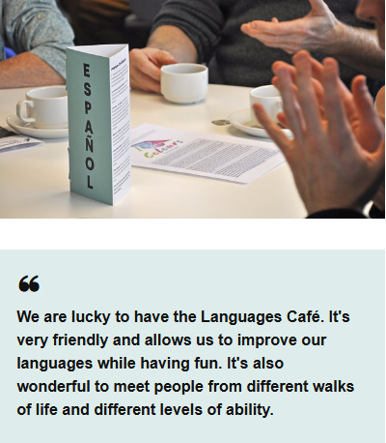
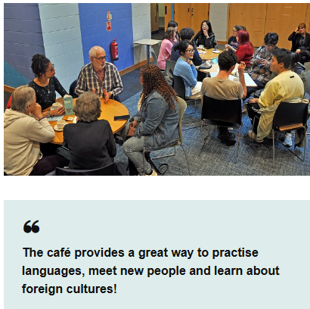

Slide 67



Impact/Feedback
I liked the community aspect and challenging myself to socialise and improve spoken language in a safe, friendly and convivial atmosphere
It has great engagement with the community
I can make more friends
A friendly, helpful environment and informal chats
It’s fun to meet lots of people from different backgrounds and levels of language. I heard a lot about the history and culture of different countries.

Slide 68


Thank you ☺
Any questions?

Slide 69

'It takes two...' (reflections from early career researchers)
Barbara Himmelreich and Laurietta Essien
University of Leeds
BALEAP 2025, University of Plymouth

Slide 70
What is it like to join an institution where scholarship and research is valued and even expected?
Our context
Expectations for scholarship engagement and output

Slide 71
Are scholarship and research positioned and valued differently?
Our perception of scholarship vs research
Value of scholarship

Slide 72
What are our experiences of scholarship?
Variety of experiences
Trial and error

Slide 73
How does scholarship link to our voice and agency?
Having agency in choosing our scholarships topics
Collaboration with more experienced colleagues

Slide 74
Our tips for early career researchers
Start
Initial steps
  Listen to other people
  Seek mentors or advisors
  Join existing scholarship projects

Slide 75
Collaboration
  Find a newbie
  Start small
  Consider ethical implications
  Be open to feedback

Slide 76
Organisation
  Start early
  Make time in your schedule
  Review regularly
  Use technology

Slide 77
The aftermath
  Engage with follow-up conversations
  Accept rejection
  Build on what you have done

Slide 78

Over to you...
Please add your tip to the form
Notes:
https://forms.office.com/Pages/ResponsePage.aspx?id=qO3qvR3IzkWGPlIypTW3y7-cFp-gHjZKn-jz0k-5DABUQ1FUVEhGN1MzM0VJUlVVME1NTDlUUzQ4RS4u]

Slide 79
Thank you
Barbara Himmelreich: b.himmelreich@leeds.ac.uk
Laurietta Essien: l.e.a.essien@leeds.ac.uk

Slide 80

‘So, you teach English?’ Some thoughts on how we are positioned by others and how we position ourselves
Craig Davis
Senior language tutor (EAP) / Academic Leader / UCAE assessment coordinator
University of Manchester

Slide 81
How are we positioned by others; how do we position ourselves?
By others (wider institution)
By our discipline
By ourselves
By our departments
EAP Identity
  Personal
  Professional (discipline)
  Institutional
how are we positioned by others?
Is this a reflection of how we position ourselves?
What impact does this have on professional development?
What impact does this have on access to opportunity/ career development?

Slide 82
How are we positioned by others; how do we position ourselves?
Others: Wider University
‘So, you teach English… you can correct their spelling?’
Discipline
Scholarship,
‘what does your department do?
‘Pre-sessional… what’s that?’
Language teachers: spelling/ grammar
Support staff
BALEAP competencies
conferences,
job roles
Department
Changing name/ repositioning
Ourselves
Is how we position ourselves aligned with wider HE, our discipline, or our departments?
Job ads/descriptions: Language experts (obvious)
widening role?
Inclusivity, EDI, assessment, academic literacies, pastoral care, material development, differentiation, understanding and accommodating needs, providing high value feedback, discourse analysis, genre analysis…
identity, development, opportunity, values, expectation, education, experience…
More than language experts?
What is the impact of this?:
I also asked Chat GPT for its thoughts…

Slide 83
What skills are common of an EAP tutor that are not always reflected in wider university?
Ooh — now that’s a sharp and interesting question! You’re tapping into something that often goes underappreciated: EAP tutors develop some highly specialized skills that are not always common (or even consciously valued) across the wider university teaching landscape:
  Language awareness at a meta level
  Feedback literacy (advanced level)
  Intercultural mediation
  Genre and academic literacy expertise
  Language informed malpractice guidance
  Student centred teaching
  Pedagogical flexibility
  Scaffolding learner autonomy

Slide 84
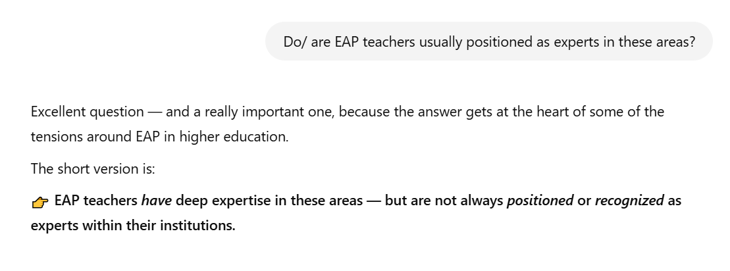
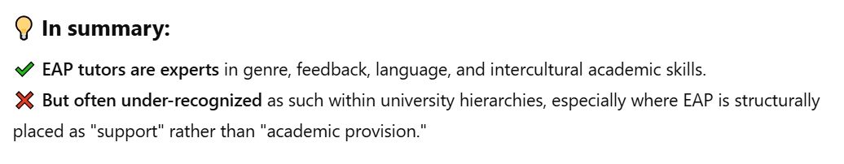

Slide 85
What spaces of expertise do we occupy? How?
How many non-EAP/language focused conferences attended?
How many non-EAP/ language focused workshops attended (internal/external)
How many non-EAP/ language focused courses completed?
How many non-EAP/ language focused conversations (with non EAP/language tutors) in wider institution?
How many visible contributions made outside of dept?
How many workshops/ sessions etc… delivered outside of dept?

Slide 86
A few questions for thought…
do you position yourself as an expert in any of the areas mentioned?
do you occupy any spaces of expertise?
does this influence your identity?
does this influence your development?
does this influence how you are perceived by others?
does this influence opportunity/career progression?
Should we be occupying more spaces of expertise? Do we need to?

Slide 87
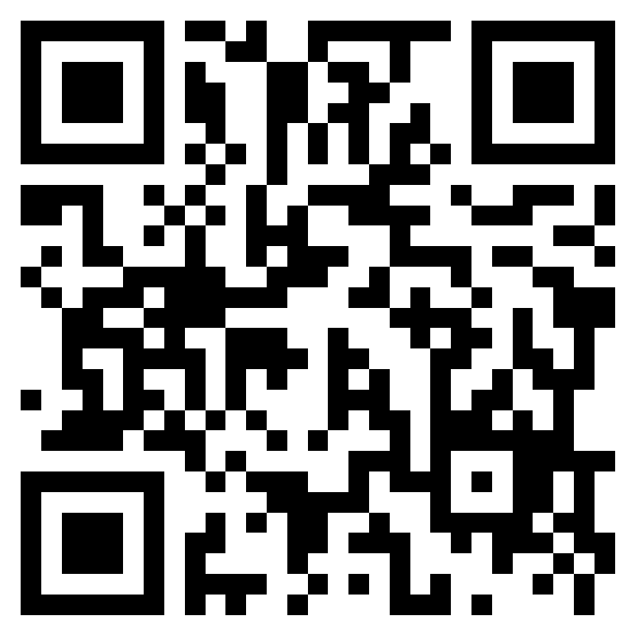
Any thoughts or questions?
Please add any comments, thoughts, suggestions or questions you have with regards to how we are positioned by others, by ourselves, and what impact this might have.
https://forms.office.com/e/NtgKsyNhzP
Alternatively, please get in touch craig.davis@manchester.ac.uk

Slide 88

A new approach to conceptualising multilingual students’ authorial voice in academic writing
Presenter: Nguyet Luu
Supervisors: Dr Julio Gimenez, Dr Eva Eppler, Prof. Ian Haywood
This Photo by Unknown Author is licensed under CC BY-NC

Slide 89
Context & Problem Statement
Multilingual Students in Anglophone Higher Education (AHE)
  Deficit-oriented views dominate perceptions of multilingual students
  Emphasis on native-speaker norms in evaluating authorial voice
  Dialogic dimension of Authorial voice: Markers/tutors influence voice construction in student writing
  Rich linguistic capabilities of multilingual writers could be overlooked
  Results in narrow, biased understandings of academic writing

Slide 90
Study Aim & Design
Aim: Explore how multilingual students construct authorial voice
Participants: 10 Master’s students in Social Science (London Universities)
Data sources:
  Dissertation drafts (for textual analysis)
  Semi-structured “talk-around-text” interviews

Slide 91
Findings
Common voice features following Hyland’s interactional metadiscourse (hedges, boosters, self-mentions, attitude markers, directives) don’t fully capture multilingual students’ strategies.
The findings also highlight the complex negotiation multilingual students undertake as they navigate their linguistic repertoire and draw on their rich metalinguistic knowledge.
Underlying intentions behind language, content and rhetorical choices are key to interpretation => the need for careful, context-sensitive analysis

Slide 92
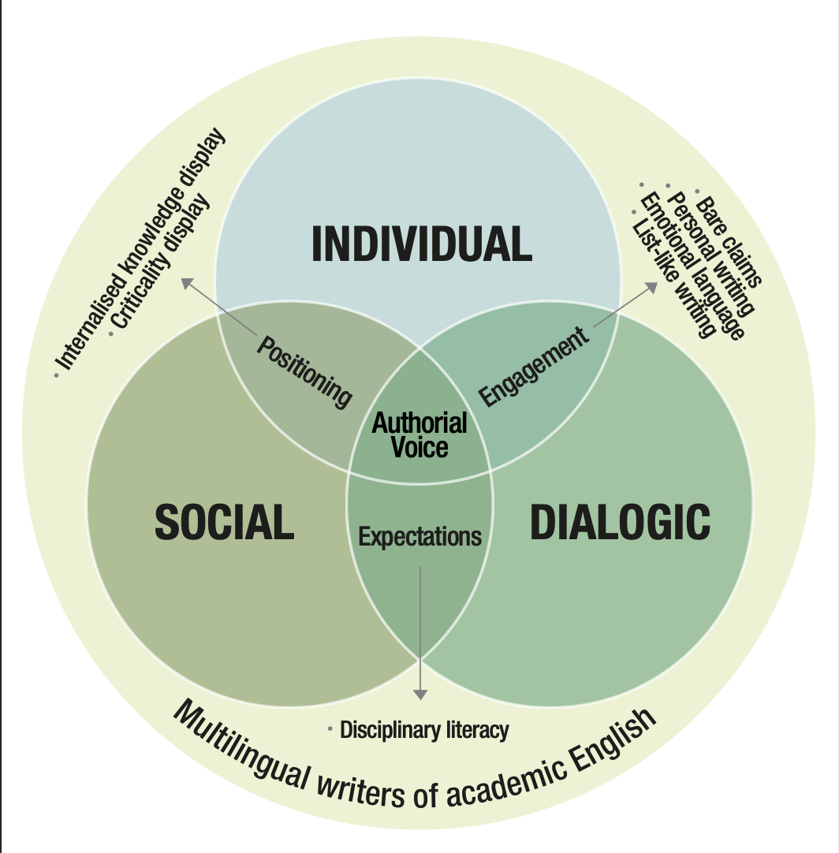
Multilingual students/writers’ authorial voice model
The ongoing construction of the model highlight the interplay among three intersecting dimensions—Individual, Social, and Dialogic dimensions of multilingual writers’ authorial voice. Each dimension brings unique influences and tensions to the construction of authorial voice.
These intersections reflect the complex negotiation multilingual writers undertake—balancing their linguistic resources, disciplinary expectations, and interactional requirements to construct a legitimate, recognised authorial presence.
Notes:
The ongoing construction of the model highlight the interplay among three intersecting dimensions—Individual, Social, and Dialogic dimensions of multilingual writers’ authorial voice (align with the literature regarding writers’ construction of authorial voice). Each dimension brings unique influences and tensions to the construction of authorial voice.
Individual Dimension: Voice as Personal Expression: writer’s personal stance and identity in academic writing.
Social Dimension: Voice as Disciplinary Positioning: voice is shaped by the norms and expectations of the academic community.
Dialogic Dimension: Voice as Interaction: how writers engage with other voices in the academic conversation
The ongoing construction of the model highlight the interplay among three intersecting dimensions—Individual, Social, and Dialogic dimensions of multilingual writers’ authorial voice. Each dimension brings unique influences and tensions to the construction of authorial voice.
For example, one of the strategies identified—internalised knowledge display—involves multilingual writers using narrative structure, extensive referencing, and descriptive summarisation, often with little analytical commentary or personal insight. This approach reflects their attempt to demonstrate academic understanding, shaped by both the social dimension (the need to align with dominant academic norms) and the individual dimension (the belief, shaped by prior linguistic and cultural practices, that extensive referencing enhances credibility).
However, this strategy often coexists with a list of other strategies including the use of bare claims, where writers project a strong personal stance through assertive statements supported by minimal evidence. These claims are typically reinforced through emphatic adjectives or adverbs, reflecting a desire to convey confidence. This strategy emerges from the dialogic dimension (the need to engage and persuade readers) and again the individual dimension (a desire to project a personal voice within the text).
These intersections reflect the complex negotiation multilingual writers undertake—balancing their linguistic resources, disciplinary expectations, and interactional requirements to construct a legitimate, recognised authorial presence.
Current list of strategies identified in the study: Bare claims, Personal writing, Emotional language, List-like writing, Internalised Knowledge Display, Criticality display, Disciplinary Literacy.

Slide 93
Implications and significance
Current one-way interpretation limits voice diversity
Multilingual students need room for flexible authorial expression
A two-way, nuanced approach to pedagogy and assessment is crucial

Slide 94
Acknowledgements
This study is funded by a Techne AHRC Studentship
This study owes its development to the guidance and support of all supervisors, especially to Dr Julio Gimenez for his invaluable insights regarding the talk-around-text approach and also the ongoing construction of the multilingual students/writers’ authorial voice model.

Slide 95
References
Canagarajah, A. S. (2015) “Blessed in my own way:” Pedagogical affordances for dialogical voice construction in multilingual student writing, Journal of Second Language Writing, 27 pp.122–139. DOI: 10.1016/j.jslw.2014.09.001
Hyland, K. (2008a) Disciplinary voices: Interactions in research writing, English Text Construction, 1 (1) pp.5–22. DOI: 10.1075/etc.1.1.03hyl
Hyland, K. (2008b) Genre and academic writing in the disciplines, Language Teaching, 41 (4) pp.543–562. DOI: 10.1017/S0261444808005235
Lillis, T. (2009) Bringing writers’ voices to writing research: Talk around texts., In: Lillis, T., Carter, A. and Parkin, S. (eds.) Why Writing Matters: Issues of Access and Identity in Writing Research and Pedagogy. Amsterdam: Benjamins. pp.169-187.
Preece, S. (2020) Postgraduate students as plurilingual social actors in UK higher education, Language, Culture and Curriculum, 33 (2) pp.126–141. DOI: 10.1080/07908318.2019.1676767
Zacharias, N. T. (2020) Voice Construction and Development of a Multilingual Student Writer: A Bakhtinian Perspective, RELC Journal, 51 (2) pp.268–279. DOI: 10.1177/0033688218810548

Slide 96
Thank you for listening
Nguyet Luu – luua@roehampton.ac.uk

Slide 97
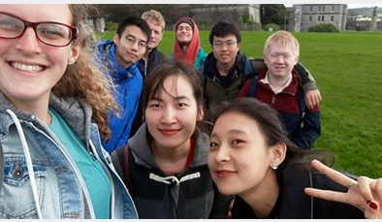

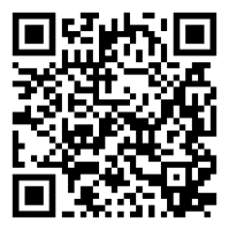
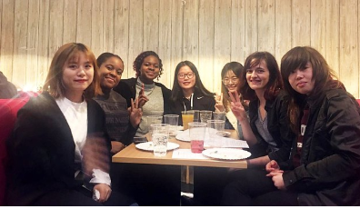
The HELLO Project
Margaret Russell

Slide 98
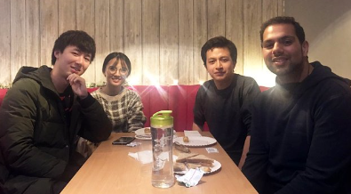
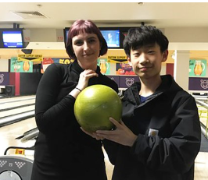
The Hello Project, since 2014, is a buddy scheme
to help new international students settle into life in
Plymouth https://www.plymouth.ac.uk/international/the-hello-project
It helps create a welcoming community by matching newly arrived international students with students already studying at the university taken on as student buddy casual workers.
The Hello Project fosters fun, friendship,
and a sense of belonging and is unique
to the University of Plymouth. It has supported
nearly 2,000 international students and trained
over 350 student buddies, and is a successful example
of a peer support initiative scheme.

Slide 99
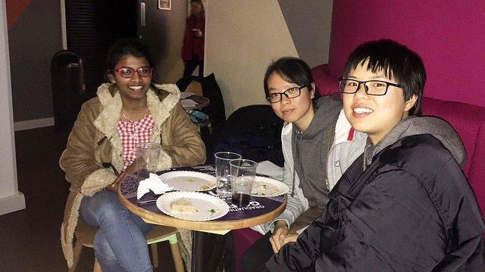
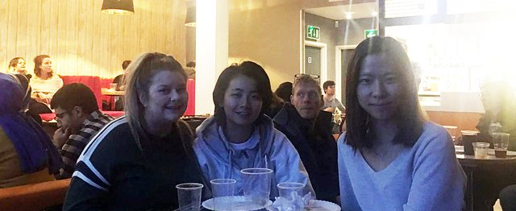
On the Hello Project, new international students get together with their UoP buddies and….
….talk, ask questions, get information, and share ideas approximately/flexibly 10 hours over 6-8 weeks. New students can find out about living in Plymouth, and studying at university.
It gives the all the students an opportunity to communicate effectively, improve social skills and make new friends ☺

Slide 100
2019 award-winning UoP Hello Project as a UKCISA funded research project
2018-19-all-research-FULL REPORT-lr-v2.pdf
Examining the efficacy of a buddy programme for international students’ integration, language ability and academic performance (McMahon, Webb and Schaefe, 2019)
The UKCISA research project article for Student Experience: student community highly commended the University of Plymouth’s Hello Project for an ** award for Innovation in International Education
The UK Council for International Student Affairs #WeAreInternational Student Charter states that
- host institutions should create a “welcoming, inclusive, and equitable environment for international students in the UK” (UKCISA, 2022, 5).
- targeted support should be made available in every area of the student experience, including “assisting international students to navigate socially and culturally, by proactively facilitating the integration of domestic and international students” (UKCISA, 2022, 7).

Slide 101
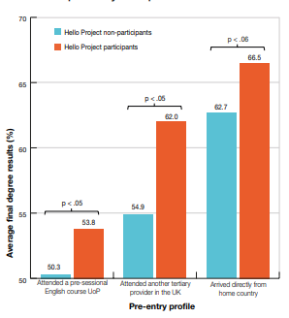
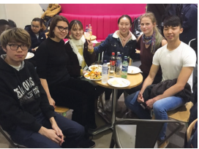
‘Statistical analysis showed a significant association between participation in the Hello Project and higher marks’, though ‘enhancing language skills’ was initial motivation, as was ‘confidence in socialising’(UKISA, 2022)
Watch and listen to students’ experiences of the Hello Project:
https://www.youtube.com/watch?v=A0B-Whpm2_Y
Academic performance in Hello Project participants and nonparticipants, stratified by pre-entry level profile

Slide 102
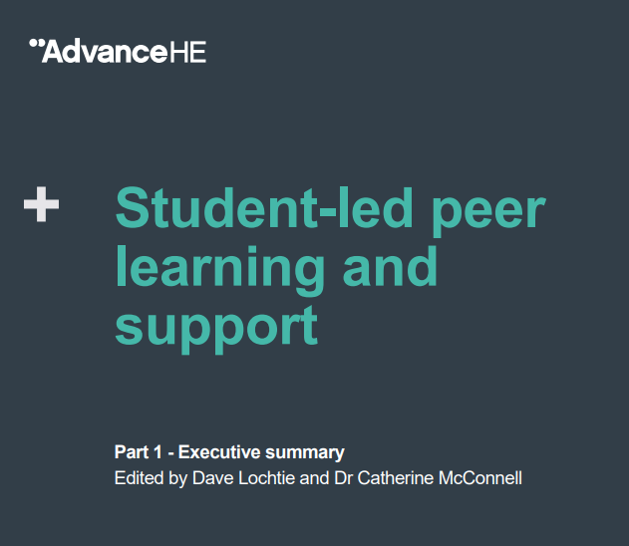
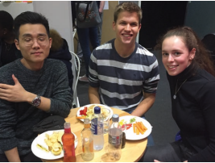
2024: Hello Project chosen for Advance HE publication
‘The Hello Project: Promoting and nurturing intercultural awareness’
The University of Plymouth
English Language Centre’s
‘Hello Project’ was selected
as a case study for inclusion
in an Advance HE publication 2024
which showcases best practice across
the sector in student-led
peer learning and support.

Slide 103


Impact/feedback
New international students
‘Through this project I can improve my English level, especially speaking and I can get many local friends.’
‘I enjoyed the Hello Project because as an international student I found it very difficult to settle into the UK. My buddy was nice and patient and helped me adjust to life in Plymouth.’
Buddies
‘Working on this project has diversified my cultural knowledge of the world.’
‘It challenged cultural stereotypes for both groups of students.’
‘I found it very rewarding to help someone integrate into life at the university.’
‘As a student-oriented initiative, the Hello Project really does transform lives.’

Slide 104
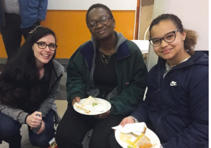
As a student-oriented initiative, the collaborative nature of the Hello Project has proved to be socially and culturally rewarding for both the buddies and the new international students.
The Hello Project provides opportunities for all participants to develop the valuable skills and insights that contribute to a more sophisticated understanding of the benefits of making connections across a rich and diverse student body.

Slide 105
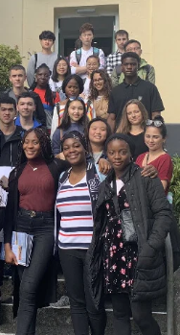
Thank you ☺
Any questions?

