Slide 1
Creating an Academic Skills Centre The story so far
Prof. Steve Kirk
BALEAP 2025 | University of Plymouth
Notes:
P42. Wed 9.30. Room 3 – BBG 410

Slide 2

Overview
New structures. New identities
Academic Skills Centre (ASC): Origins
ASC: What’s the same
ASC: What’s different
ASC: What’s next
Closing reflections on aids to progress
This Photo by Unknown Author is licensed under CC BY

Slide 3

1. New structures. New identities
Aug 2018: Creation of ‘DCAD’
(Durham Centre for Academic Development)
Combining various service units
Fracturing English Language Centre and EAP
Now: Reorganising. Regrouping. Revitalising
Sep 2023: Launched Academic Skills Centre
This Photo by Unknown Author is licensed under CC BY
Notes:
Context / Background – Creation of DCAD (partic. digital and digital education orientation); My early interactions with PVC Ed in role as ELC Director. Identity fracture – Combining of EAP and LD but separation of PS & IS; Reorg; Regroup; Revitalise (Now feels broadly v positive, despite current climate of falling int Ss etc. Symbolic

Slide 4

DCAD
Academic Excellence
Student Success
Academic Transitions
Researcher Development
Digital Development
Academic Skills Centre
Educational Development
Pre-sessional
N.B. Loss of MA TESOL & Applied Linguistics to School of Modern Languages & Cultures – from August 2025

Slide 5
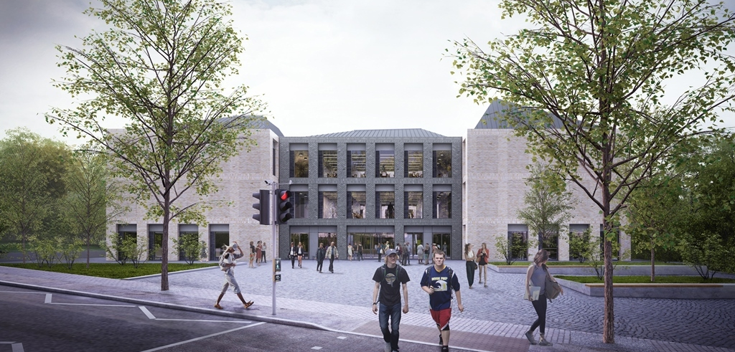
DCAD and the Academic Skills Centre
Teaching & Learning Centre (TLC)
Notes:
Placing us materially at the heart of things...

Slide 6

3. Academic Skills Centre: Origins
Access & Participation Plan 2020/21–23/24
Closing attainment gaps
ASC: Strategic pivot to this agenda
“Students can access academic advice from their departments and pastoral support from their colleges, but this does not appear to be sufficient for students in groups where there is an attainment gap. DCAD will offer student academic support programmes, with special attention to the writing, communication, numerical and analytic skills and abilities needed to thrive at Durham. DCAD will also offer staff development programmes to facilitate inclusive teaching. We anticipate that DCAD initiatives will close the gap in degree class outcomes for LPN students, black students and disabled students compared with the general student population.” (Durham APP 2020/21-23/24)
This Photo by Unknown Author is licensed under CC BY

Slide 7

4. ASC: What’s the same
Orientation to academic communication while not shying from ‘academic English’
In-sessional EAP and LD are integrated
(...though LD remains a space with question marks)
Retain a basic EGAP / ESAP split in centralised vs departmental offer
Retain 121 consultations
(...but with a triage system for access)
This Photo by Unknown Author is licensed under CC BY

Slide 8
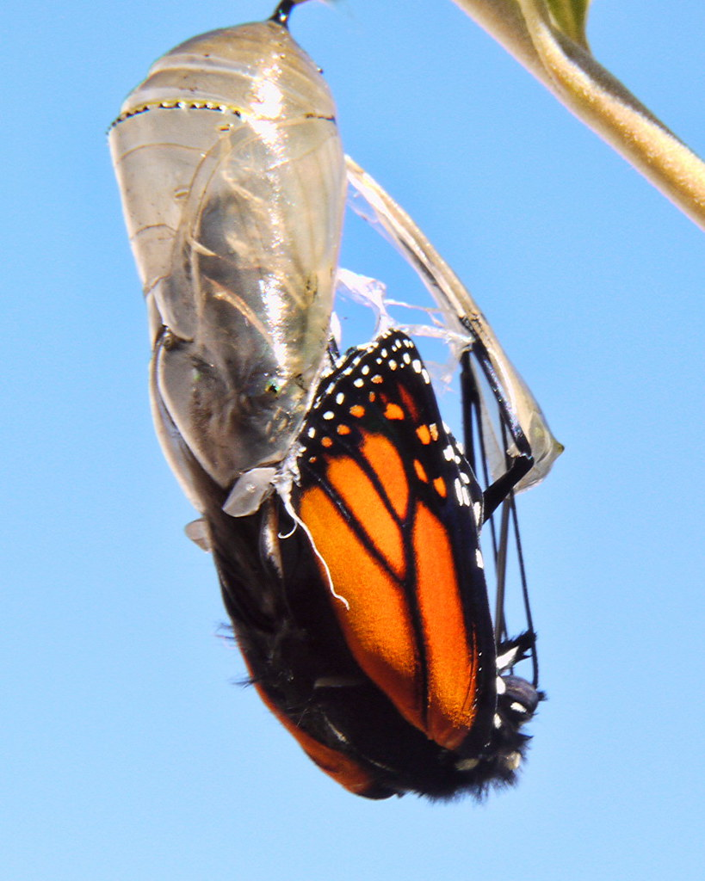


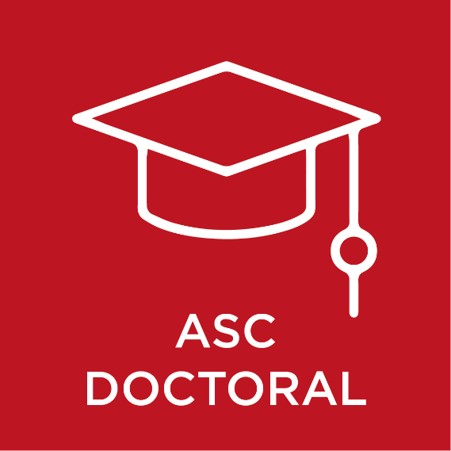
5. ASC: What’s different
The Offer
Leaning into ‘skills’ (cf. Wingate 2006...)
Three main streams, incl. Doctoral + Drop-ins
Academic development work with subj. staff
The Brand and the Discourse
New look. New messages. Push on comms
Language of levelling the playing field; demystifying; transitions; equity; inclusivity
The Strategy
New collaborations within – E.g. Digital Developers; Researcher Development
New collaborations across – Going in at Dept / School / Faculty level
Strategic ‘infiltration’ into University projects – E.g. UG Programme Design; Graduate Attributes
The Collective Sense of Self
Greater symbolic capital – Directly + by proxy
Greater confidence – To propose; to challenge
This Photo by Unknown Author is licensed under CC BY

Slide 9


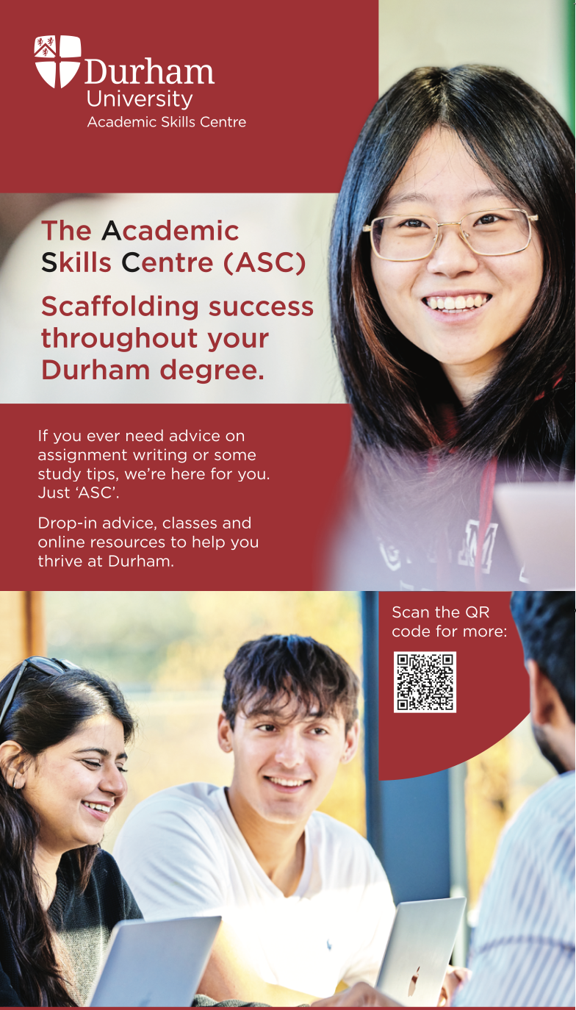
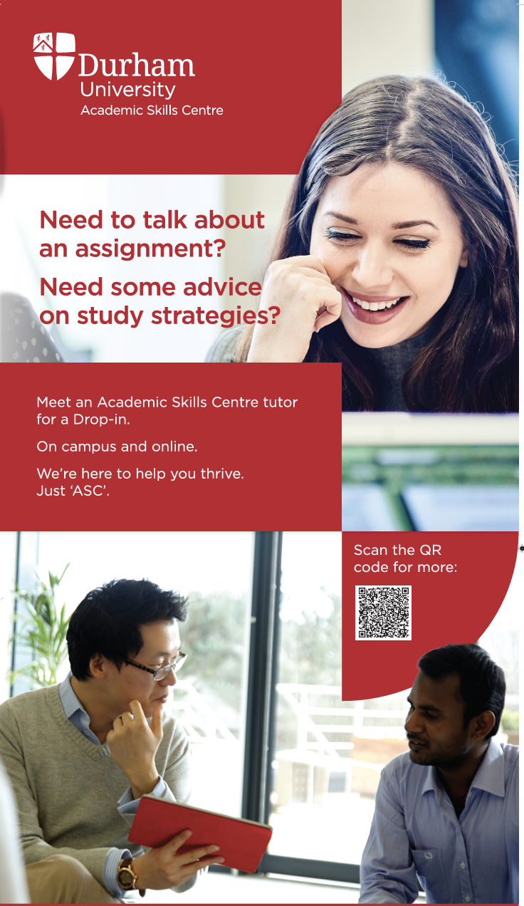
5. ASC: What’s different
The Offer
Leaning into ‘skills’ (cf. Wingate 2006!)
Three main streams, incl. Doctoral + Drop-ins
Academic development work with subj. staff
The Brand and the Discourse
New look. New messages. Push on comms
Language of levelling the playing field; demystifying; transitions; equity; inclusivity
The Strategy
New collaborations within – E.g. Digital Developers; Researcher Development
New collaborations across – Going in at Dept / School / Faculty level
Strategic ‘infiltration’ into University projects – E.g. UG Programme Design; Graduate Attributes
The Collective Sense of Self
Greater symbolic capital – Directly + by proxy
Greater confidence – To propose; to challenge
This Photo by Unknown Author is licensed under CC BY

Slide 10
5. ASC: What’s different
The Offer
Leaning into ‘skills’ (cf. Wingate 2006!)
Three main streams, incl. Doctoral + Drop-ins
Academic development work with subj. staff
The Brand and the Discourse
New look. New messages. Push on comms
Language of levelling the playing field; demystifying; transitions; equity; inclusivity
The Strategy
New collaborations within – E.g. Digital Developers; Researcher Development
New collaborations across – Going in at Dept / School / Faculty level
Strategic ‘infiltration’ into University projects – E.g. UG Programme Design; Graduate Attributes
The Collective Sense of Self
Greater symbolic capital – Directly + by proxy
Greater confidence – To propose; to challenge
This Photo by Unknown Author is licensed under CC BY

Slide 11
Pivoting to Priorities. Dancing the Discourse.
Transitional Education
Inclusive Education
Widening Participation
Academic Language & Literacies
Student Belonging
Programme Design
Graduate Attributes

Slide 12
5. ASC: What’s different
The Offer
Leaning into ‘skills’ (cf. Wingate 2006!)
Three main streams, incl. Doctoral + Drop-ins
Academic development work with subj. staff
The Brand and the Discourse
New look. New messages. Push on comms
Language of levelling the playing field; demystifying; transitions; equity; inclusivity
The Strategy
New collaborations within – E.g. Digital Developers; Researcher Development
New collaborations across – Going in at Dept / School / Faculty level
Strategic ‘infiltration’ into University projects – E.g. UG Programme Design; Graduate Attributes
The Collective Sense of Self
Greater symbolic capital – Directly + by proxy
Greater confidence – To propose; to challenge
This Photo by Unknown Author is licensed under CC BY

Slide 13

6. ASC: What’s next
Projects – and in the pipeline (e.g.)
Communicating Your Science
School-wide integration – School of Education
Staff-facing integration work – Sport; History
Closer collaboration with Academic Transitions
Bringing international student and WP student thinking, strategy and practices closer together
Proposal for subject staff-led model
ASC/AT-mediated but Dept/Faculty-led model for working with staff on integrating ALL(S) (cf. Anson & Flash 2021; Flash 2021)
Speaks esp. to WP agenda + moves to lower IELTS entry scores to increase recruitment

Slide 14
Closing Reflections on Aids to Progress
(without pretending there are easy answers in the current climate...)

Slide 15
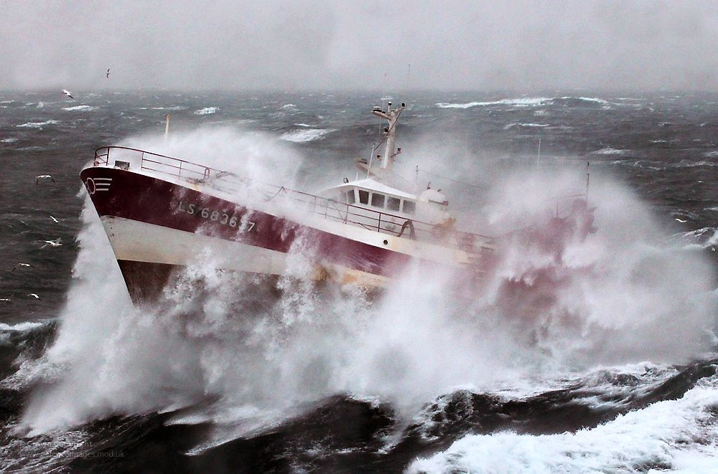
Acknowledging that times are turbulent again...
...Some (temporary?) notes-to-self of local optimism:
This Photo by Unknown Author is licensed under CC BY-SA

Slide 16

Thankful for our current ecosystem.
Academic contracts. Time for scholarship. Invested colleagues. Allies in high places. Central to strategy
(at the moment...)

Slide 17
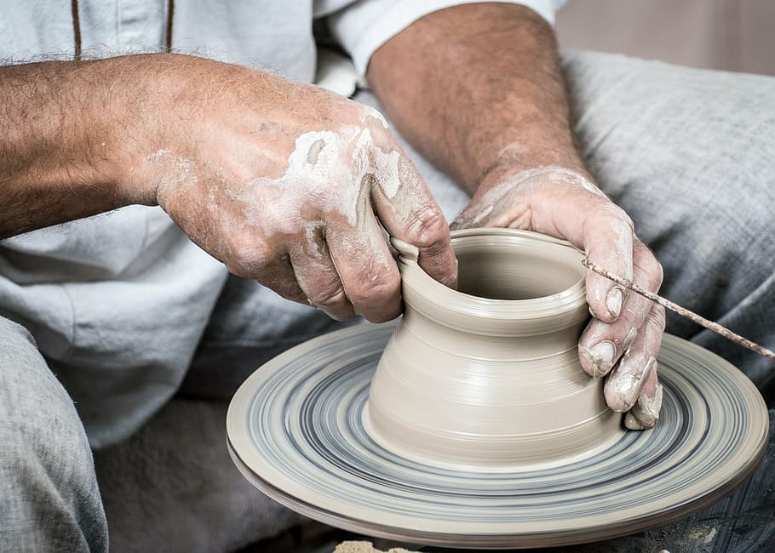
Context shapes but does not define.
We do have Agency. Ability. Opportunity.
Notes:
At the moment at least...!

Slide 18

Flex.
Position(ing) matters but so does pivoting.
Notes:
Speak the language of the institution – Language and framing matter...
We do do language. We do do skills. Lean in. Appropriate. Own. Inject a knowledge orientation (cf Ashwin)
We also do transitional education. We help students communicate their science. We help staff integrate academic literacy into disciplinary teaching
Strong return to equity and social justice. From deficit > EAP is for everyone > equitable access for a diversifying student body

Slide 19


Refract.
Open up the conversation.
Reorient to ALL.

Slide 20

Deliver.
Expertise matters. Put our methodology where our mouth is.
Notes:
(Embodied) cultural capital

Slide 21

References
Anson, C. M., & Flash, P. (Eds.). (2021). Writing-enriched curricula: Models of faculty-driven and departmental transformation. WAC Clearinghouse.
Flash, P. (2021). Writing-enriched curriculum: A model for making and sustaining change. In Anson, C. M., & Flash, P. (Eds.), Writing-enriched curricula: Models of faculty-driven and departmental transformation (pp.17–44). WAC Clearinghouse.
Wingate, U. (2006). Doing away with ‘study skills’. Teaching in Higher Education, 11(4), 457-469.

Slide 22
Thank You
Steve Kirk | s.e.kirk@durham.ac.uk

