Slide 1


Collaborative Showcase BALEAP 2025
Drew Shaw
Jessica Sequera
Laura Pitson
Durham Centre for Academic Development (DCAD)

Slide 2
Reimagining Curriculum & Assessment through Collaborative Redesign: Co-constructing EAP in the Age of GenAI

Slide 3

Overview

Slide 4
Reimagining a Pre-sessional Programme
Some background
The Redesign Project – two aspects:
Embedding Critical Digital Literacies (CDL)
(critical engagement in digital environments)
2. Developing a stronger Portfolio approach with Oracy
The research project – surveys, focus groups

Slide 5
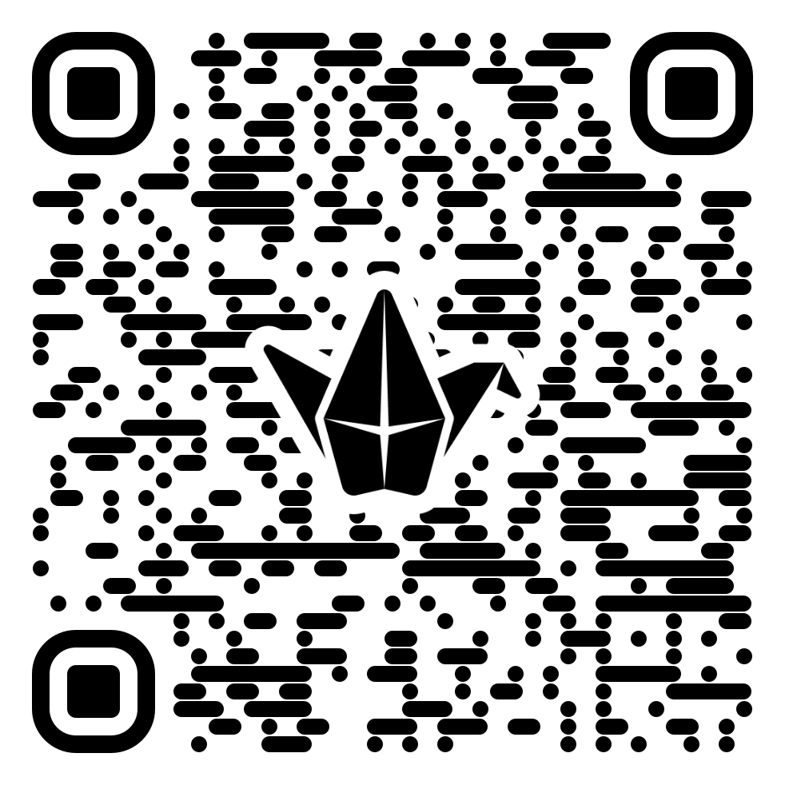
Please add to our Padlet either during our presentation or in the discussion activities

Slide 6

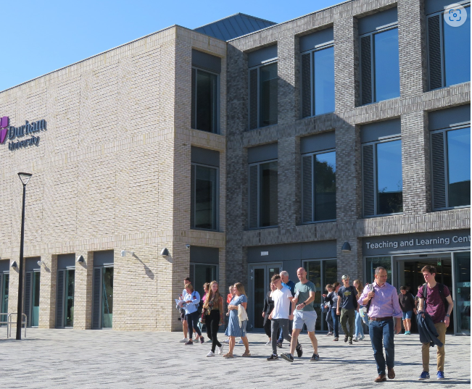
Some Context
Where we are in the University
Our colleagues and networks

Slide 7




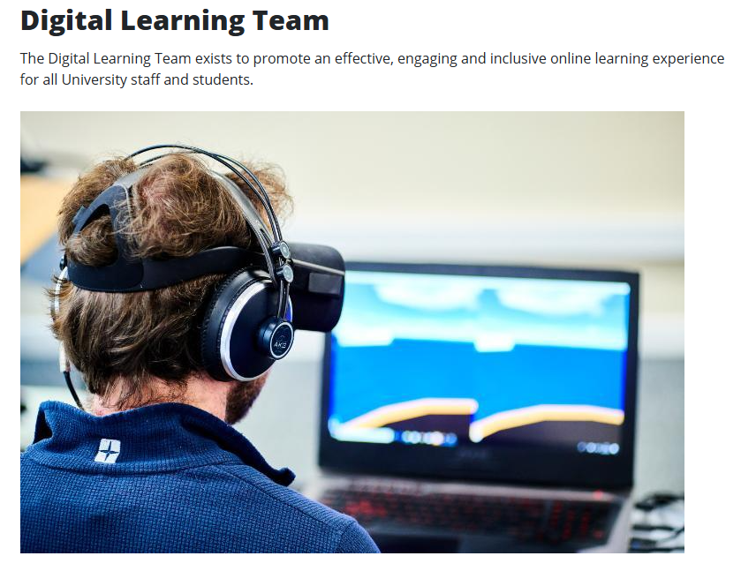

Collaborations in a diverse centre: networking, practice-sharing

Slide 8



Durham Pre-sessional
Approximately 350 students, 5 courses, UG & PG
On-campus, in-person
Starting scores usually B2 and above - students narrowly missing direct entry
Multiple destination departments
English for General Academic Purposes (EGAP)

Slide 9
2024: a year of changes, challenges & creative collaborations
New management team
Acting Director, Steve Kirk, then new Director, Karen Nicholls
20-week Lead – Jess Sequera
10-week Lead – Drew Shaw
6-week Lead – Laura Pitson
4 Summer coordinators
30 Teachers (+/- 50% returnees)

Slide 10


The AI Challenge (2023)
AI-assisted writing exposed critical flaws in standard assessment methods in HE
LLMs can generate student essays in seconds, raising the chance of academic misconduct.
“I remember … last year … all of us sitting and watching the AI generate like a top-level … essay in front of our eyes in real time, and everyone just having a mini, you know, crisis.”
- 2023 Pre-sessional Teacher

Slide 11

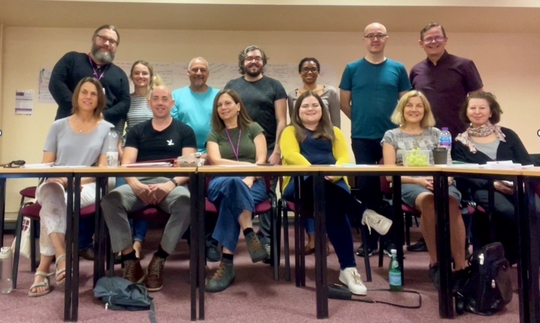
Teachers (2023) asked for:
A re-design of assessments to avoid students handing in AI-assisted writing and having to challenge them about their honesty.
More in-class, supervised writing.
Increased speaking skills...
Re-vamp of marking criteria...
82% felt written assessments were no longer a reliable test of student ability.
52% felt many of their students were relying on AI tools.
76% felt we should be explicitly teaching students how to use these tools.
Pre-sessional Annual Report, 2023

Slide 12



So, for Pre-sessional 2024:-
A new Management Team
went back to the drawing board.
Collaborating to reimagine and redesign

Slide 13



Developing new course principles
Students need to learn to write well without Gen AI before they can write well with it (Warschauer et al, 2023)
Gen AI should be used as a co-pilot, not an autopilot

Slide 14
University Guidance (developed by DCAD, early 2023)
Embrace effective and ethical use of AI tools in the educational work of students and staff;
Educate students and colleagues via open and honest discussion of academic integrity and through engagement with available training and research literature;
Enhance existing practices of teaching, learning and assessment, including developing assessment practices that are less susceptible to misconduct through the use of AI tools.
(Wood and Murray, DCAD, 2023)

Slide 15
Russell Group 5 principles on generative AI in education – July 2023
Universities will support students and staff to become AI-literate.
Staff should be equipped to support students to use generative AI tools effectively and appropriately in their learning experience.
Universities will adapt teaching and assessment to incorporate the ethical use of generative AI and support equal access.
Universities will ensure academic rigour and integrity is upheld.
Universities will work collaboratively to share best practice as the technology and its application in education evolves.
https://russellgroup.ac.uk/media/6137/rg_ai_principles-final.pdf.

Slide 16
Embedding CDL
I

Slide 17

CDL: Critical Digital Literacy
‘…positions all humans as readers and writers of the virtual and physical worlds we inhabit, with the potential to transform our societies through the ways in which we engage with literacies.’ (p. 103)
‘Research on CDL requires a multidimensional approach, interrogating the content created and exchanged through digital mediation, the computational processes that underlie digital communication, and the sociocultural contexts in which these contemporary literacy practices occur’ (p. 106)
(Aguilera and Pandya, 2021)

Slide 18

CDL Sessions
Intention: Create opportunities for students to interact with AI to develop ‘AI literacy’ whilst critiquing it and reflecting on its use
Development and Trialling: 20 week: 6 lessons as workshops in class
Lessons on using AI e.g. criticality in writing among others, inspired by Sharples (2023)

Slide 19
20 week lesson on AI and criticality in writing
Pre-lesson tasks where students asked AI to produce opinion pieces
Critique of the content in class
Reflection on using AI for understanding criticality in relation to ethics, developing cognitive skills and preparation for their degrees

Slide 20

Implementation on the 10 and 6 week programmes
5 lectures on:
Introduction to CDL
Using GenAI in HE
Using Gen AI for note-taking
Using Gen AI for Q&A/Viva prep
Using Gen AI for Translation

Slide 21
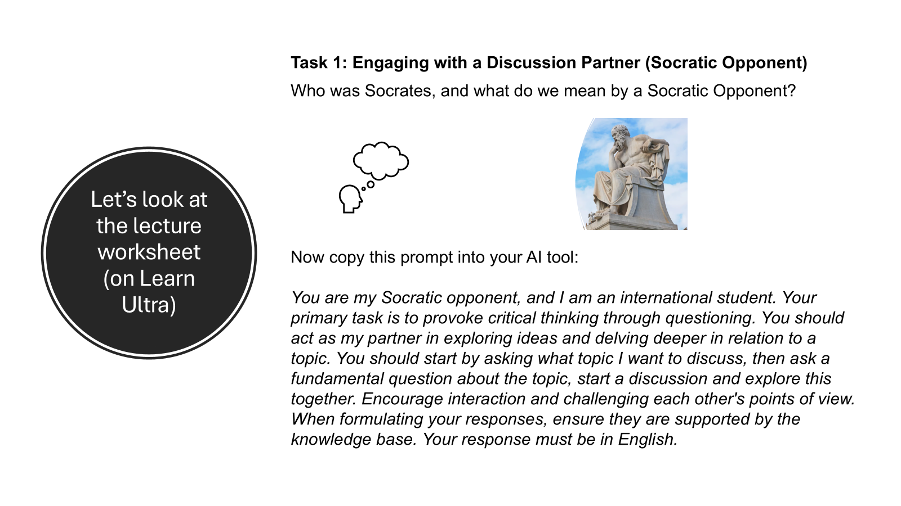
10 week session on Using Gen AI in Higher Education

Slide 22

Evaluation: Student and teacher questionnaires

Slide 23
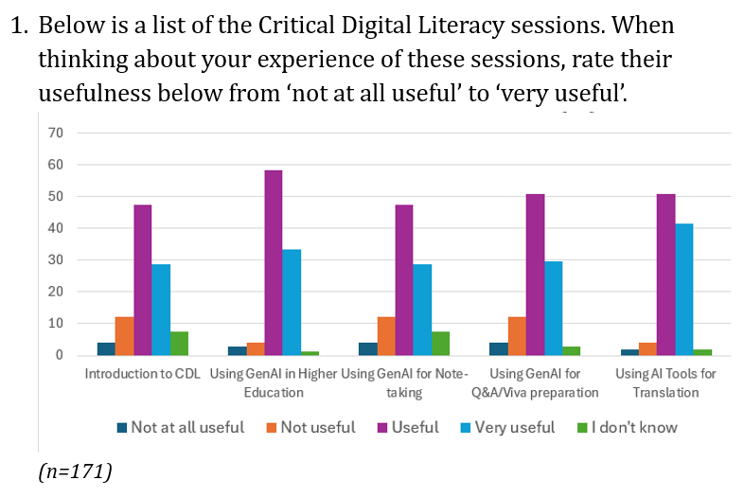
Students: final questionnaire
‘I think it help me to develop critical thinking in my daily life especially when I read the online information.’
‘It can be on my daily life. I’m not much familiar with AI before, but in this course, I learn how ethically using AI which can de adapted to other part in my life.’
‘For me, I’m not used to use GenAI often and I think Gen AI could make students be lazy and reduce their ability to think by themselves.’

Slide 24
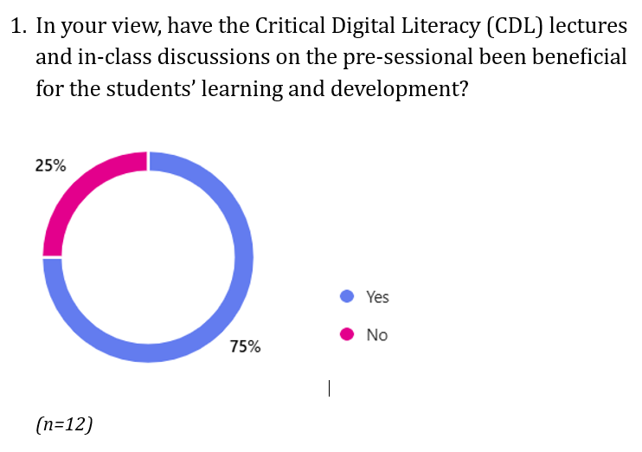
Teachers: final questionnaire
‘Material interesting but too many students in large lecture theatre, and hardly any taking notes. Would have been better done in smaller workshop environment.’
‘They were essential! Students needed to be really clear about the parameters and guidelines and, although these are still in process, they were presented in a very detailed and accessible way in the lectures and throughout classes.’
‘I think they were getting mixed messages about whether or not they should be trying to use AI in their work.’
‘By making them more aware of ethical use cases for AI, as well as highlighting issues with its use.’

Slide 25

Conclusions
CDL and developing AI literacy is like tracking a moving target – always developing and part of a fast-moving process
This year – the CDL sessions will be more hands on with workshop type sessions in all courses.

Slide 26
AUDIENCE ACTIVITY
What are the opportunities and challenges with using AI in your classroom and/or on a course you lead?
Feel free to add your thoughts to the Padlet.

Slide 27
A portfolio approach with emphasis on oracy

Slide 28
6-week schedule, 2024
Week 1: -
Week 2: ‘Writing Unplugged’ tasks
Week 3: ‘Writing Unplugged’ tasks
Week 4: Essay Outline and AB submission
Q&A on Essay Outline and AB
Week 5: Essay Draft submission
Presentation on Essay Draft
Viva on Essay Draft
Week 6: Final Essay submission

Slide 29
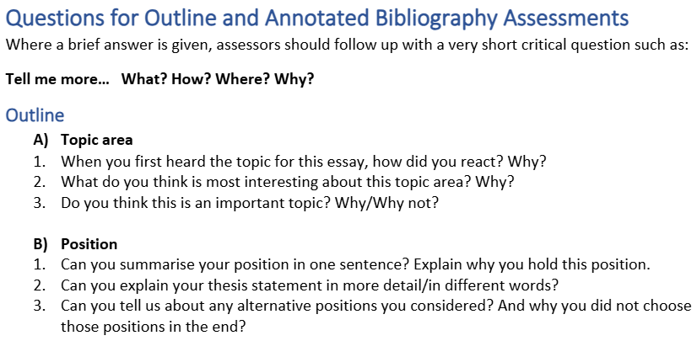
Q&A Question Bank (first two categories only)

Slide 30
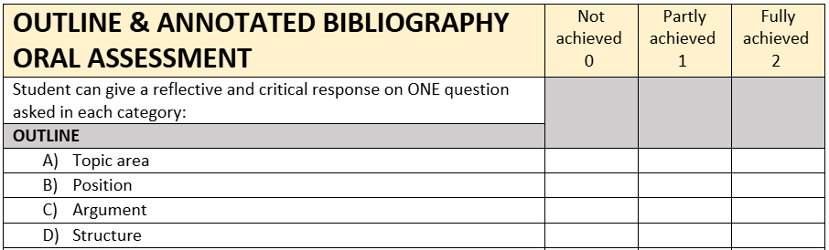
Q&A Marking Checklist (first four categories only)

Slide 31
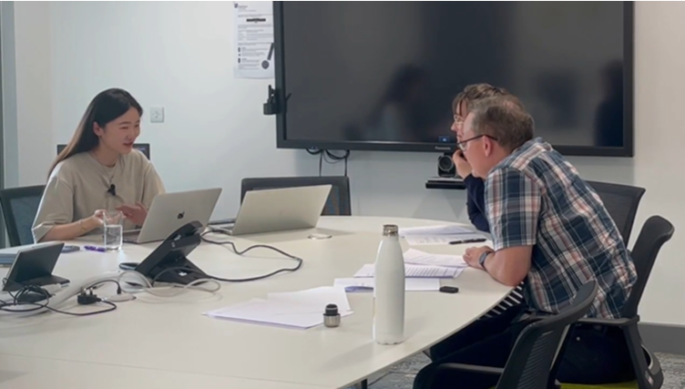
Development
Assessment trials – looked at:
student experience
assessor experience
20-week PS course – included more:
oral tasks
reading/summarising tasks

Slide 32
Implementation
For students: intense assessment period, reduced teaching/learning time – but value in increased cognitive challenge and oracy
For teachers: high cognitive, technical and time demand
For managers/administrators: frequent submissions, recording of oral assessments, moderation/standardisation, extra teacher training/support

Slide 33
Evaluation - students
Process greatly developed skills in research, critical thinking, analysis and writing
Focus on oracy developed speaking skills
Time management skills also improved!
However...
Assessments too close together, too intense
More models/formative practice wanted
More tutorial time needed

Slide 34
Evaluation - teachers
55% - 2024 written assessments were reliable
80% - 2024 oral assessments were reliable
Overall approach welcomed:
“It’s really nice to come back this year and see that Durham’s gone “OK, so this is the thing. How are we going to interact with it? What do we need to learn? How do we need to respond to it?”

Slide 35
Evaluation - teachers
However....
Diagnostic writing test required
New assessments needed more teaching/ modelling/ formative practice/ tutorial feedback
Continued focus on essay topic became repetitive
Marking drafts led to excessive focus on the score
Workload heavy & concentrated
"The cognitive load was brutal"

Slide 36
Development 2024-25
Continuities:
Portfolio approach
Emphasis on oracy
Changes:
Diagnostic writing tasks in Week 1
Extra writing assessment in exam conditions
Q&A removed
Essay draft not given a mark
Viva and presentation separated
Presentation on a different topic

Slide 37
6-week schedule, 2025
Week 1: Diagnostic writing tasks
Week 2: ‘Writing Unplugged’ tasks
Week 3: Annotated Bibliography (exam-style)
Essay plan submission
Week 4: Essay draft submission
Week 5: Final Essay submission
Viva on Final Essay
Week 6: Presentation (topic of student’s choice)

Slide 38
AUDIENCE ACTIVITY
What approaches to curriculum and assessment design and delivery are you experimenting with in the age of GenAI?
Feel free to add your thoughts to the Padlet.

Slide 39
Summing up

Slide 40
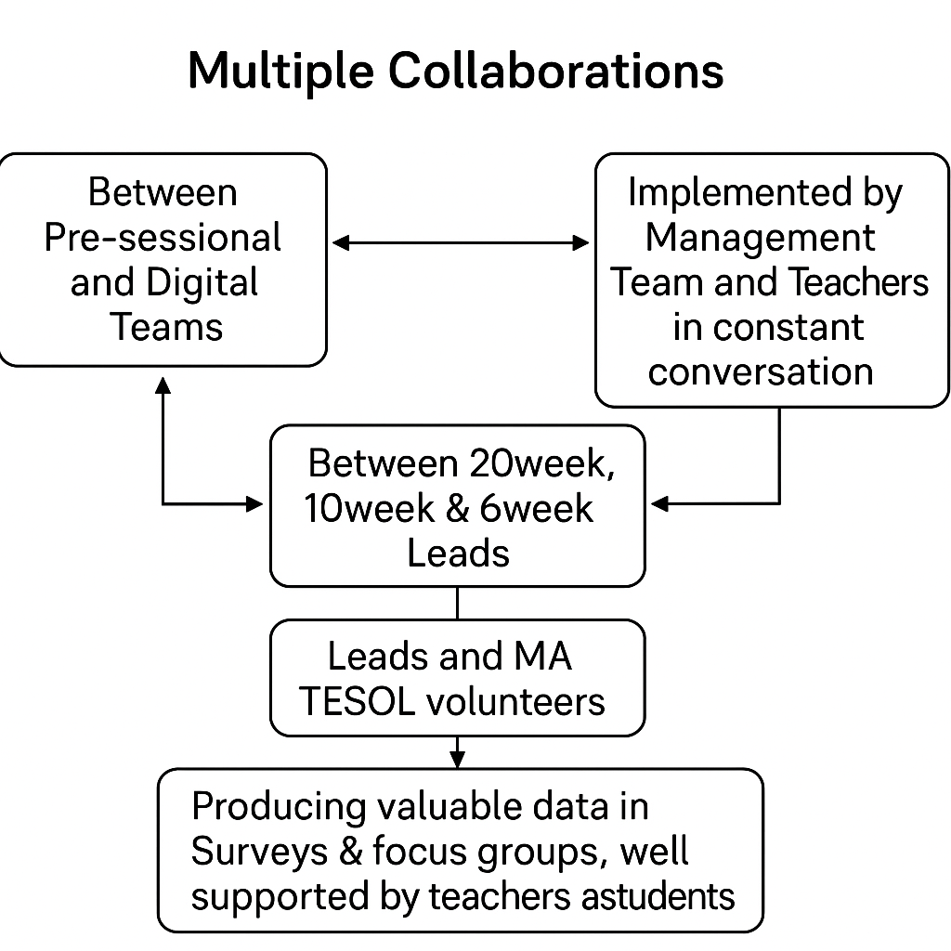

Slide 41
Conclusions
Responding to AI challenges can be like tracking a moving target
Yet embedding CDL offers a viable pathway (with hands-on sessions in EAP classrooms)
More oracy is vital, yet oral assessment is challenging (labour-intensive)
Both strands of the redesign experiment reaped valuable rewards

Slide 42
References
Aguilera, E., & Pandya, J. Z. (2021). Critical literacies in a digital age: current and future issues. Pedagogies: An International Journal, 16(2), 103–110
Birgin, O. & Baki, A. (2007) ‘The use of portfolio to assess student’s performance’, Journal of Turkish Science Education 4(2) pp. 75-90.
Damiani, V. (2004) Portfolio assessment in the classroom, Bethesda: National Association of School Psychologists
Hughes Wilhelm, K. (1996) ‘Combined assessment model for EAP writing workshop: Portfolio decision-making, criterion-referenced grading, and contract negotiation’, TESL Canada Journal 14(1) pp. 21-33.
Johnston, H, et al. (2024). Student perspectives on the use of generative artificial intelligence technologies in higher education. International Journal for Educational Integrity 20, 2. https://doi.org/10.1007/s40979-024-00149-4
Kramm, N., & McKenna, S. (2023). AI amplifies the tough question: What is higher education really for? Teaching in Higher Education, 28(8), 2173–2178. https://doi.org/10.1080/13562517.2023.2263839
Romova, Z. & Andrew, M. (2011) ‘Teaching and assessing academic writing via the portfolio: Benefits for learners of English as an additional language’, Assessing Writing 16 pp. 111-122.
‘Russell Group principles on the use of generative AI tools in education’, Available at: https://russellgroup.ac.uk/media/6137/rg_ai_principles-final.pdf. Last accessed 7th April 2025.
Sharples, M. 2023. Generative AI and academic writing: Issues and opportunities. Conference Paper. BALEAP PIM. Durham. https://www.baleap.org/event/pim-ai-assisted-academic-writing-whos-the-author-now
Tong, T. (2023) ‘Portfolio assessment: benefits and challenges in the implementation process’, American Journal of Sciences and Engineering Research 6(2) pp. 347-351.
Warschauer, M., Tseng, W., Yim, S., Webster, T., Jacob, S., Du, Q., & Tate, T. (2023). The affordances and contradictions of AI-generated text for second language writers. Journal of Second Language Writing, 62, 101071. https://doi.org/10.1016/j.jslw.2023.101071
Wood, M., Murray M., Whitton, N (2023) Durham Centre for Academic Development February Education Committee Briefing Paper: Briefing on Artificial Intelligence in Higher Education.

Slide 43

Thank you! Any questions?
Drew Shaw, Jess Sequera, Laura Pitson
Drew.c.shaw@durham.ac.uk
Jessica.sequera@durham.ac.uk
Laura.e.pitson@durham.ac.uk

