Slide 1


Students’ Participation and Perceptions of L2 Vocabulary Learning and Diagnosis Using Chatbot-Assisted Dynamic Assessment (CA-DA) as a Personalized Lexical Inferencing Tool
BALEAP 2025
Co-presenters:
Lin Ma | Anning Yang | Feiran Xu | Jiahang Li

Slide 2
Overview
Introduction
Literature Review
Methodology
Results and Discussion
Implications (and Take-away)

Slide 3
01
Introduction: Teaching Context

Slide 4





Transitional Higher Education (TNHE): Sino-British joint venture university in Suzhou, China: Xi'an Jiaotong University & the University of Liverpool
Established in 2006
25,000+ Registered students (majority Chinese native speakers)
The School of Lanuages: 8,469 students
The aim of the first-year English course: CEFR (Common European Framework of Reference for Languages) B2-level.
Y1 Core Pathway
Two semester-long, 10-credit
General EAP modules

Slide 5
02
Literature Review

Slide 6

Lexical inferencing as vocabulary learning strategy
Lexical inferencing is referred to as a meaning-extraction technique or meaning-derivation mode without continual consultation to a dictionary.
Immediate acquisition and retention of lexical/semantic information (Ellis, 1997; Nassaji, 2003)
Inferring new word meanings from context is challenging
ESL students struggle with accurate inference(Bensoussan & Laufer, 1984; Dessenberger et al., 2023; Shu, Anderson, & Zhang, 1995; Nassaji, 2003)
Most common vocabulary learning strategy
Effective for acquiring second language vocabulary(Barcroft, 2002; Mondria, 2003; Rott, 1999; Shokouhi & Askari, 2010; Webb & Chang, 2015)
In our EAP classroom
Students heavily rely on translation software

Slide 7
How to infer the meanings of new words
Reference words
Word analysis
Learner’s experience
Common sense
Grammar
Punctuation
Definition
Contrast
Connectives
Definition
Learners’ experience
Contrast
Inference
Analysis
Trail-and-error approach: guessing- justification- elaboration
Give learners independence
Steinberg (1978)
Brown (1980)
Bruton & Samuda (1981)
Kruse (1979)
Chandrasegaran (1980)
Clark & Nation (1980)；
Nation (2022)
A systematic procedure (questioning)
Dependent on teacher’s choice of questions
Word elements
Picture, diagrams and charts
Definition
Inference clues from discourse
Function of the words
Word inference structured approach
Promote independent learning
Reduce dependence on external resources

Slide 8


Dynamic assessment (DA)
The merging of assessment and instruction into a single, cohesive activity designed to foster learner development (Poehner, 2008).
Studies on DA for L2 Vocabulary Learning
Effective for vocabulary learning (Andujar, 2020; van der Veen, Dobber, & van Oers, 2016)
Assists learners with understanding unknown words in context (Ebadi et al., 2018; Rassaei, 2020)
Limitations in DA Application
Time, resources, and support constraints
Teachers struggle to deliver individual interactions in classroom settings (Davin & Donato, 2013)

Slide 9




Computer-based Language Assessment & AI
Intelligent tutoring systems provide automated responses for language errors (Ai, 2017; Heift, 2017)
Challenges
Limited answers narrow feedback and reduce opportunities to address learner issues (Sharples et al., 2015; Shute, 2011; Shute & Ventura, 2013)
Teachers lack programming knowledge (Ai, 2017)
XIPU AI
AI assistant and chatbot launched by XJTLU in September 2023
Chatbot-assisted Dynamic Assessment (CA-DA)

Slide 10
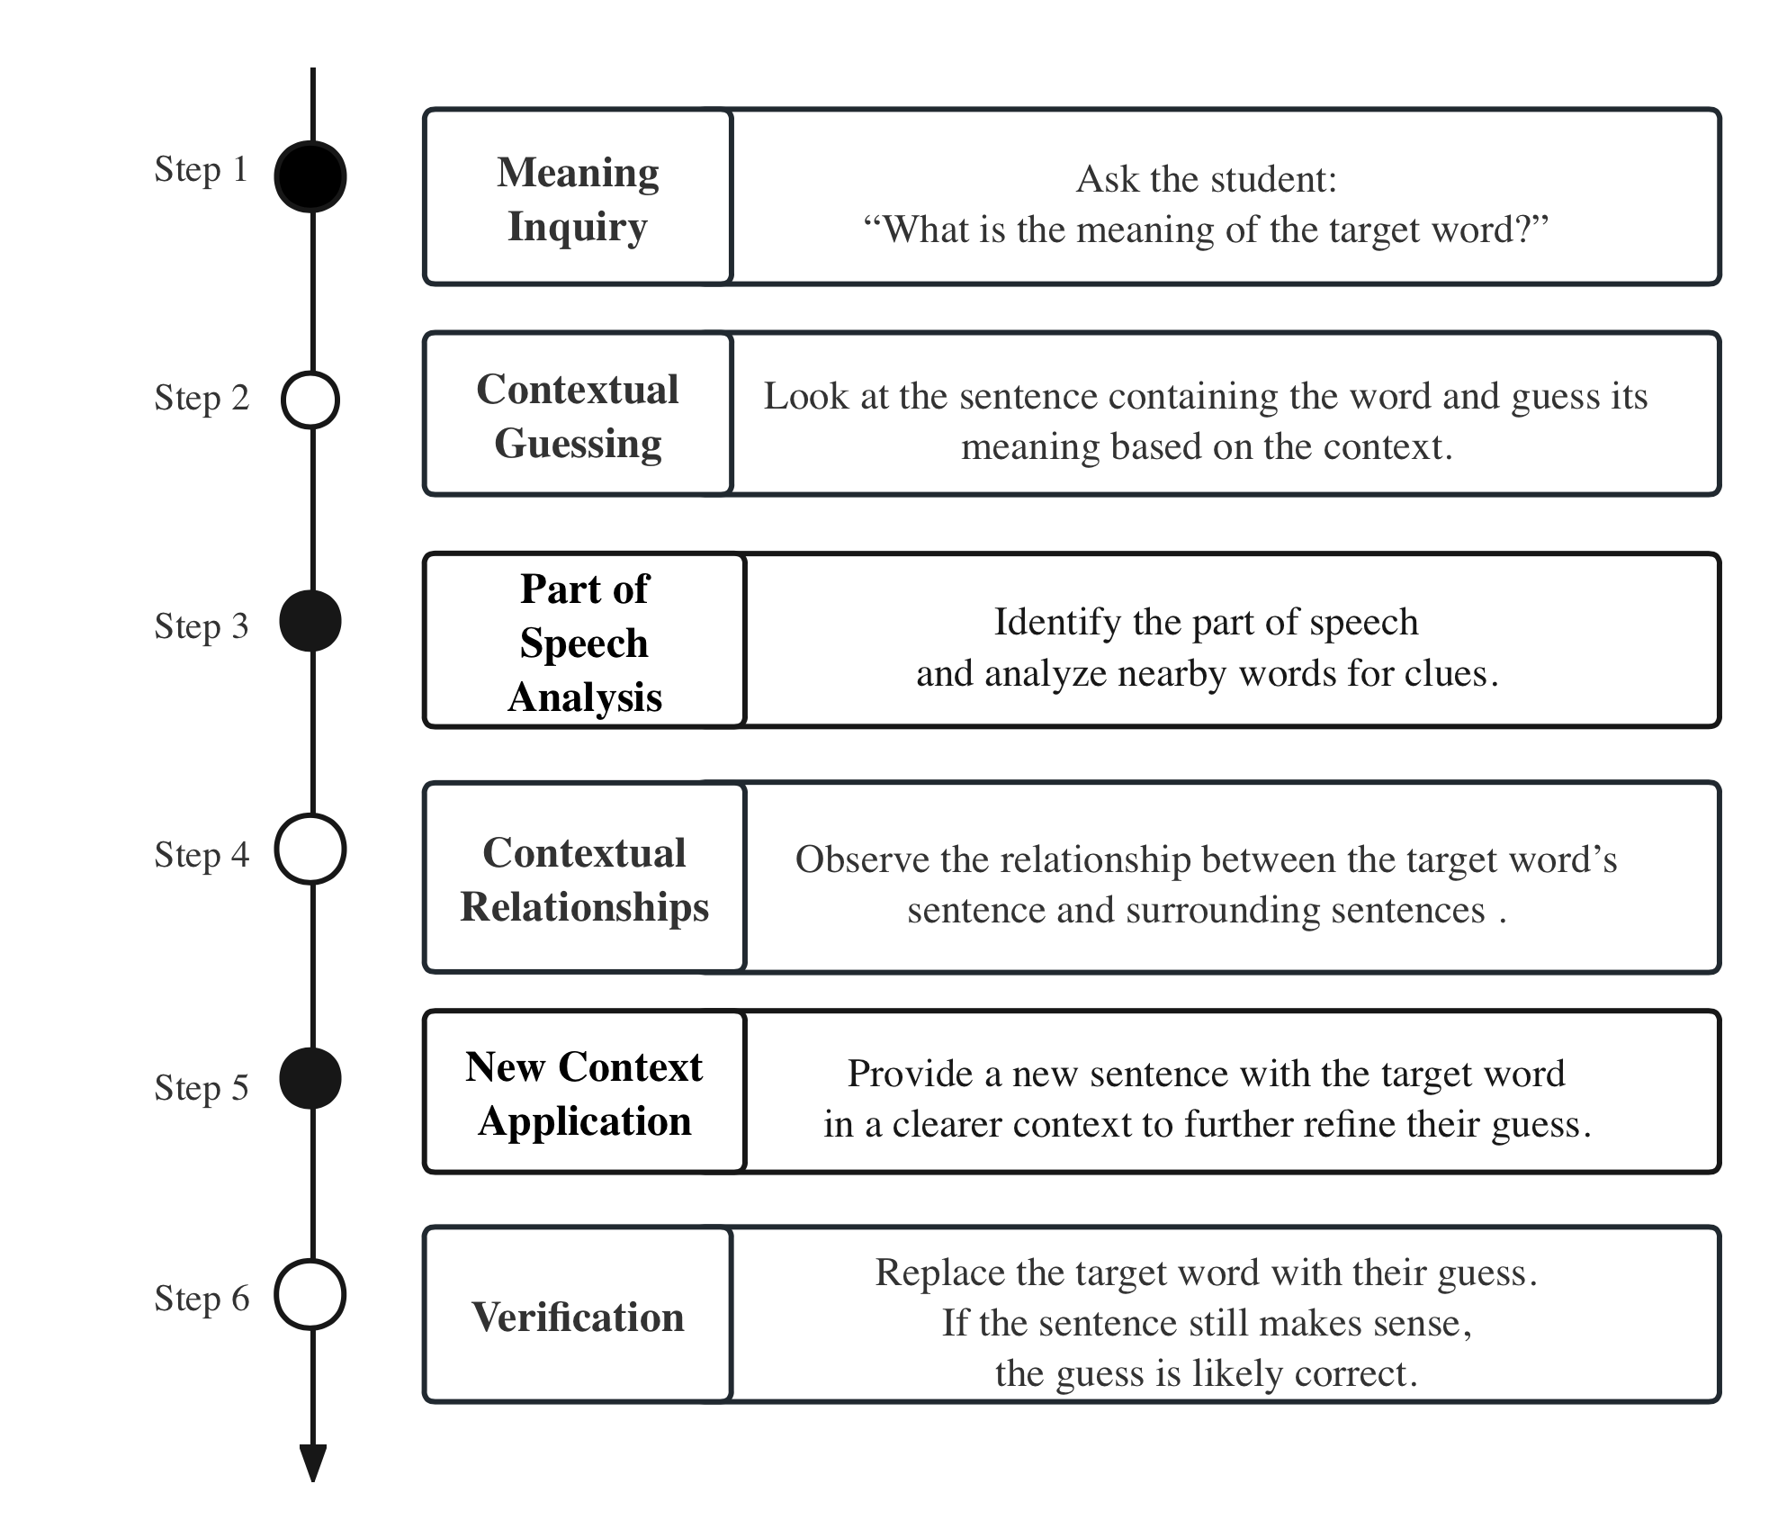

Prompts Design
Graduated prompt approach
Follow a gradual sequence when giving feedback from most implicit to most explicit (Campione & Brown, 1990; Rassaei, 2020)
Word inference structured approach (Clark & Nation, 1980; Nation, 2022)

Slide 11
Research questions
RQ1: How CA-DA can support second language learners’ receptive vocabulary learning?
RQ2: How can CA-DA be applied to diagnose vocabulary learning?
RQ3: What are students’ perception and attitudes toward the role of CA-DA in vocabulary development?

Slide 12
03
Methodology

Slide 13

Methodology
Participants:
Around 240 year-one Chinese undergraduates from XJTLU
Intermediate EAP Module
Target participants
after Vocabulary Size Test + Pre-test: select qualified participants
44: around 4,000 vocab size – CEFR B2 + vocab knowledge gap of ALL 6 target words
Experimental groups (CA-DA, 24 students)
Control groups (20 students)
5 students pilot study

Slide 14
Methodology
CA-DA for Vocabulary Learning: Research Procedures
Stage 1 (Quantitative) |  |  |  |  | Stage 2 (Qualitative)
Vocabulary Size Test (VST) | Pre-test: | Experimental (Treatment) Session | Post-test | Delayed Post-test | Interview
Select target participants (CEFR B2) | Select level-appropriate target words for Experimental Sessions | Experimental Sessions 1 and 2: Two reading texts Experimental Group Control Group | Post-tests 1 and 2 (measure vocab learning effectiveness) | Two weeks after post-tests (measure vocabulary retention) | Explore students’ attitudes and perceptions

Slide 15
Experimental Sessions +
Post-tests
CA-DA Groups
(n=24)
Day1: Session 1: Reading Text 1
Day2: Post-test 1
Session 2: Reading Test 2
Control Groups
(n=20)
Day1: Session 1: Reading Test 1
Day3: Post-test 2
Day2: Post-test 1
Session 2: Reading Test 2
Day 3: Post-test 2
Methodology
Experimental Sessions and Post-tests Delivery Pattern
Target vocabulary learning:
Step-by-step chatbot interactions
Target vocabulary learning: consult e-dictionary only

Slide 16
Methodology
The scoring system for diagnosing learners’ vocabulary learning abilities in CA-DA group
Prompt
Score
Interaction logs between learners and chatbots from the CA-DA group
Actual score and mediated score.
Actual score: 5 points for correct answers without assistance, 0 points if help was needed.
Mediated score: 5 points for correct answers without prompts; points varied for assistance:
4 points for Step 2 prompt (least explicit)→ 0 points if the learner couldn't answer even with help.
Total mediated score was the sum of points earned for each item.
5
4
3
2
1

Slide 17
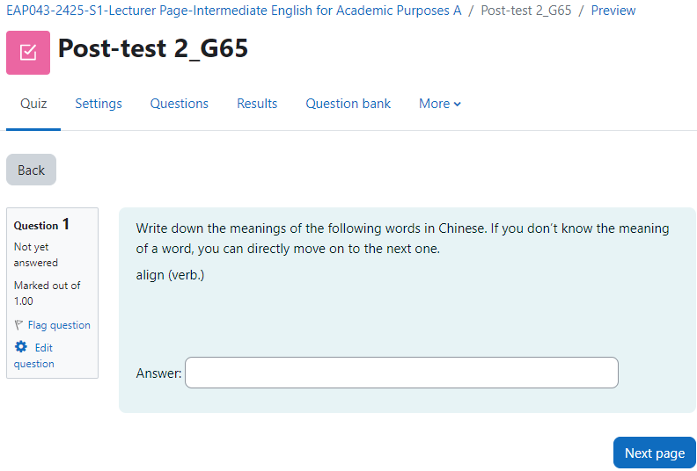
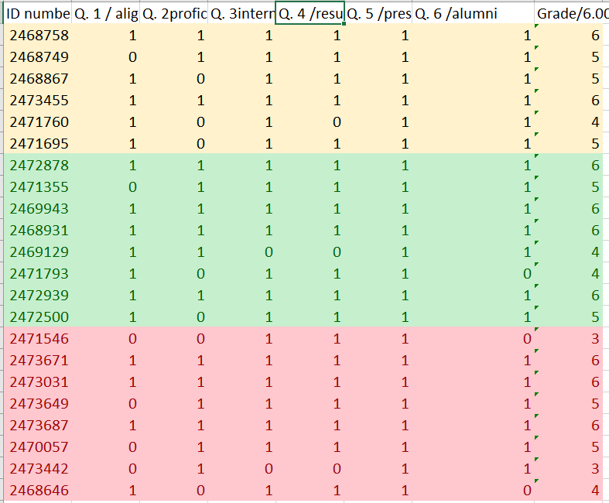


Methodology
Data analysis
Quantitative
Post-tests + delayed post-test results
Scoring results of interaction logs
Tools: SPSS
Qualitative
Interview
Tool: Nvivo 14

Slide 18
04
(1) Posttest and Delay Posttest Results and Discussion

Slide 19
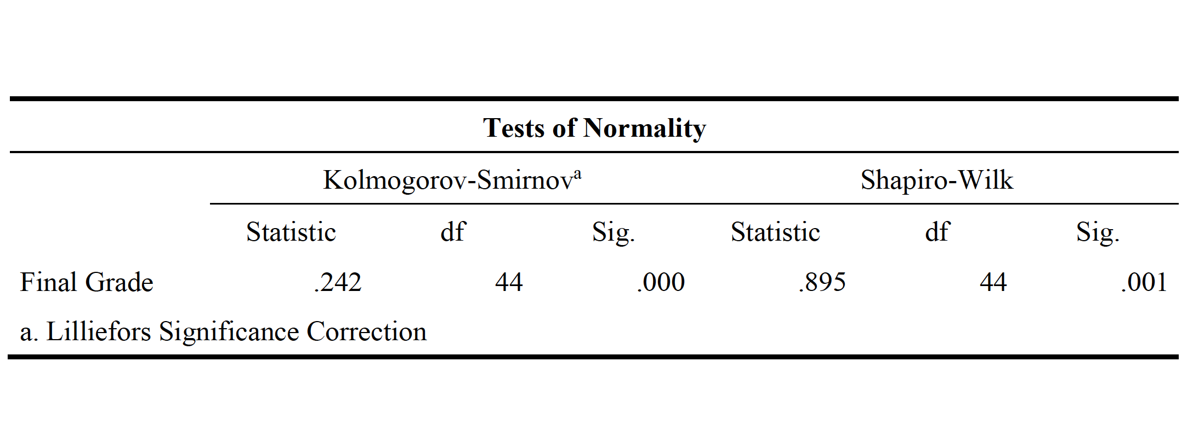
Results-posttest
Sample Size (N): 44
Tests Used:
Kolmogorov-Smirnov
Shapiro-Wilk
Normality Test: Kolmogorov-Smirnov/Shapiro-Wilk
Test Results:
K-S Test Statistic: 0.242
p-value (Asymp. Sig):.000
S-W Test Statistic: 0.895
p-value:.001
Since the p-value < .05, the data does not follow a normal distribution. Non-parametric tests will be used in further analysis.

Slide 20
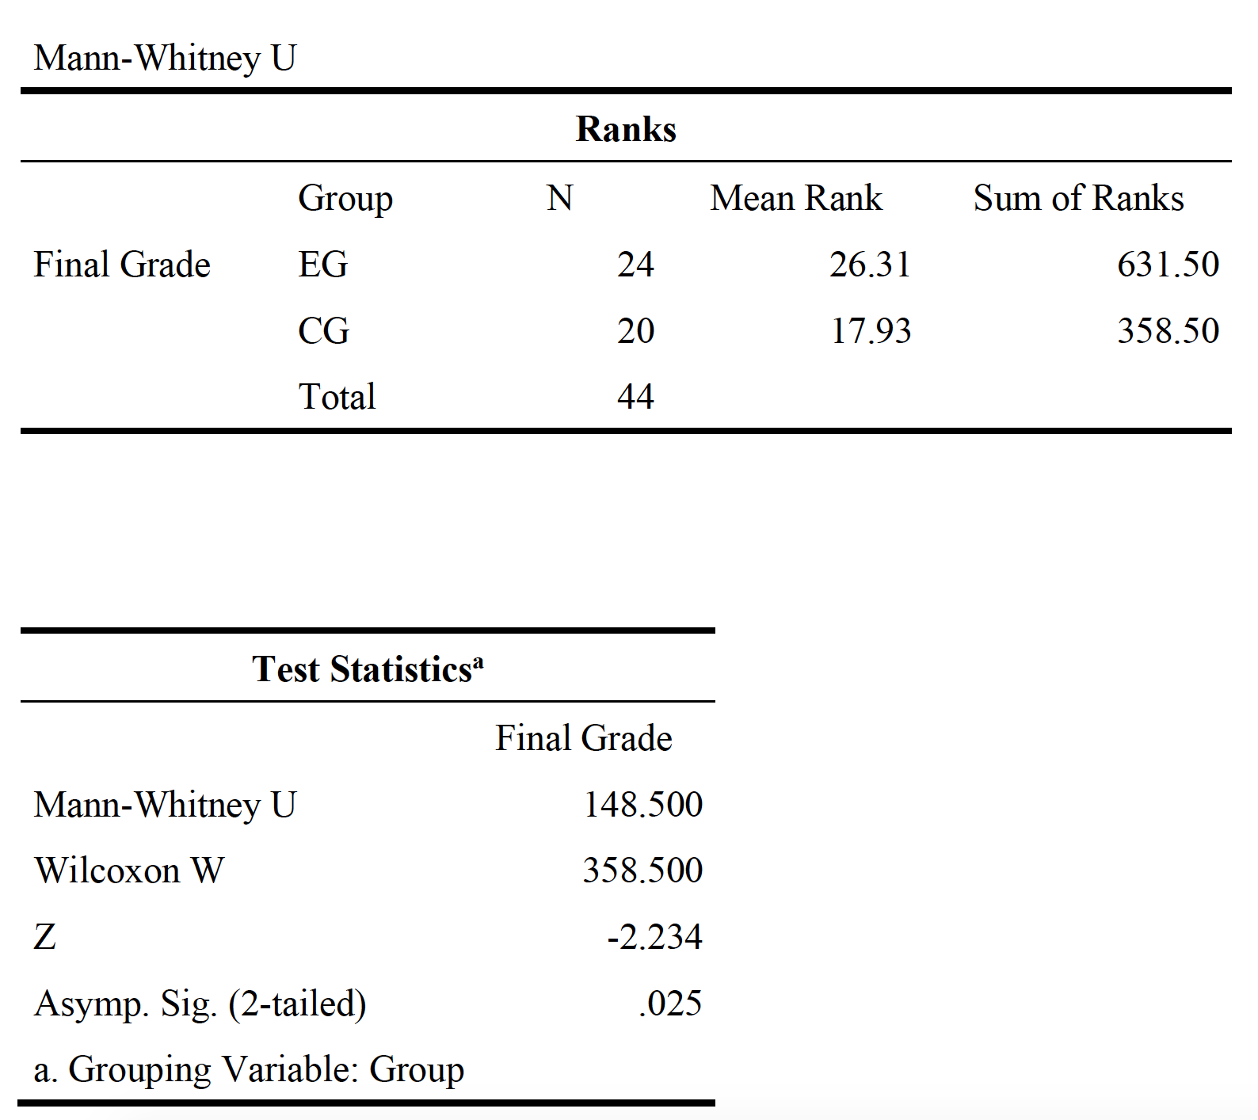
Results-posttest
Non-Parametric Test: Mann-Whitney U Test
Mann-Whitney U: 148.500
Wilcoxon W: 358.500
Z: -2.234
p-value (Asymp. Sig 2-tailed):.025
P（.025） < .05：a significant difference in final grades between the EGB and CG groups

Slide 21
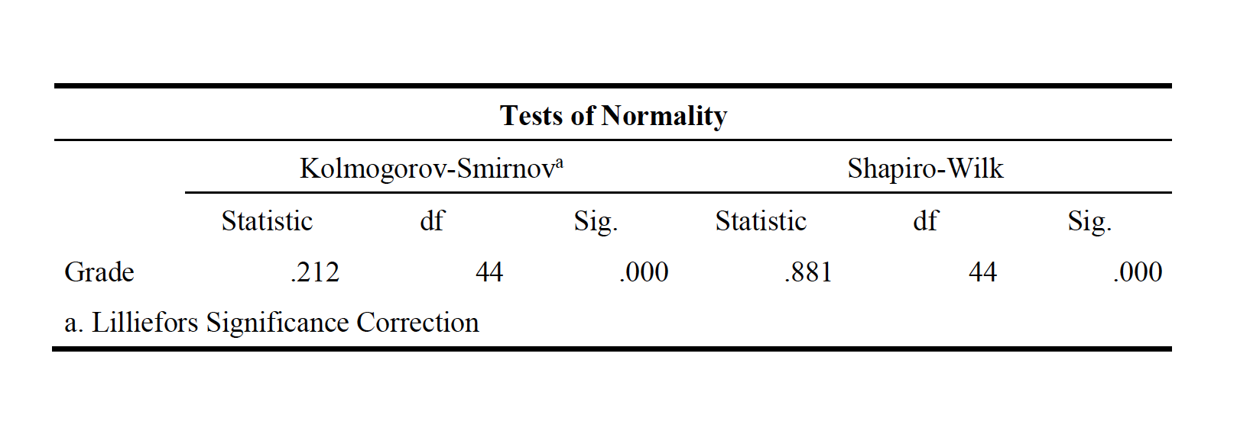
Results-delayed posttest
Sample Size (N): 44
Tests Used:
Kolmogorov-Smirnov
Shapiro-Wilk
Normality Test: Kolmogorov-Smirnov/Shapiro-Wilk
Test Results:
K-S Test Statistic: 0.212
p-value (Asymp. Sig):.000
S-W Test Statistic: 0.881
p-value:.000
Since the p-value < .05, the data does not follow a normal distribution. Non-parametric tests will be used in further analysis.

Slide 22
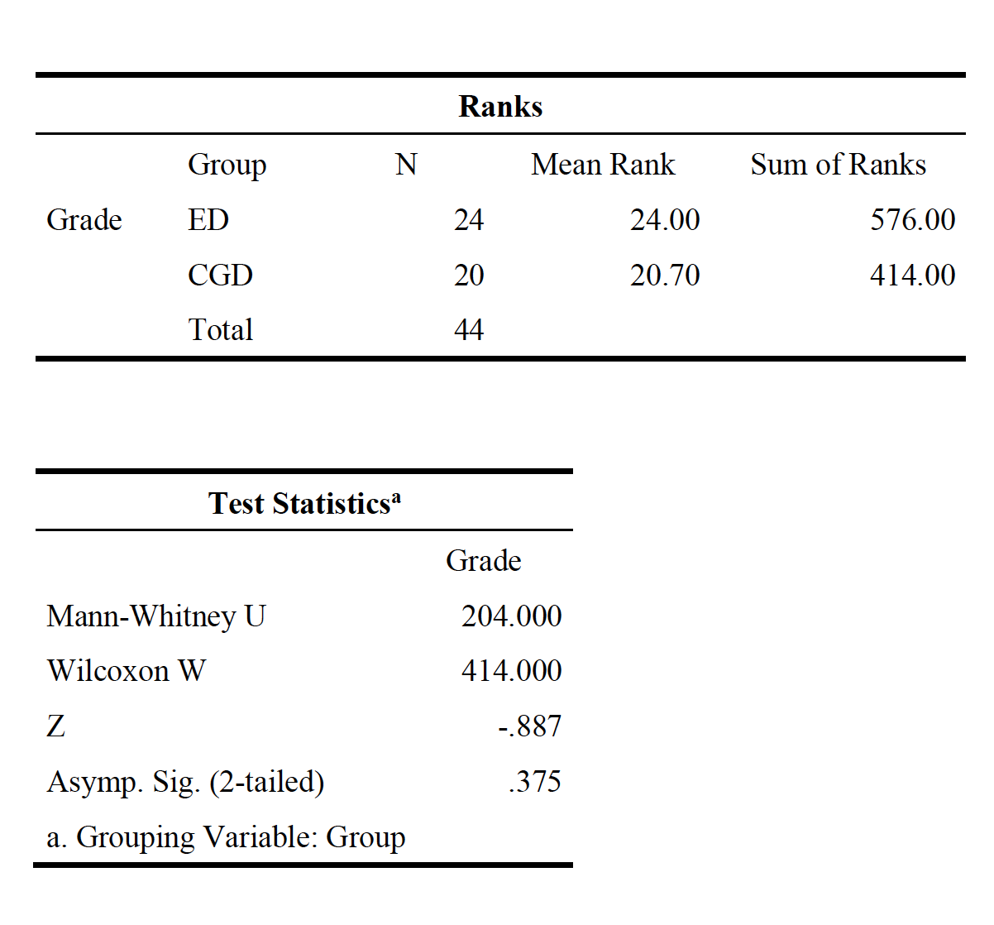
Results-delayed posttest
Non-Parametric Test: Mann-Whitney U Test
Mann-Whitney U: 204.00
Wilcoxon W: 414.000
Z: -.887
p-value (Asymp. Sig 2-tailed): .375
P（.375） > .05：no significant difference in final grades between the EGB and CG groups

Slide 23
Discussion
1. Post-test Performance:
Experimental Group (CA-DA) > Control Group
1) ZPD (Zone of Proximal Development theory)
Gap between actual development level and potential development level (Vygotsky, 1978)
Chatbot-mediated prompts: a dialogic interaction in the vocab learning process → stimulates students’ learning potential → vocabulary knowledge development↑ (Ebadi et al., 2018; Rassaei, 2021)
P (.025) < .05
2) Vocabulary Learning Strategy:
Lexical inferencing: contextual clues from graduated chatbot interaction to support word-guessing (Ebadi et al., 2018)
Lexical knowledge (e.g., part of speech, collocations) embedded in the interactive learning process (Nation, 1990; Nation, 2022)
Notes:
Chatbot-mediated prompts provide a dialogic interaction

Slide 24

Discussion:
2. Delayed post-test
No statistical significance between experimental and control groups
Repetition (diminishing returns):
P (.375) > .05
“…the first few encounters with a word are likely to add significantly to lexical knowledge, with each subsequent repetition making a smaller contribution. Karina Vidal (2011) found that the greatest increase in vocabulary learning from reading occurred at around two or three repetitions”. (Webb and Nation, 2017)
More tested target words + productive vocabulary test → larger gap (Experimental VS Control groups)
Notes:
Delayed post-test: students were already exposed to the six target words far more than 2-3 times. This possibly make the difference between two groups less significant.

Slide 25
04
(2) Scoring results of interaction logs and discussion

Slide 26
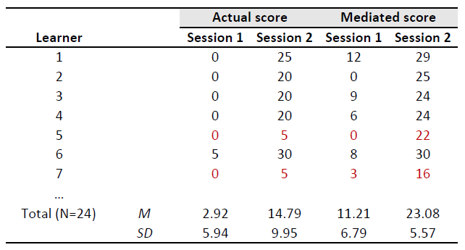
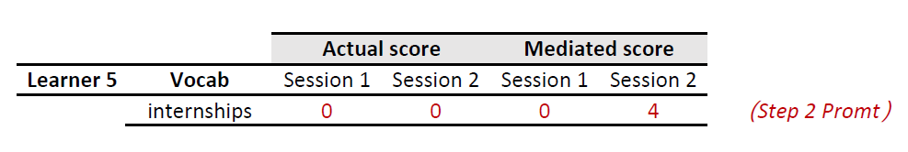
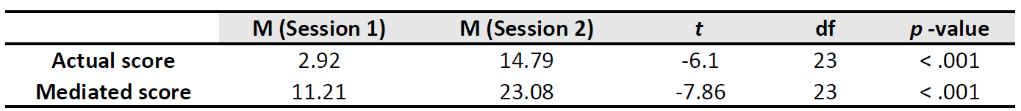
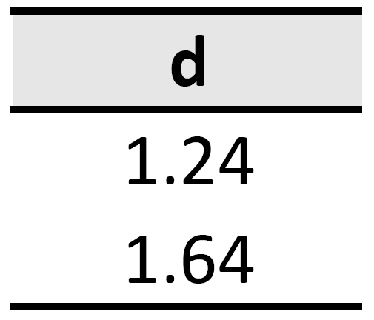
Scoring results of interaction logs
RQ2: How can CA-DA be applied to diagnose vocabulary learning?
A highly significant increase from S1 to S2 (p<.001 for each)
Large effect size: d _{Mediated score} > d _{Actual score}
Mediate score→ vocabulary learning ability
When the p - value is extremely small, specifically less than 0.001, we use the notation “< .001” for brevity.

Slide 27
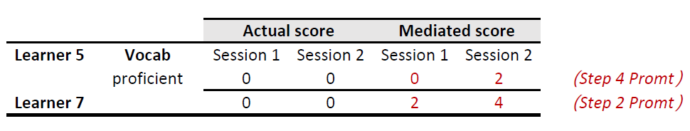
Discussion
RQ2: How can CA-DA be applied to diagnose vocabulary learning?
Further analysis of interaction logs
Variability in Learning Abilities
Diverse learning needs
Learner 5/Session 2
Chatbot: What do you think the word “proficient” means based on your current knowledge? (Step 1 Prompt)
Learner: 熟悉的 (familiar)
…
Chatbot:现在，请注意包含目标词的句子与周围句子的关系："Being **proficient** in different skills is crucial in various industries. Proficiency in areas like communication, conflict solving, and time management can significantly enhance a candidate’s chances of excelling in their fields."请注意，这里的关系是因果关系，因为掌握这些技能可以显著提高候选人在其领域中脱颖而出的机会。你能更清楚地猜出 "proficient" 的意思吗? (Step 4 Prompt)
Learner: 熟练的 (skilled)
Chatbot: 很好！"熟练的" 是对 "proficient" 的准确理解。
Notes:
Differences between familiar and proficient;

Slide 28
04
(3) Interview Results and Discussion

Slide 29
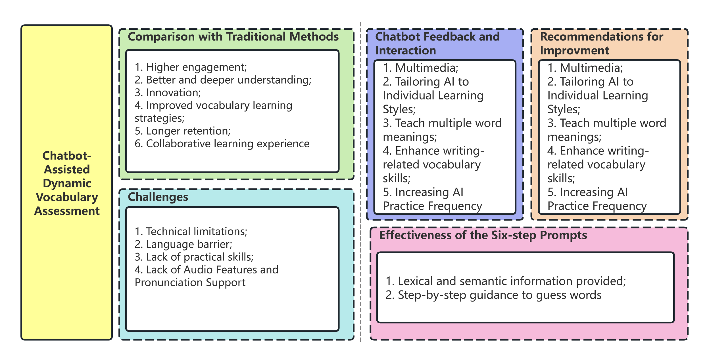
Interviews results
RQ3: What are students’ perception and attitudes toward the role of CA-DA in vocabulary development?
Thematic analysis (Braun &Clarke, 2006) /Nvivo 14
Conceptual framework of CA-DA dynamics

Slide 30
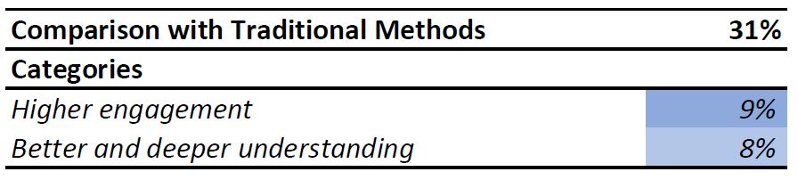
Discussion
RQ3: What are students’ perception and attitudes toward the role of CA-DA in vocabulary development?
Learner development: increased self-regulation (Lantolf & Thorne, 2012; Rassaei, 2020)
e.g. Switch between Chinese and English; being placed in a simulated exam setting
“This learning experience has boosted my confidence and given me more enthusiasm for learning vocabulary. If I have the opportunity in the future, I would definitely continue using AI for vocabulary learning. I believe that this highly interactive and timely feedback approach will greatly improve my learning efficiency and make memorizing vocabulary more effective and enjoyable.” (Learner 1)
“Communication in Chinese is indeed much faster, which makes me more engaged.” (Learner 3)

Slide 31
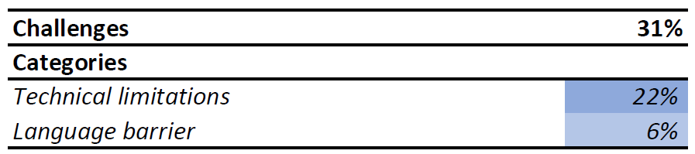
Discussion
RQ3: What are students’ perception and attitudes toward the role of CA-DA in vocabulary development?
Incomplete sentences from students can cause communication breakdowns (Yin & Satar, 2020).
Nonsensical chatbot responses can also lead to failed communication (Fryer, Nakao, & Thompson, 2019).
More appropriate for advanced language learners (Fryer & Carpenter, 2006) /Use of L1
“However, sometimes the AI’s replies seemed to merely repeat my answers or provides me with mechanical responses without providing more detailed guidance. For example:
XIPU AI: What do you think ‘align’ means in this context?
Student 1: That means to fit our skills into real experiences.
XIPU AI: Good try! Let’s delve a bit deeper. (then continue the next prompt)
In this case, I hoped the AI could give more detailed feedback on which parts of my answer were correct and which parts needed improvement before moving on to the next prompt.” (Learner 1)
“Additionally, if I still couldn’t infer the word meaning after all the prompts, the AI provided long and detailed English explanations and examples. However, for unfamiliar words, too many English explanations could be difficult for me to understand. I would prefer if the AI directly provided the Chinese meaning instead.” (Learner 1)

Slide 32
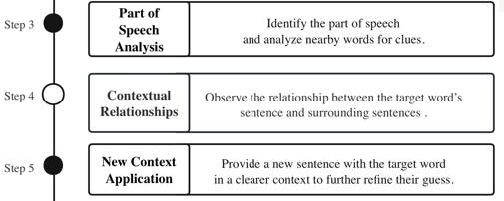
Discussion
RQ2: What are students’ perception and attitudes toward the role of CA-DA in vocabulary development?
Lexical and semantic information (e.g., contextual clues, part of speech, collocations, synonyms and an alternative/easier sentence, the relationship between clauses or sentences) of target words provided by XIPU AI → better assist vocab learning. (Barcroft, 2015; Ebadi et al., 2018; García-Castro, 2020; Nation, 2022)
The beneficial impact of managing cognitive overload on vocabulary acquisition (Teng, 2020)
“It provided three opportunities to guess word meanings through sentences and contexts. I found the first (→second) opportunity to be the most effective. In this step, the AI placed the target word within the original sentence from the text and asked me to guess its meaning. This approach was very straightforward and clearly guided me to determine the specific meaning of a polysemous word within that sentence” (Learner 1)
“In the process of guessing step by step or understanding the part of speech and meaning of the word”
“through the third and fourth steps, I can better understand by applying its part of speech and some relative contextual clues in the sentences.” (Learner 3)
Notes:
Students value the lexical and semantic information of target words provided by XIPU AI → better assist target vocab learning
Barcroft, J. (2015). Lexical input processing and vocabulary learning. John Benjamins Publishing Company
García-Castro, V. (2020) ‘The effects of vocabulary knowledge in L2 semantic lexical engagement: The case of adult learners of English as a second language’, Indonesian Journal of Applied Linguistics, 10(1), pp. 261–270. doi:10.17509/ijal.v10i1.25068.

Slide 33
Discussion
RQ2: What are students’ perception and attitudes toward the role of CA-DA in vocabulary development?
The instant, interactive, graduated and contingent nature of the feedback:
Encourage conversation: provide students with motivation and engagement during the learning process. (Ebadi et al., 2018; Jeon, 2023; Rassaei, 2020)
“The AI could not only tailor its questions based on my responses but also provide emotional feedback, which made me more engaged” (Learner 1)
“I keep guessing and even if I guess wrong, it’s actually quite distressing for me. However, XIPU AI can continuously encourage me to keep guessing and provide me with good emotional value, which gives me more confidence in learning new words with passion.” (Learner 3)
Notes:
The instant, inter active, and contingent nature of the feedback provided by XIPU AI
Promote independent learning: transit from other-regulated stage to self-regulated stage (VS mechanical learning – Control Group)

Slide 34
Discussion
RQ2: What are students’ perception and attitudes toward the role of CA-DA in vocabulary development?
Chatbot-assisted vocabulary learning: a gamified learning context:
stimulate learners’ motivation
encourage self-regulated learning
improve vocab knowledge
(Zhang, Zou and Cheng, 2014)
AI future development:
Customised learning content (smarter tech, programming)
Embedded (in-app) multimedia resources
“The second suggestion is that I hope the AI can understand my learning habits and proficiency level so that it can provide more targeted learning suggestions and feedback. For instance, by analyzing my responses and progress, the AI could adjust the difficulty of its questions or provide resources tailored to my needs, making the learning process more efficient and personalized.” (Learner 1)
“Animations. I hope to add those animation elements, like scenes from American or British dramas.” (Learner 2)
Notes:
As we mentioned early (comparison with traditional learning) Compared with conventional vocabulary learning context:
Chatbot-assisted learning functions as a gamified learning context: stimulate learners’ motivation + encourage self-regulated learning + improve vocab knowledge
Zhang, R., Zou, D., & Cheng, G. (2024). Self-regulated digital game-based vocabulary learning: motivation, application of self-regulated learning strategies, EFL vocabulary knowledge development, and their interplay. Computer Assisted Language Learning, 1–43. https://doi.org/10.1080/09588221.2024.2344555

Slide 35
05
Implications and Take-away

Slide 36
Future Actions
Productive vocabulary learning | Teachers‘ perceptions
Explore how CA-DA can improve learners’ productive vocabulary in the context of TNHE | Explore teachers' perceptions of the chatbots implementation in language learning

Slide 37
Implications
ICALL (intelligent computer-assisted language learning) for prompts implementation
Automatically generated prompts & graduated chatbot interaction
Applicable to large groups
Tailored vocab teaching approaches based on students’ language levels/needs
For lower-level students
Integrated with in-class teaching (part of speech, immediate context, wider context, word parts)
For higher-level students
Pre-training of terminology
Tailored feedback and instruction focused on students’ needs (Interaction logs analysis)
Quantity principles
Repetition
The more repetition, the stronger the learning.
Longitudinal study
Avoid the novelty effect (Huang, et al., 2022)

Slide 38
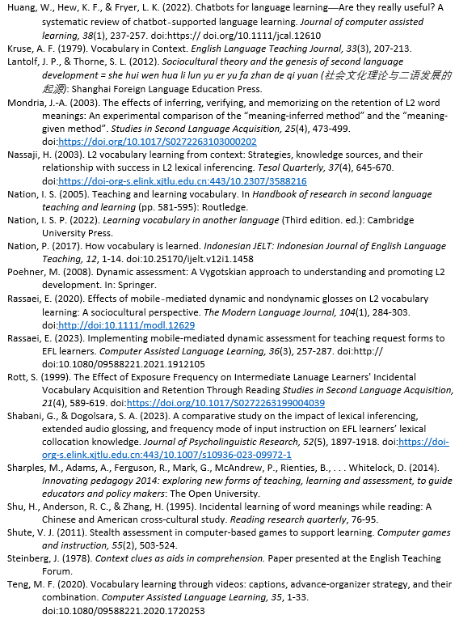
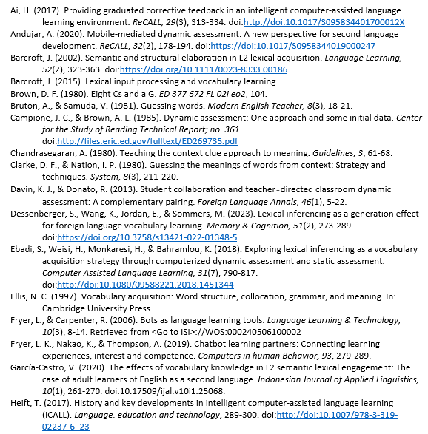
References:

Slide 39
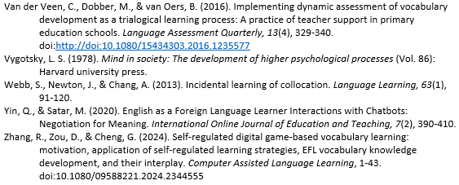
References:

